Slide 1
PRACTISES in Responsible AI
Powered by GPT4 Technology

Slide 2
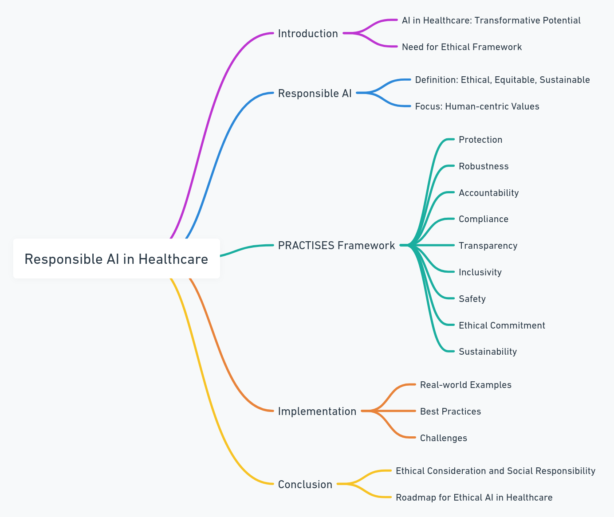
Introduction of PRACTISES in responsible AI

Slide 3
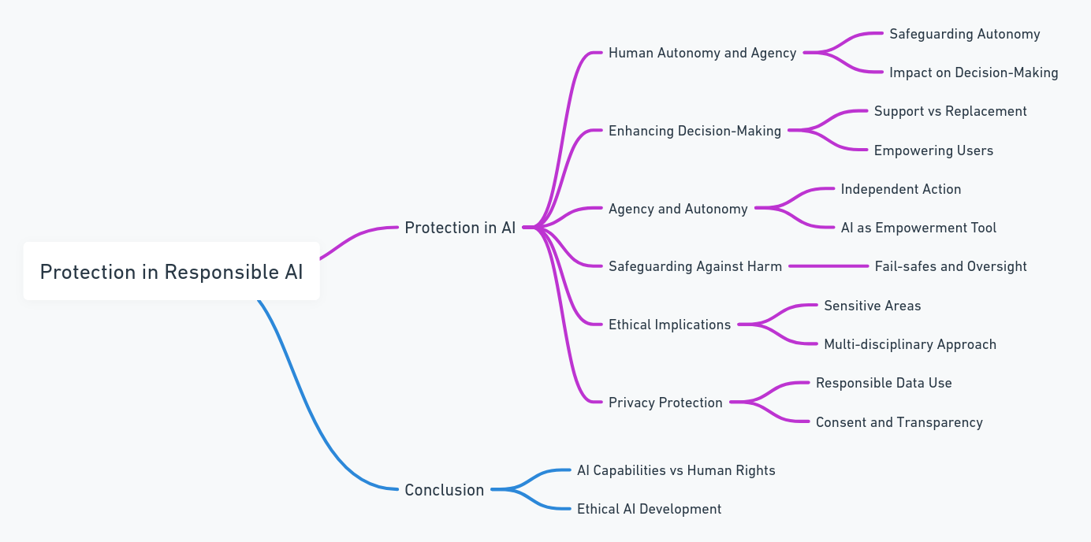
Protection - Human Autonomy and Agency in AI

Slide 4
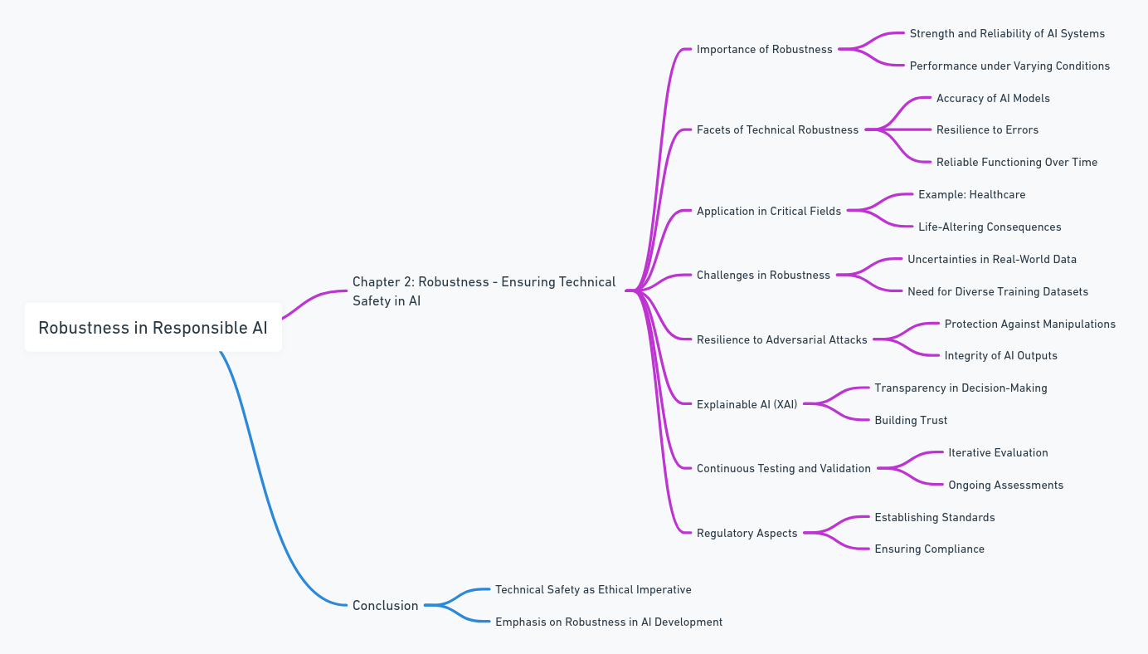
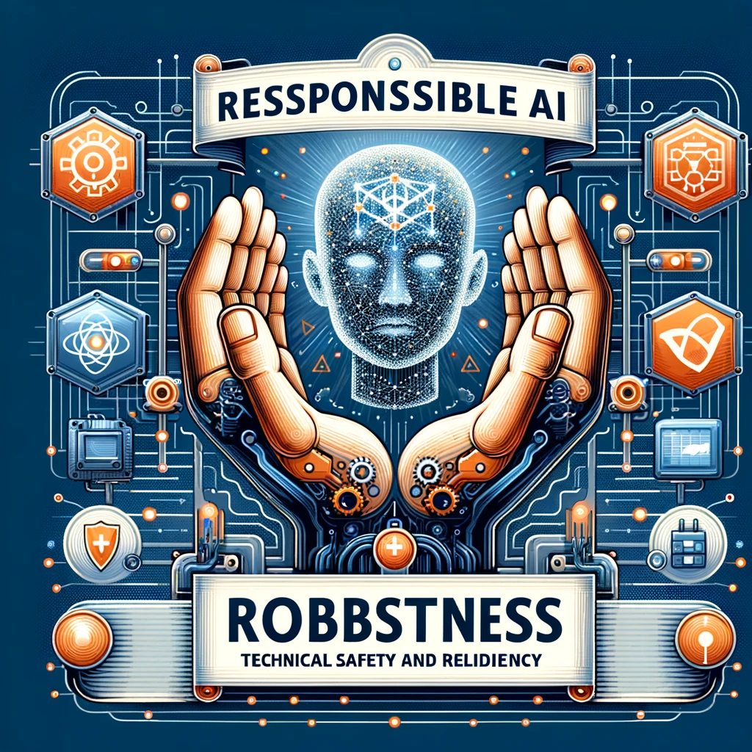
Robustness - Ensuring Technical Safety in AI

Slide 5
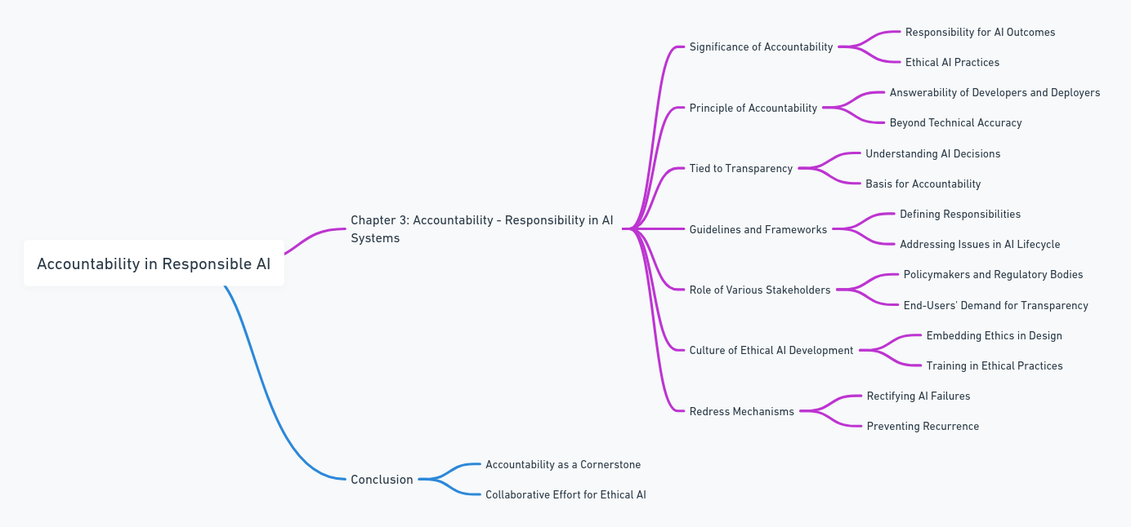
Accountability - Responsibility in AI Systems

Slide 6
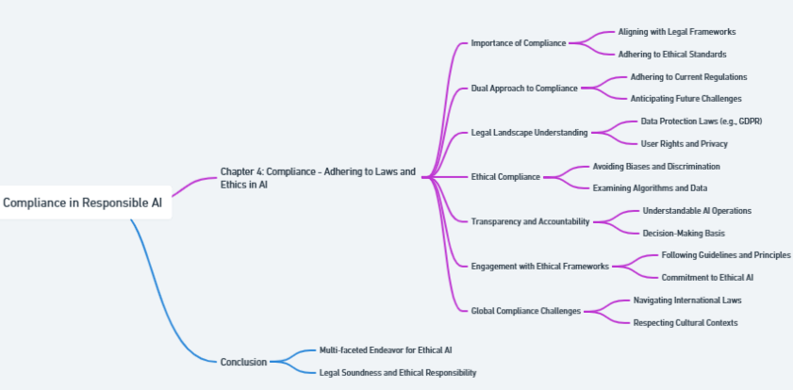
Compliance - Adhering to Laws and Ethics in AI

Slide 7
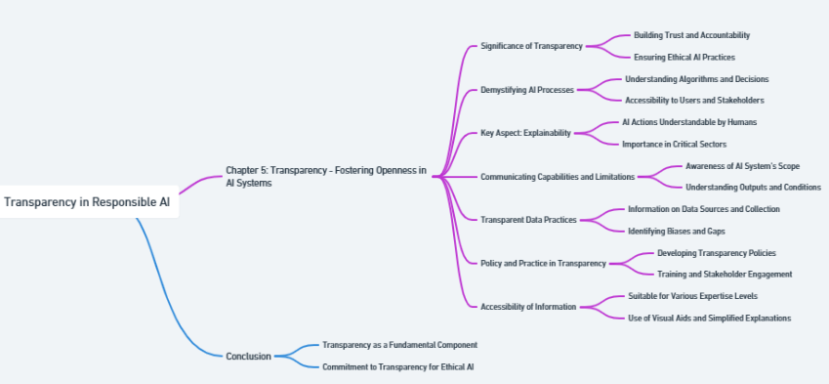
Transparency - Fostering Openness in AI Systems

Slide 8
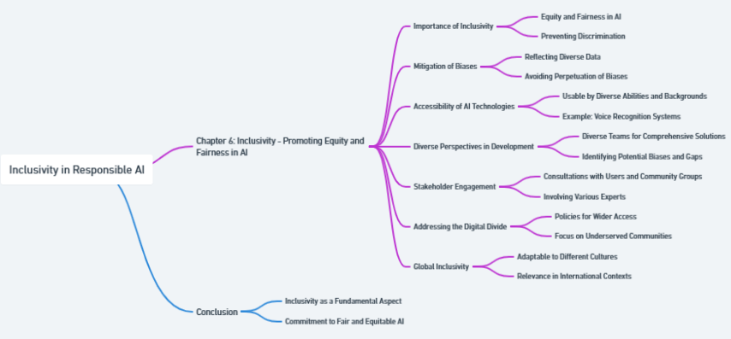
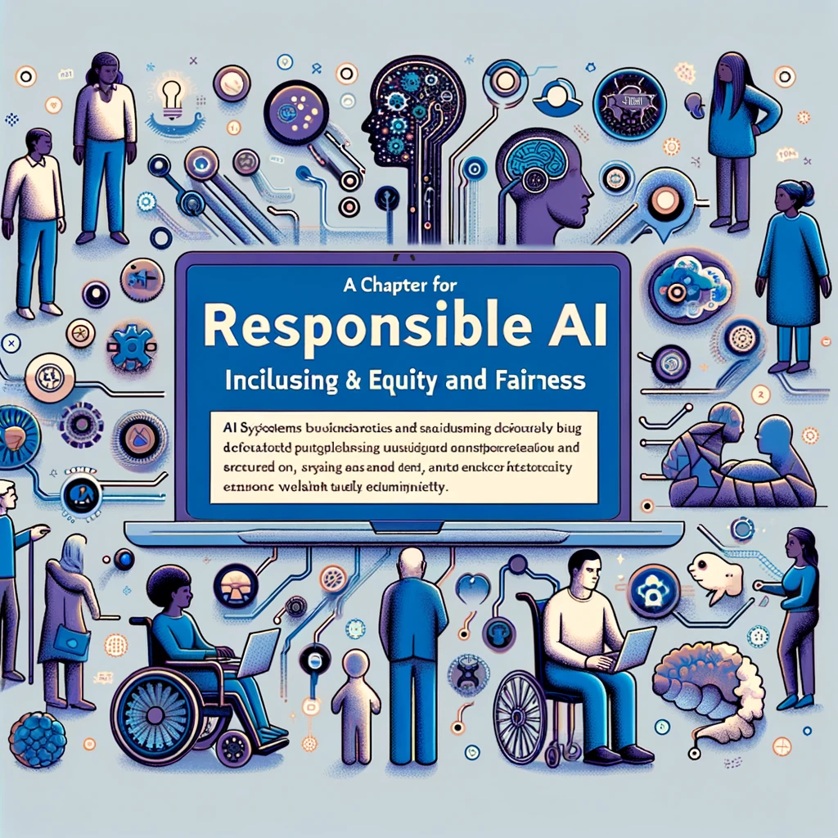
Inclusivity - Promoting Equity and Fairness in AI

Slide 9
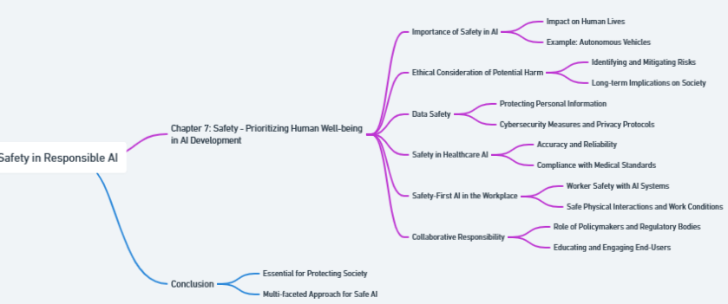
Safety - Prioritizing Human Well-being in AI Development

Slide 10
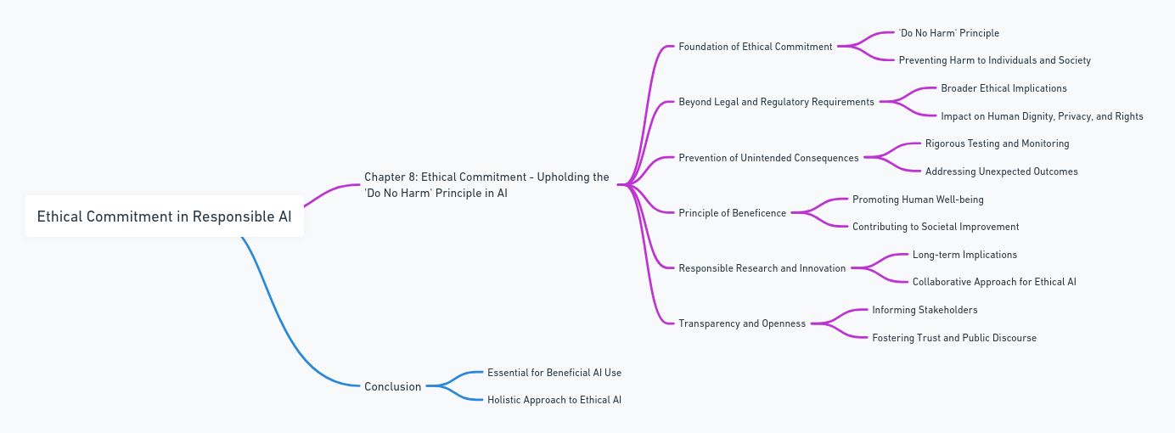
Ethical Commitment - Upholding the 'Do No Harm' Principle in AI

Slide 11
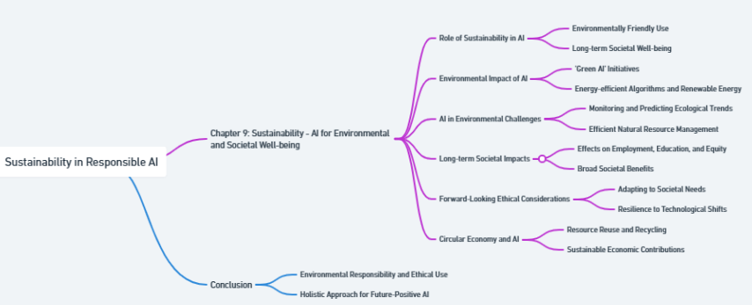
Sustainability - AI for Environmental and Societal Well-being

Slide 12
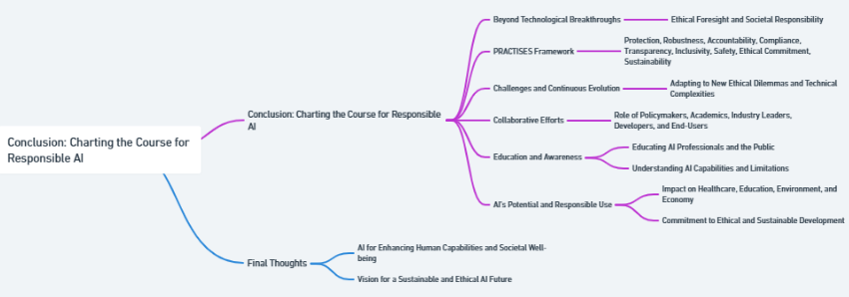
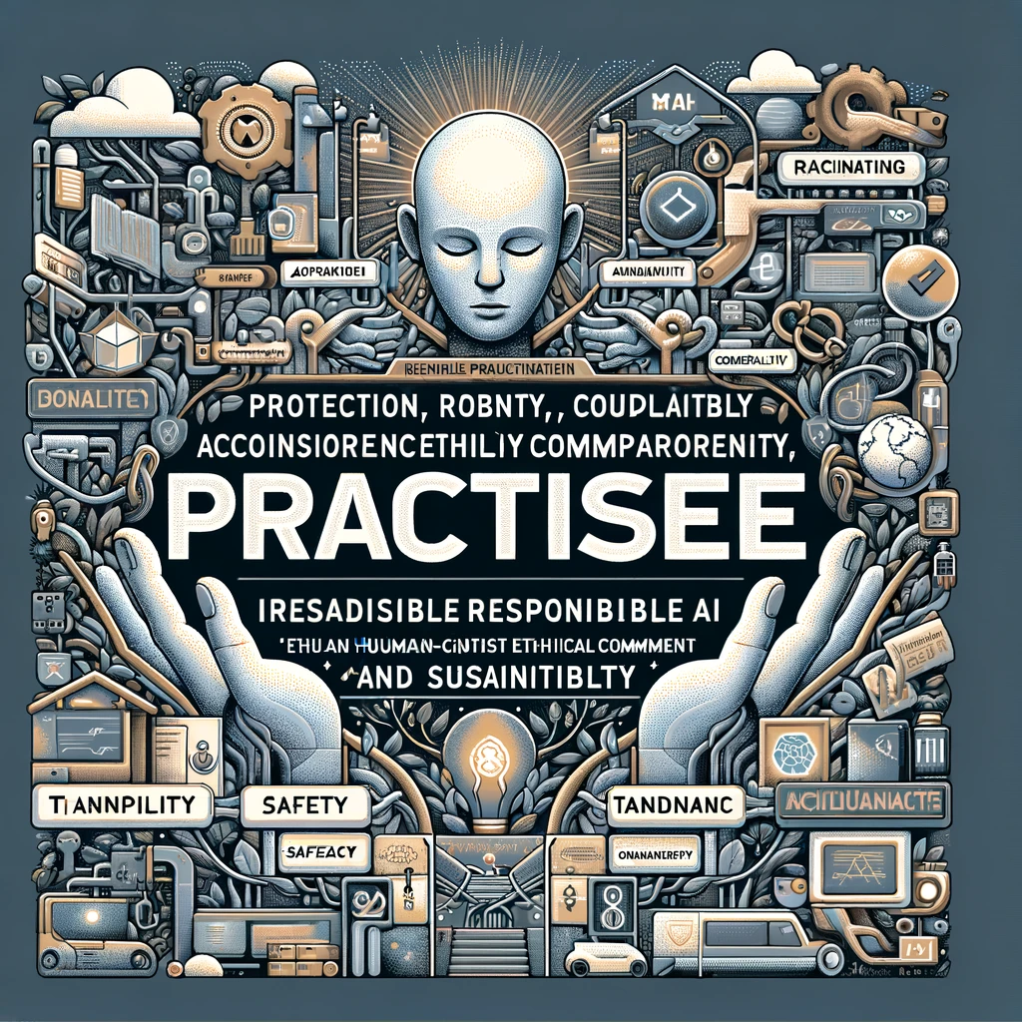
Conclusion: charting the Course for Responsible AI

