Slide 1
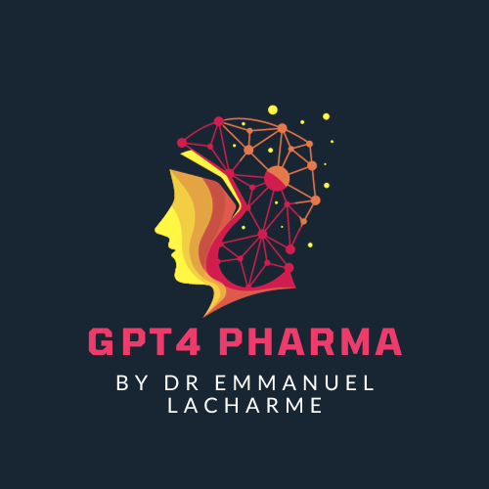
AI Revolution in Pharmaceutical Market Research: Trends, Challenges, and Future Directions
Powered by GPT4 Technology

Slide 2
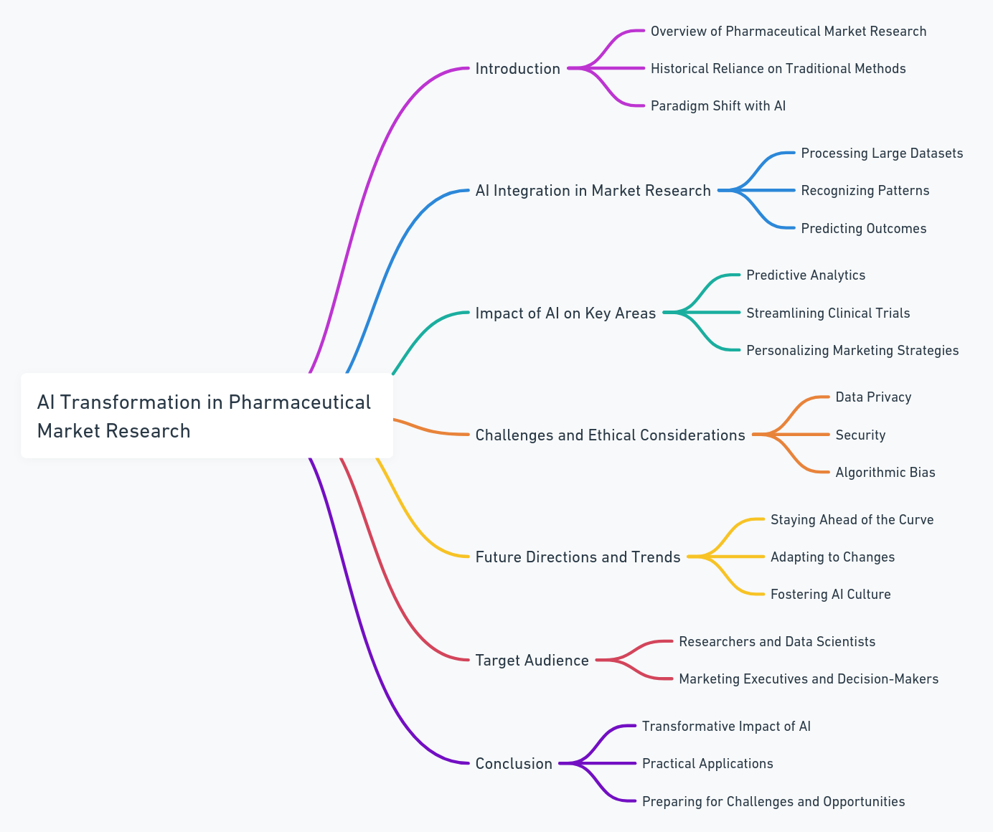
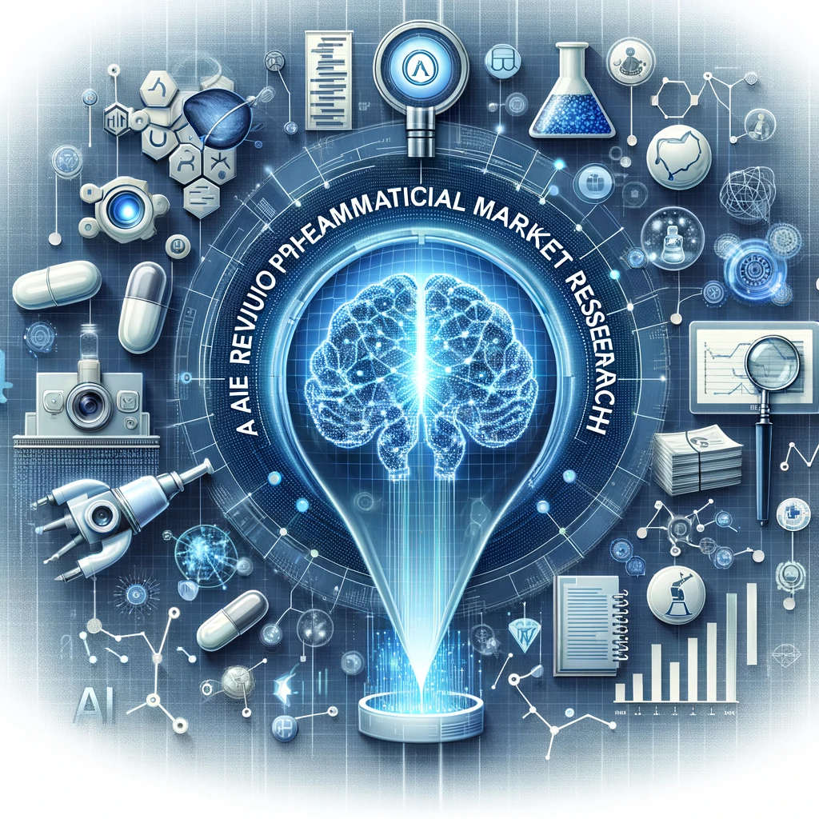
Introduction: Navigating the AI Transformation in Pharmaceutical Market Research

Slide 3
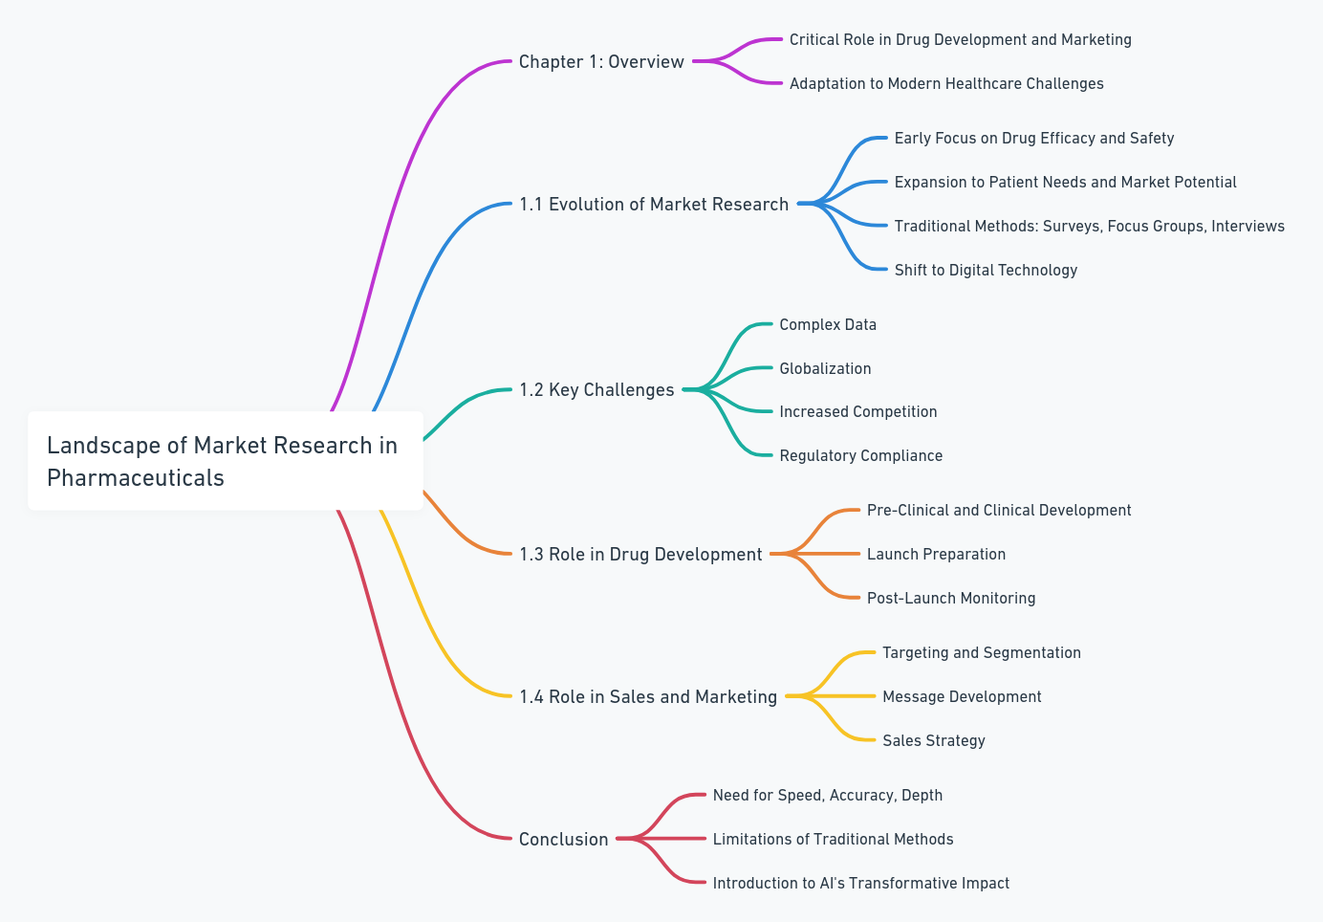
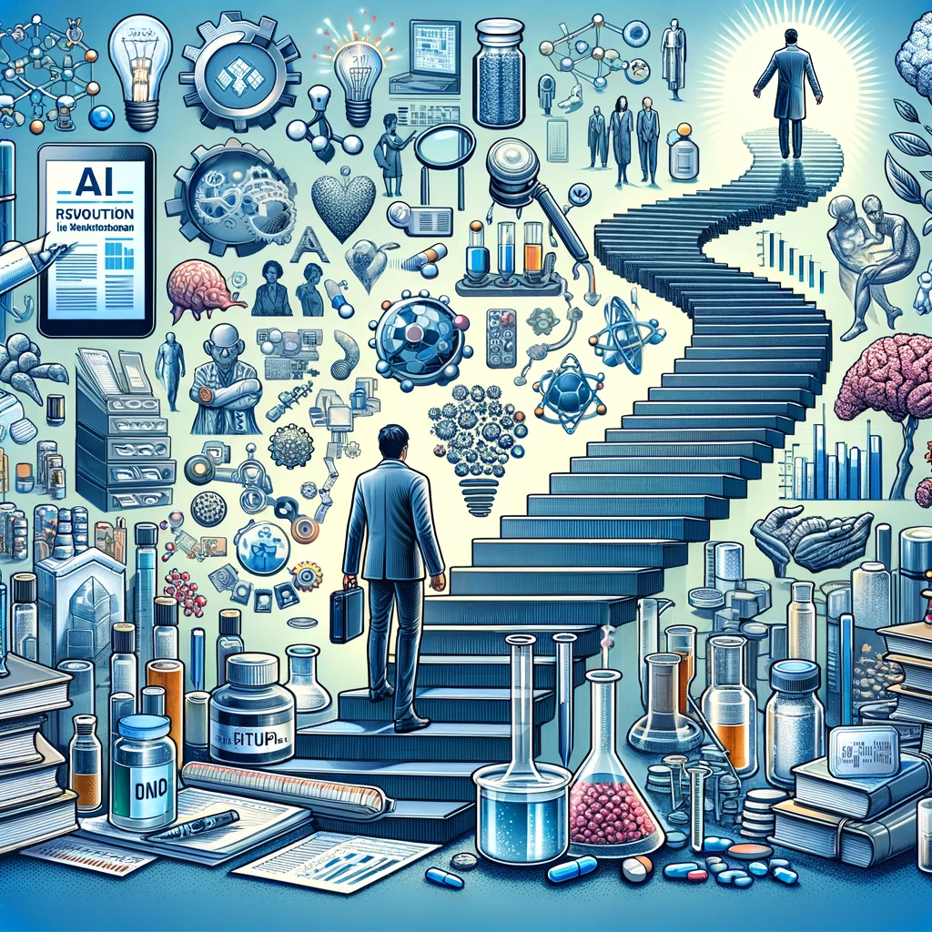
The Landscape of Market Research in Pharmaceuticals

Slide 4
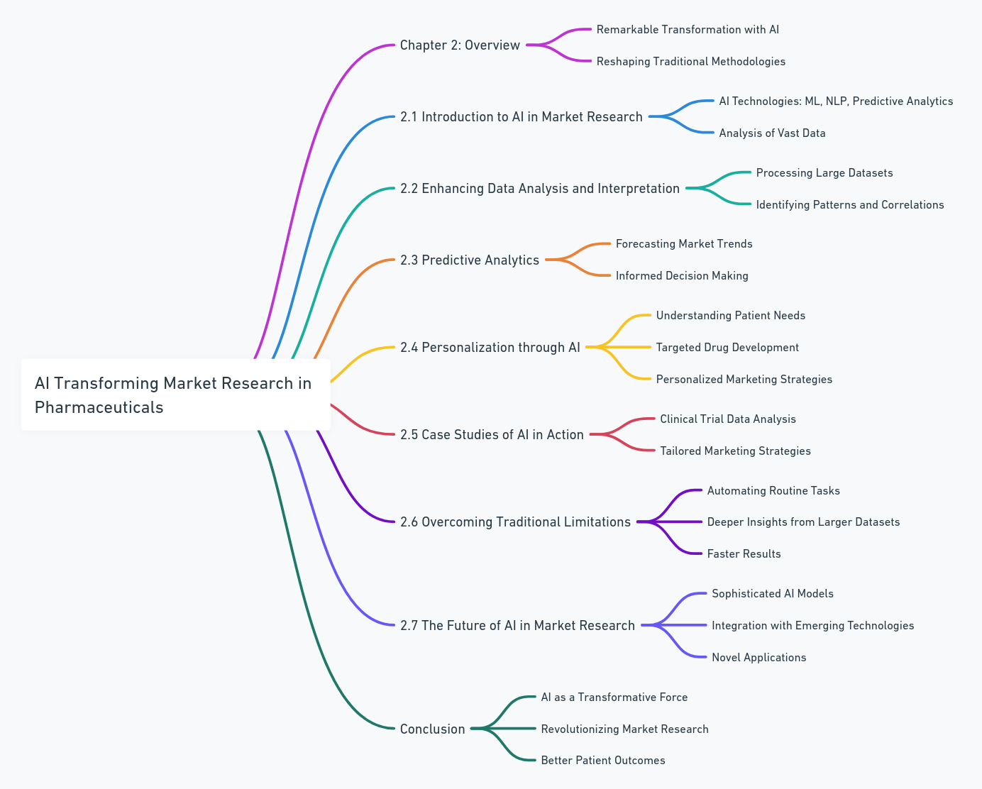
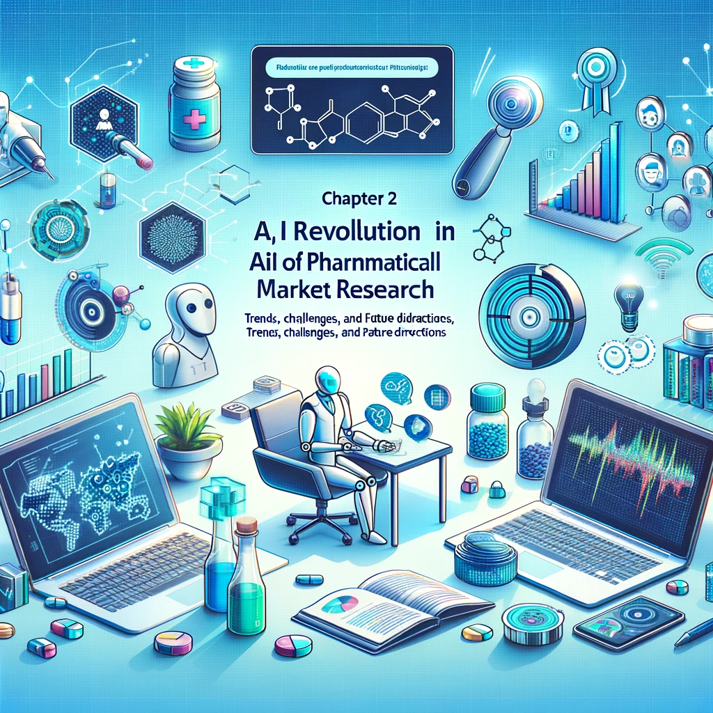
AI Transforming Market Research in Pharma

Slide 5
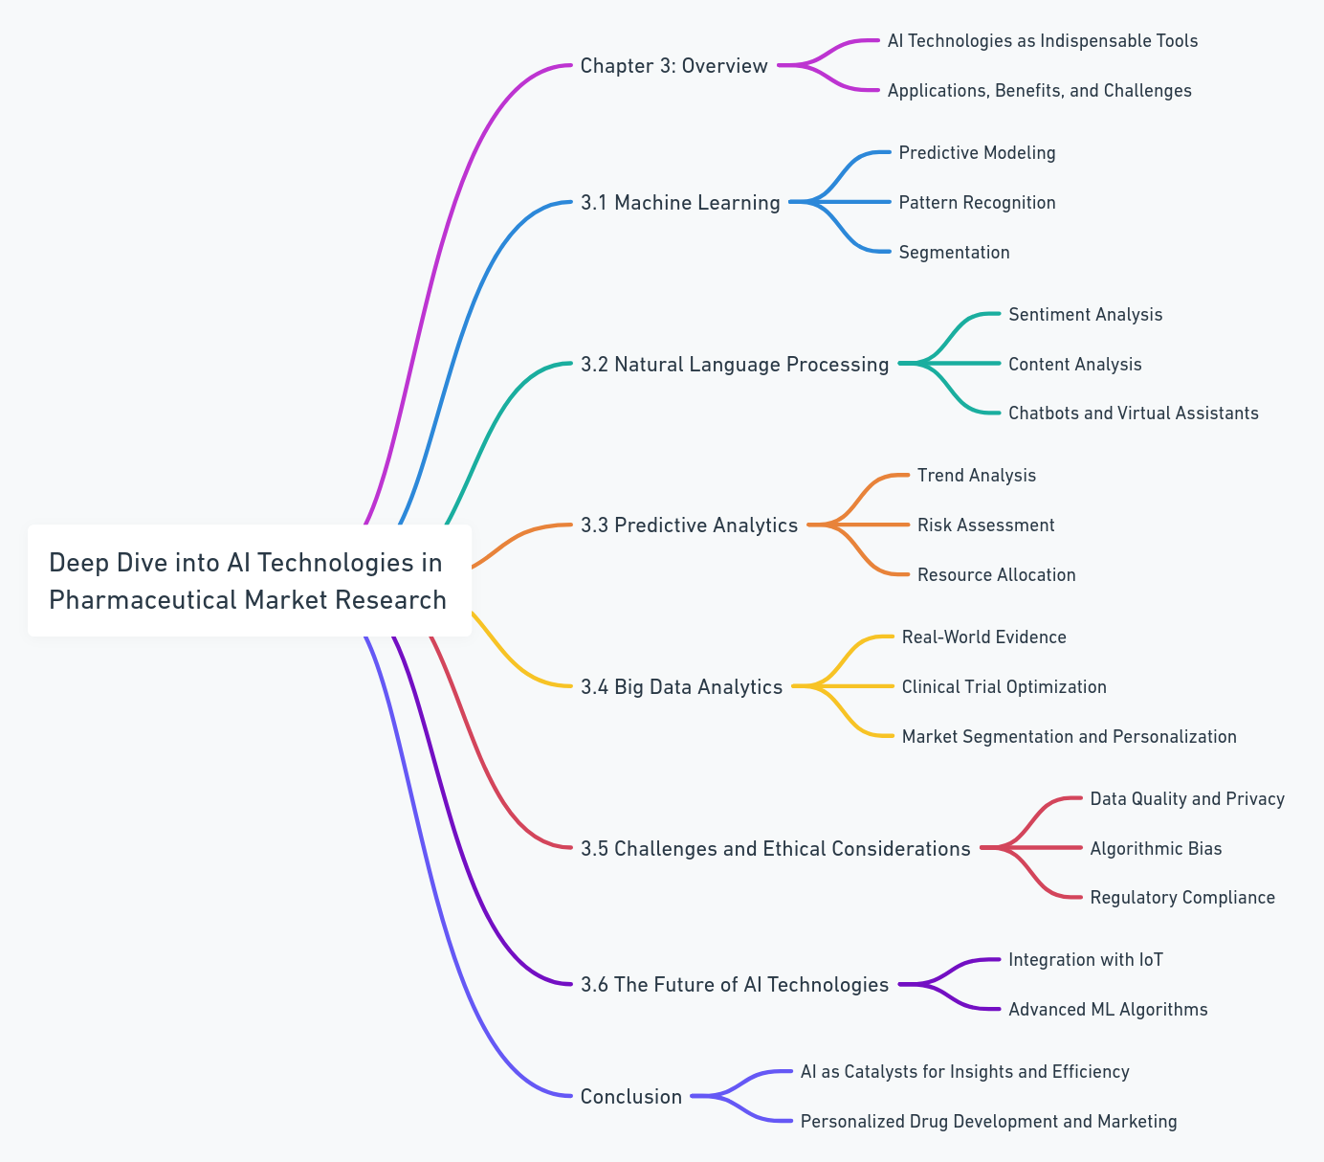
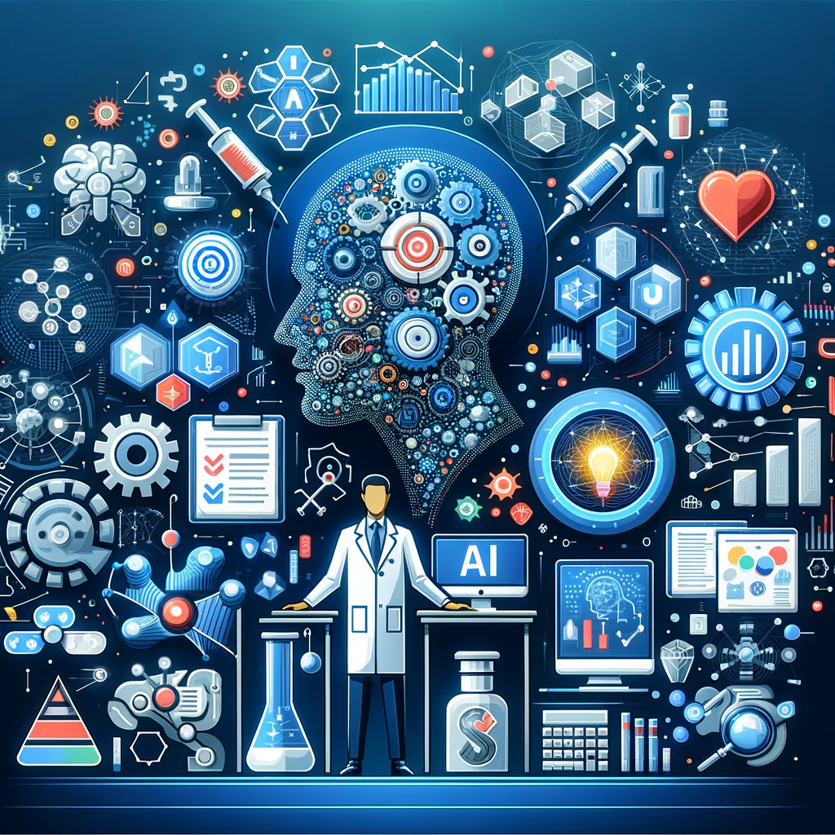
Deep Dive into AI Technologies in Pharmaceutical Market Research

Slide 6
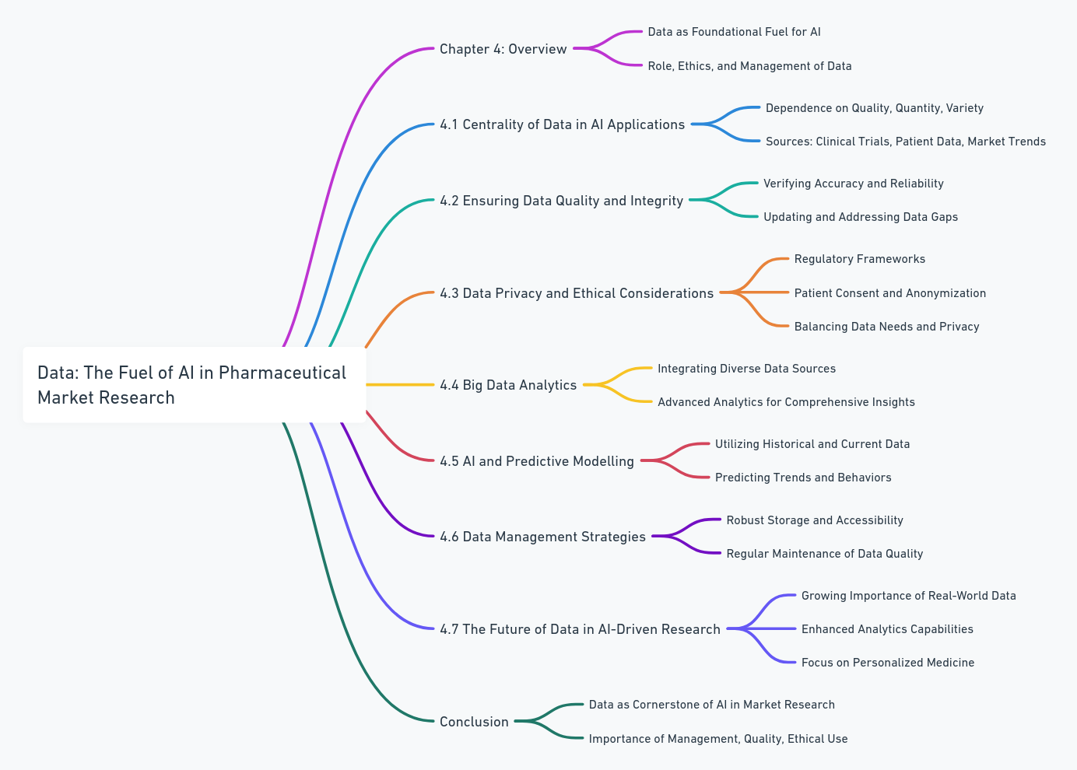
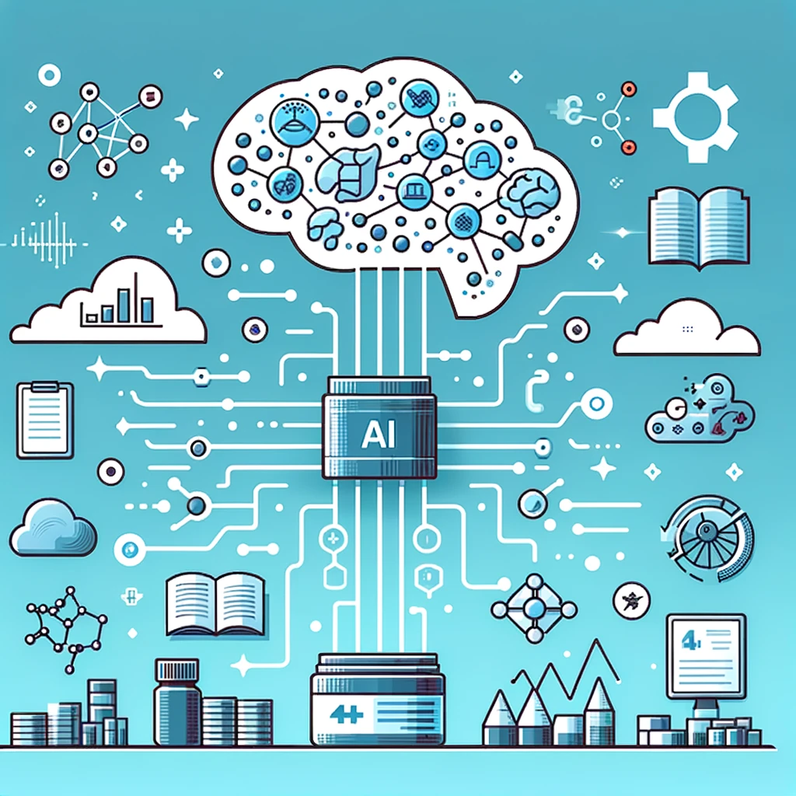
Data: The Fuel of AI in Pharmaceutical Market Research

Slide 7
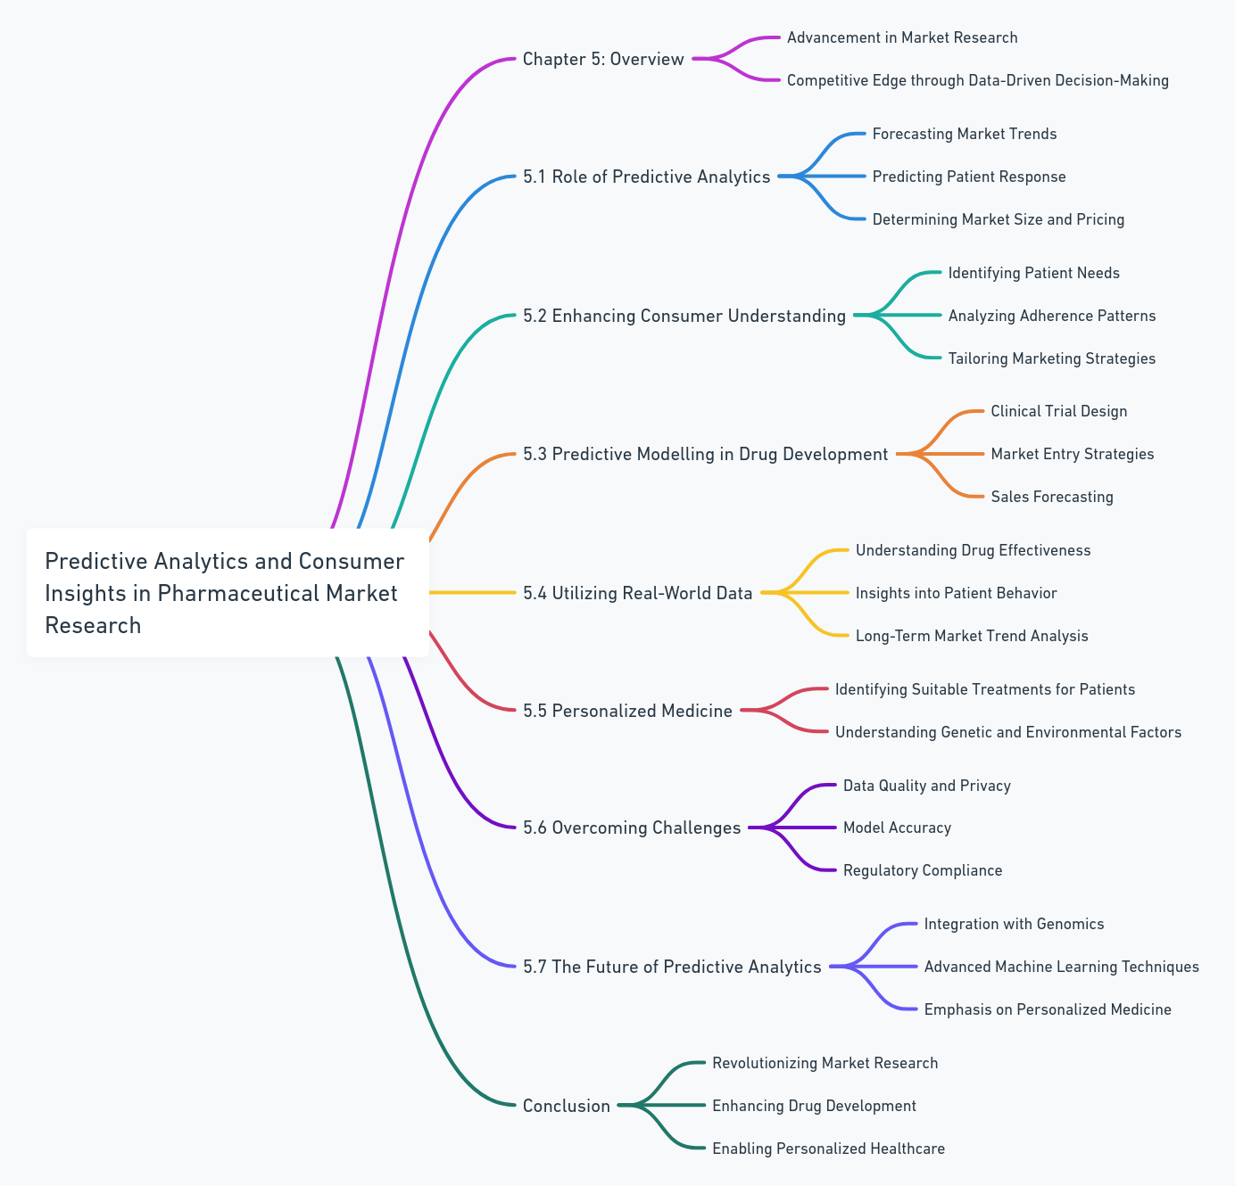
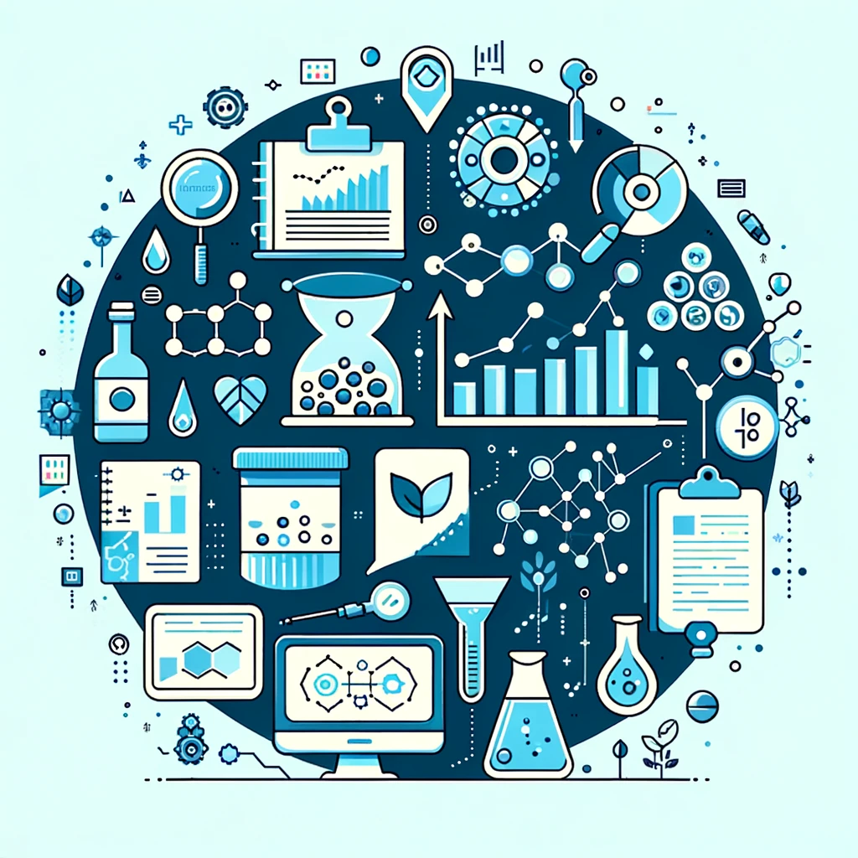
Predictive Analytics and Consumer Insights in Pharmaceutical Market Research

Slide 8
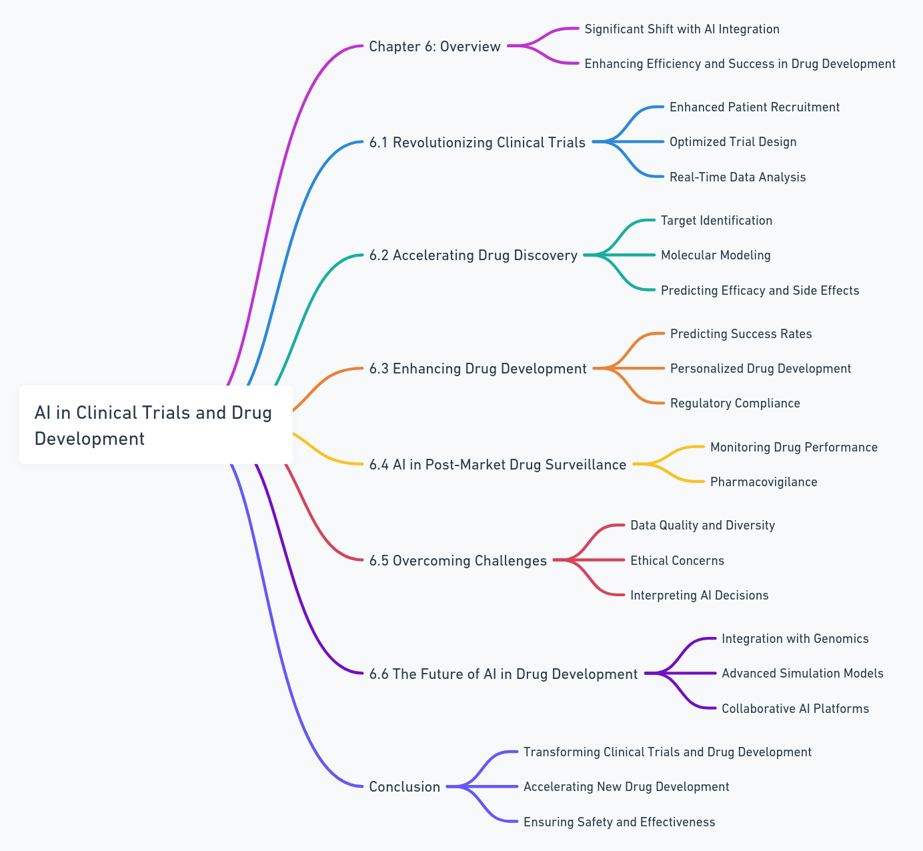
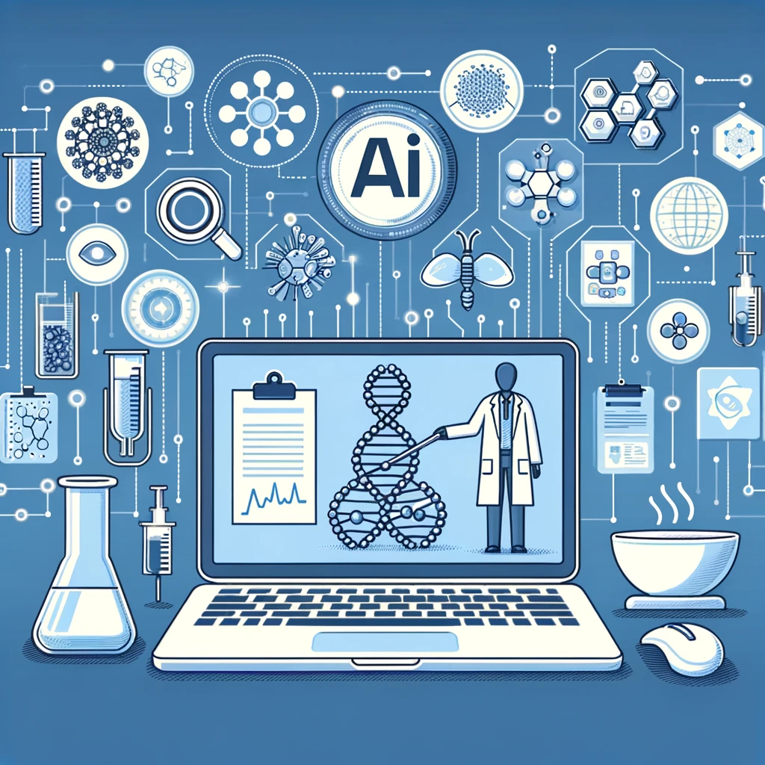
AI in Clinical Trials and Drug Development

Slide 9
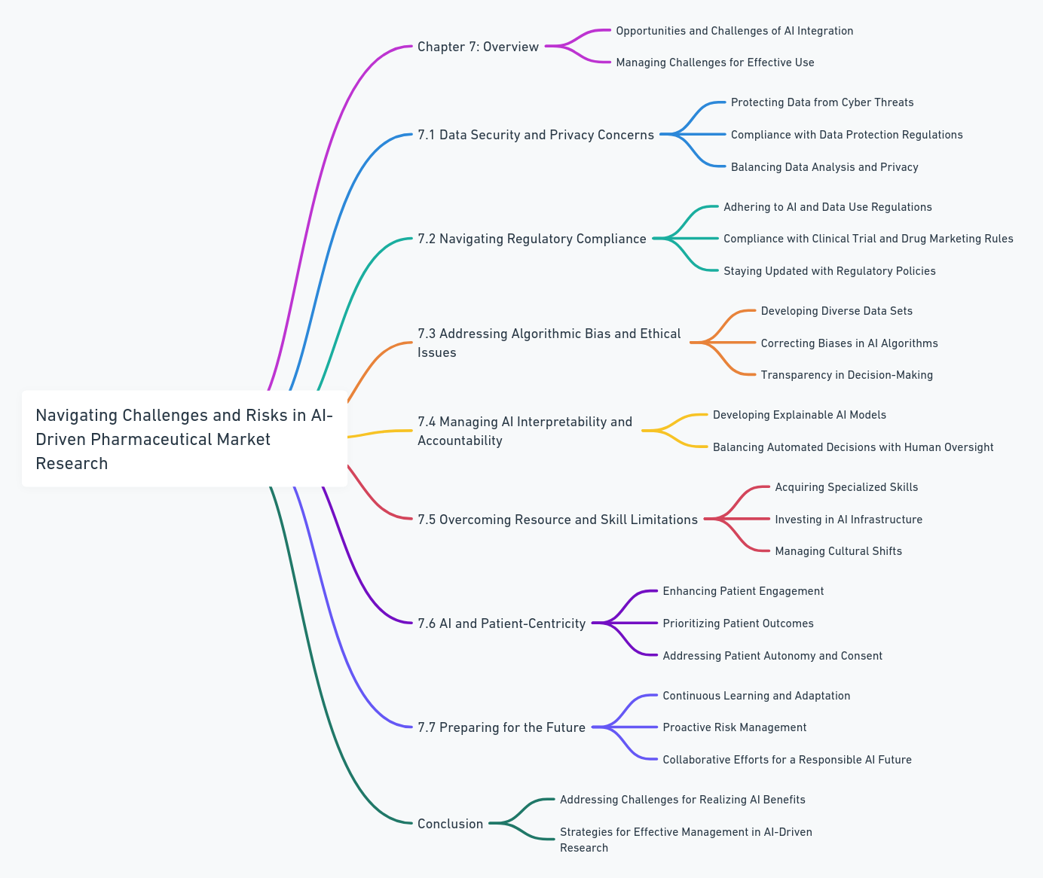
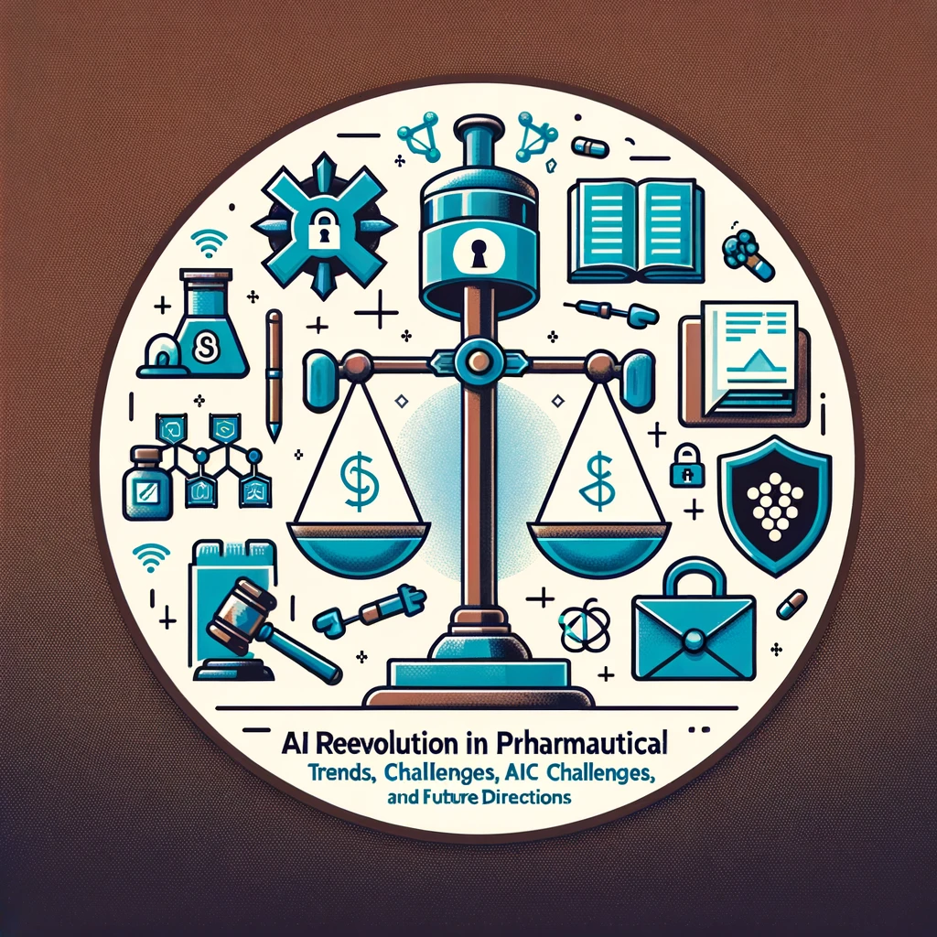
Challenges and Risks in AI-Driven Pharmaceutical Market Research

Slide 10
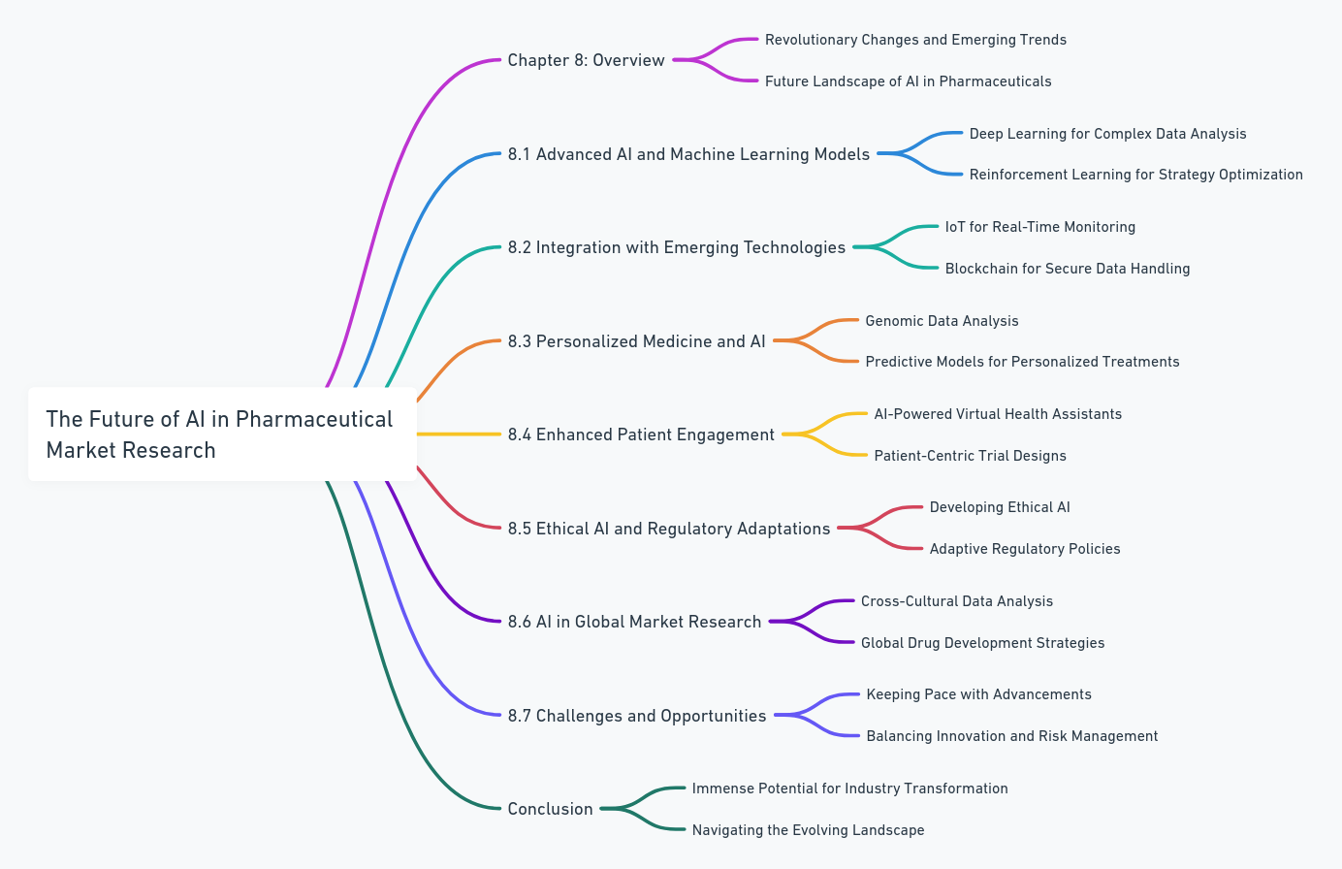
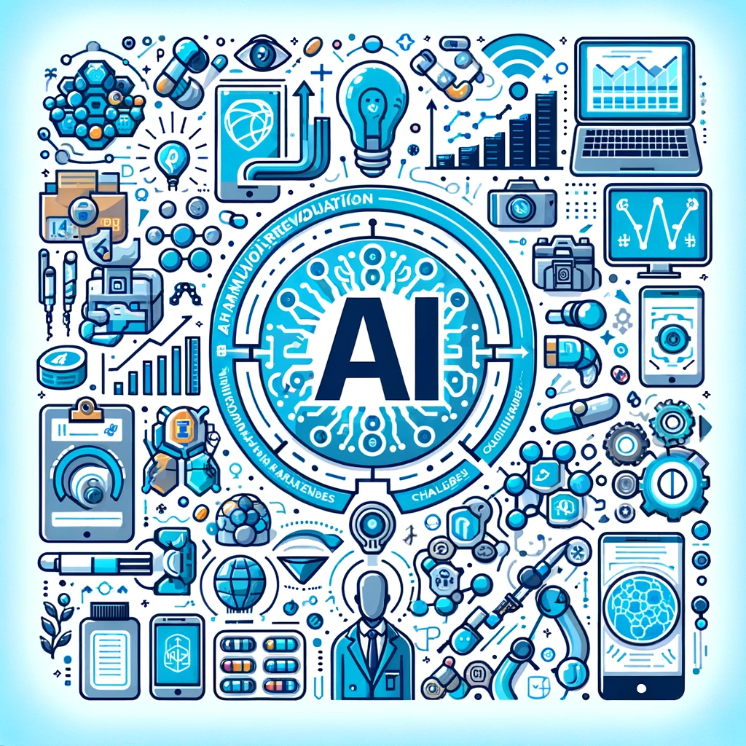
The Future of AI in Pharmaceutical Market Research

Slide 11
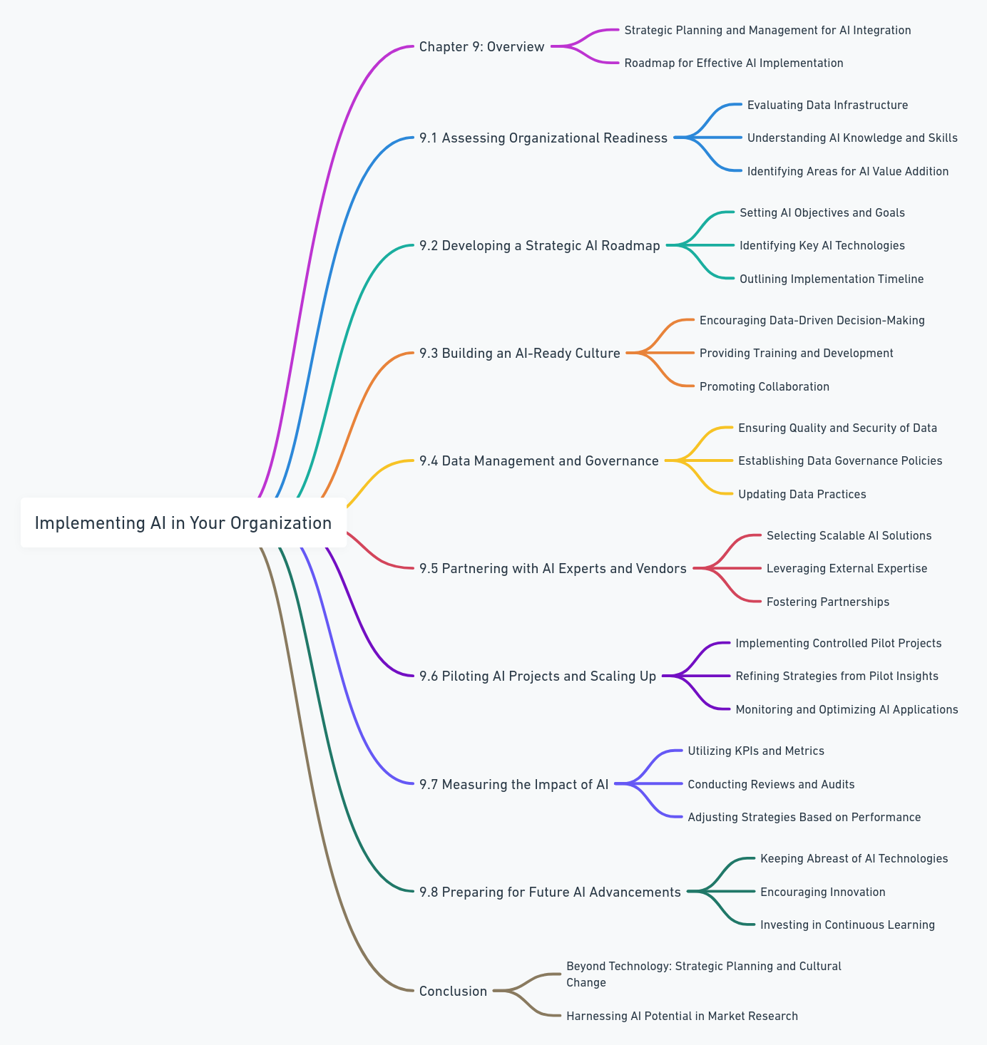
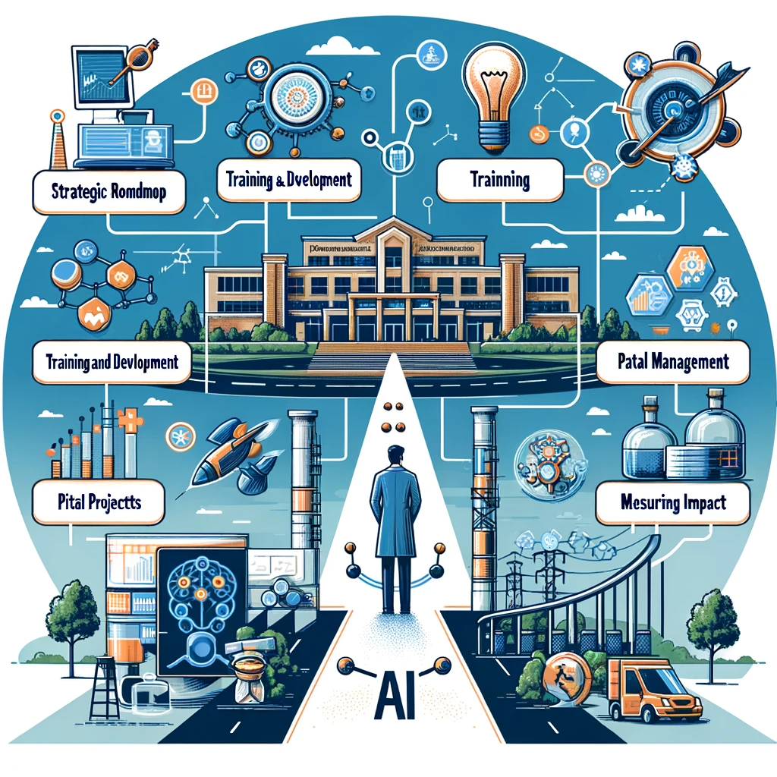
Implementing AI in Your Organization

Slide 12
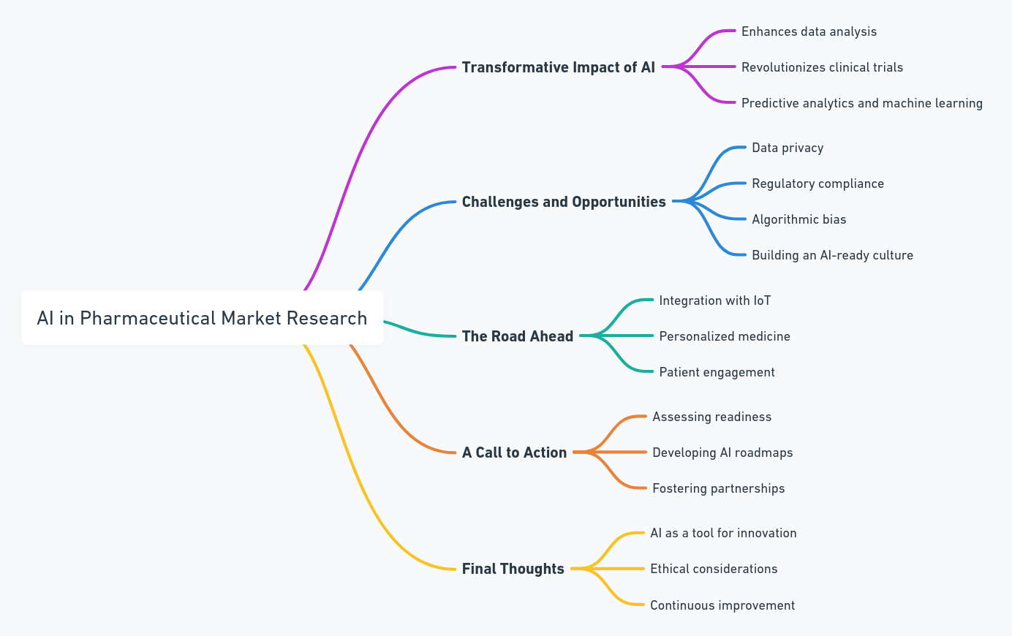
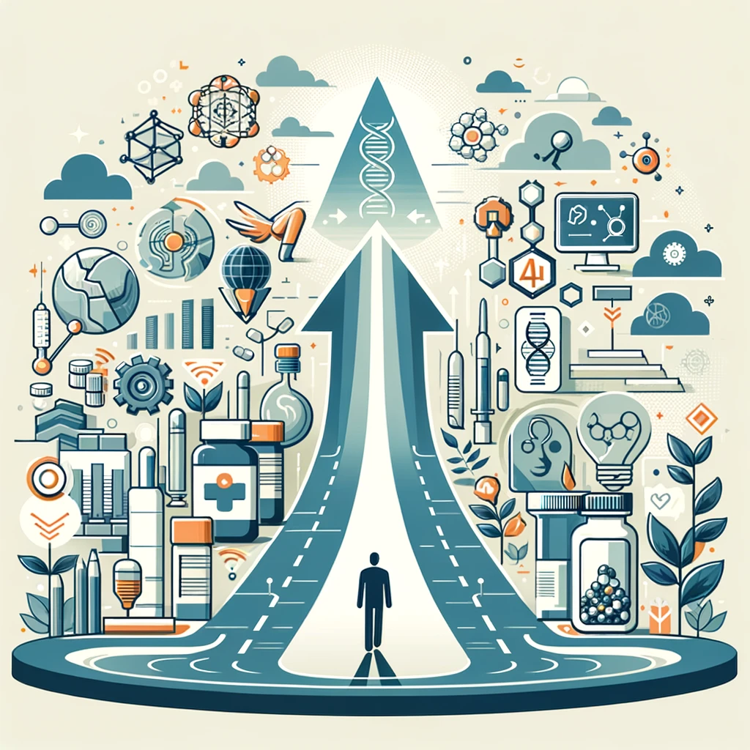
Conclusion: Embracing the AI Revolution in Pharmaceutical Market Research

