Slide 1

Integrating RWE in HTA: Strategies for Evidence Generation Planning in Pharma
Powered by GPT4 Technology

Slide 2
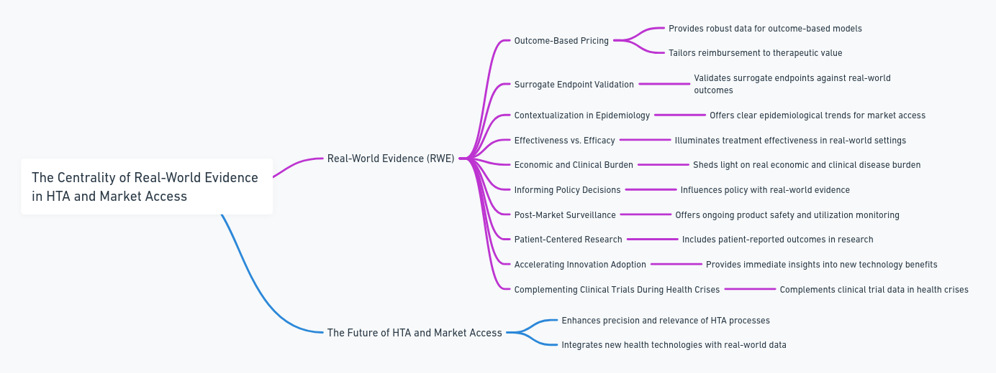

Preface: Introduction to RWE and its rising importance in HEOR and HTA

Slide 3
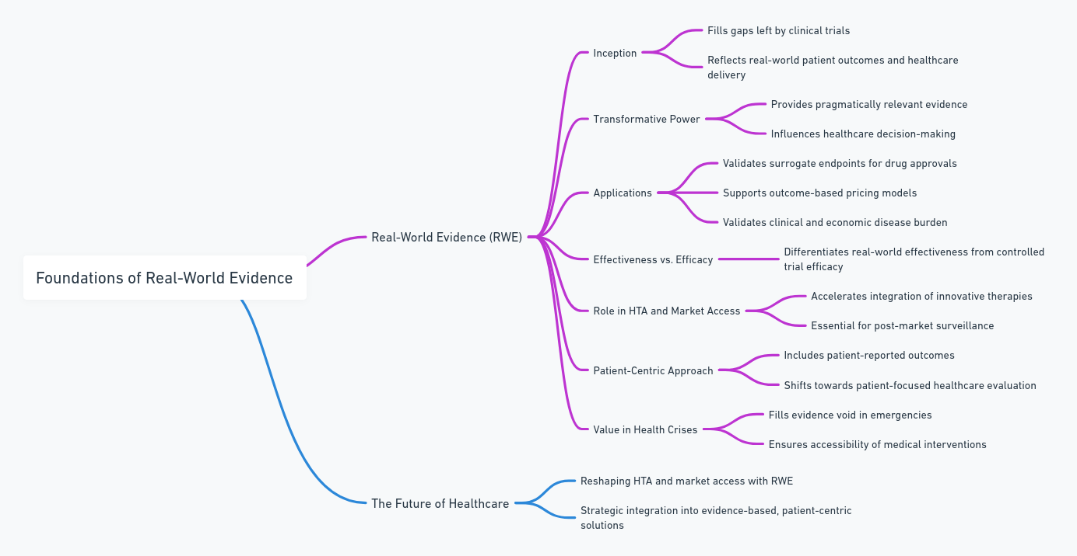

Foundations of Real-World Evidence

Slide 4
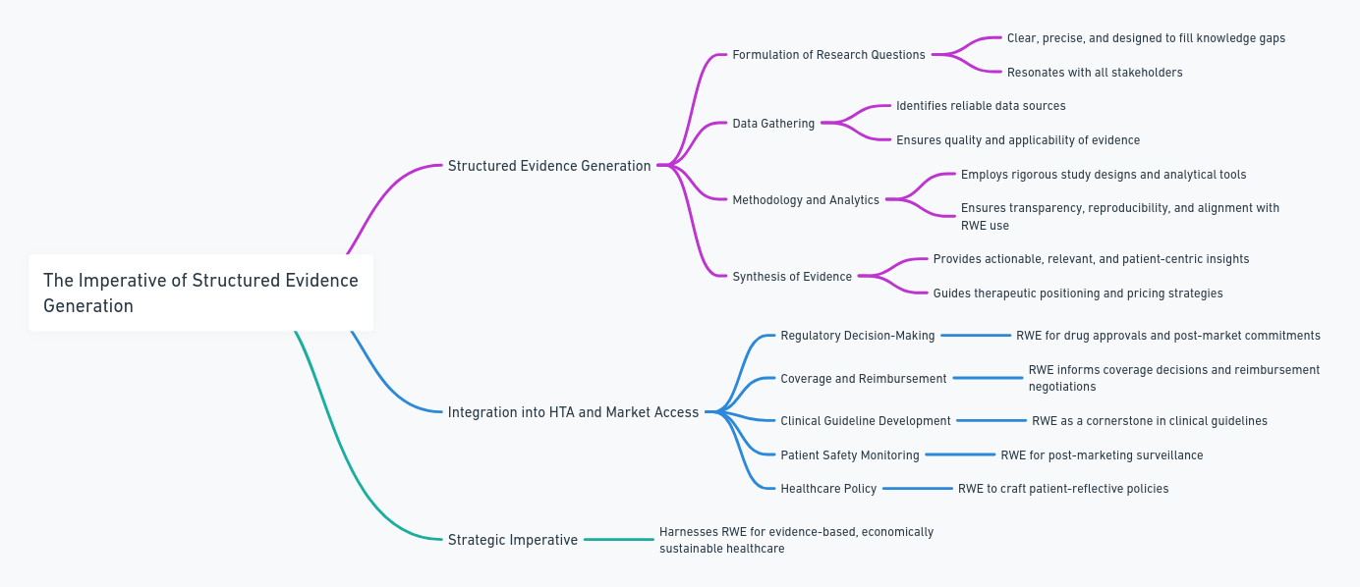

The Imperative of Structured Evidence Generation

Slide 5
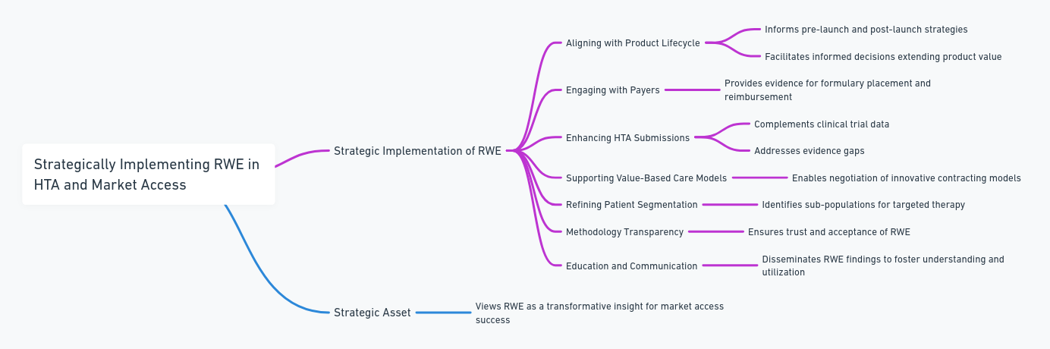

Strategically Implementing RWE in HTA and Market Access

Slide 6
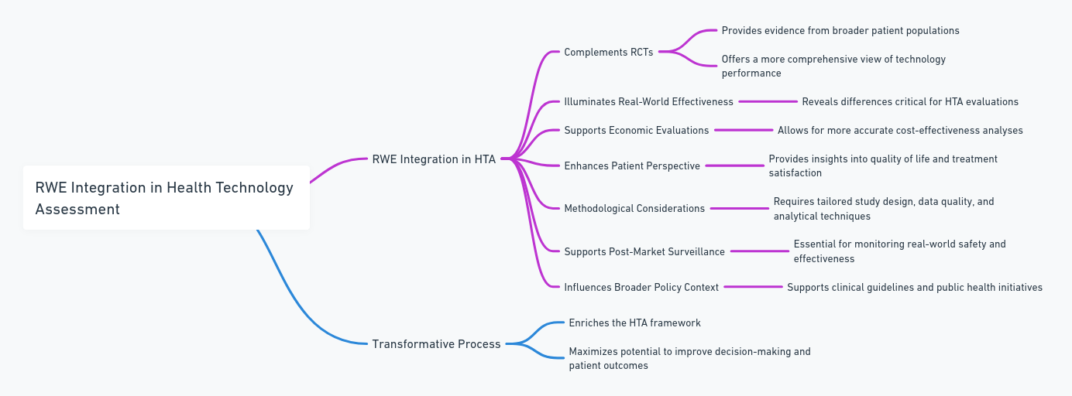

RWE Integration in Health Technology Assessment

Slide 7
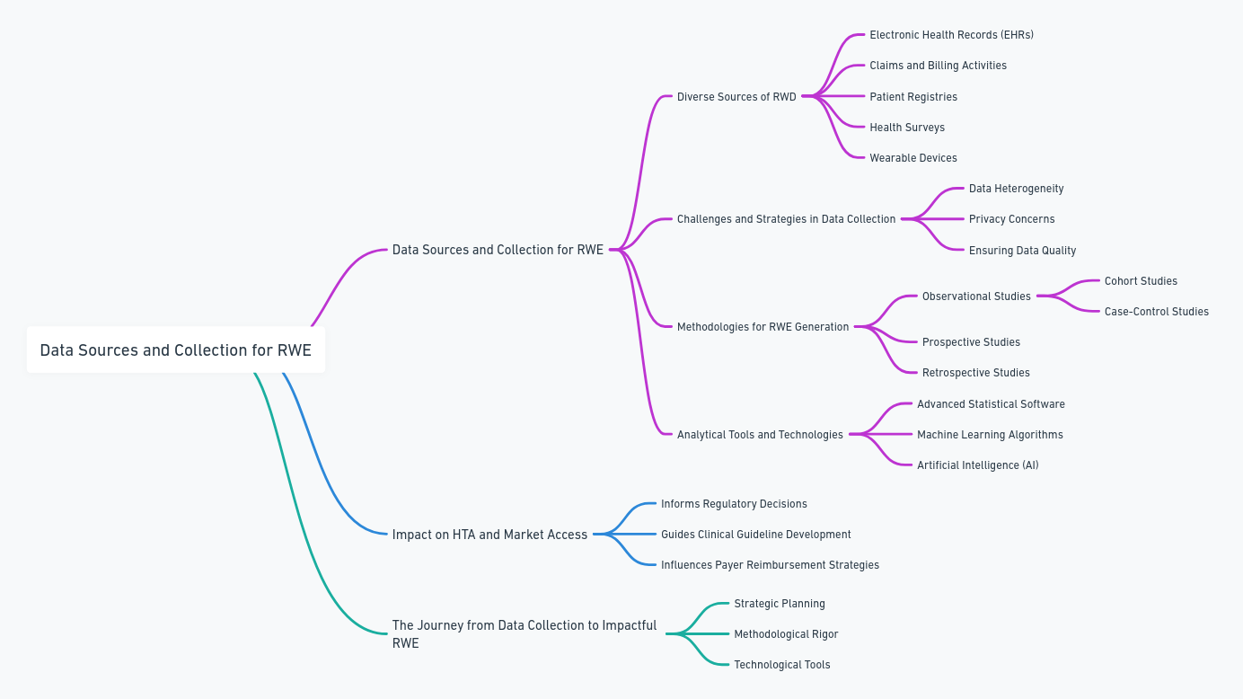

Data Sources and Collection for Real-World Evidence

Slide 8
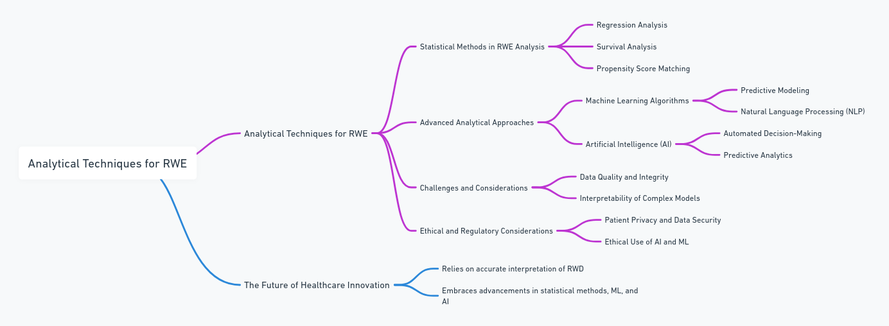

Analytical Techniques for Real-World Evidence

Slide 9
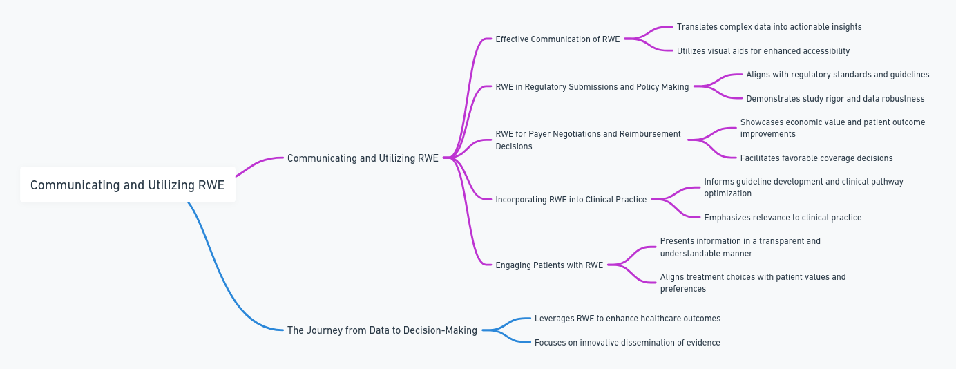

Communicating and Utilizing Real-World Evidence

Slide 10
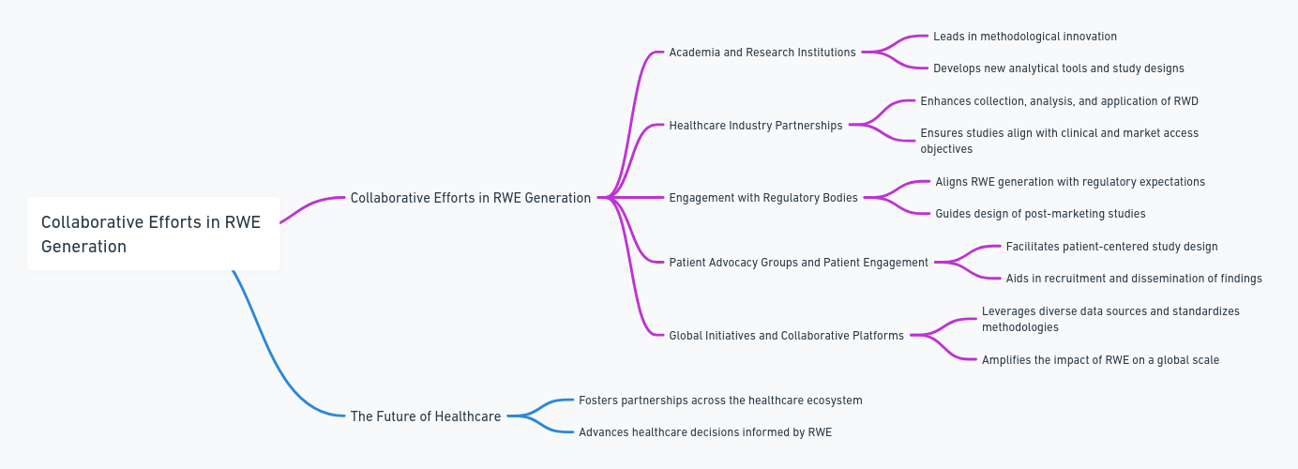

Collaborative Efforts in RWE Generation

Slide 11
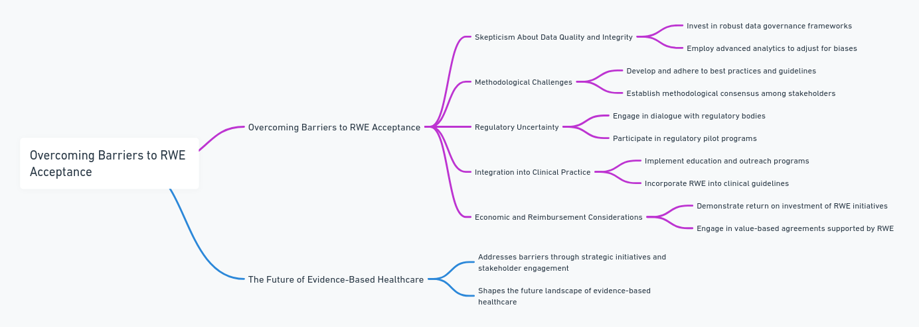

Overcoming Barriers to RWE Acceptance

Slide 12
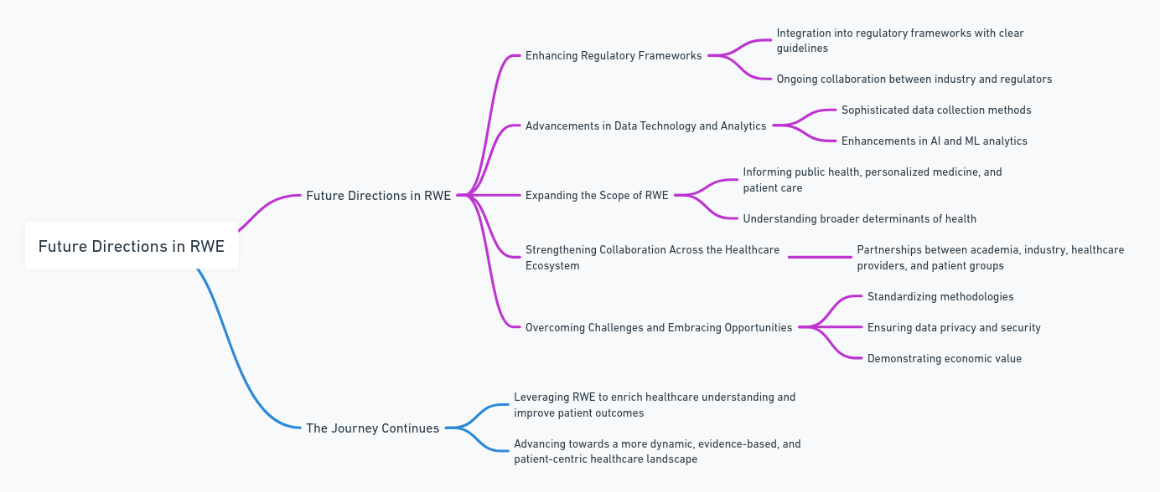

Future Directions in RWE

Slide 13
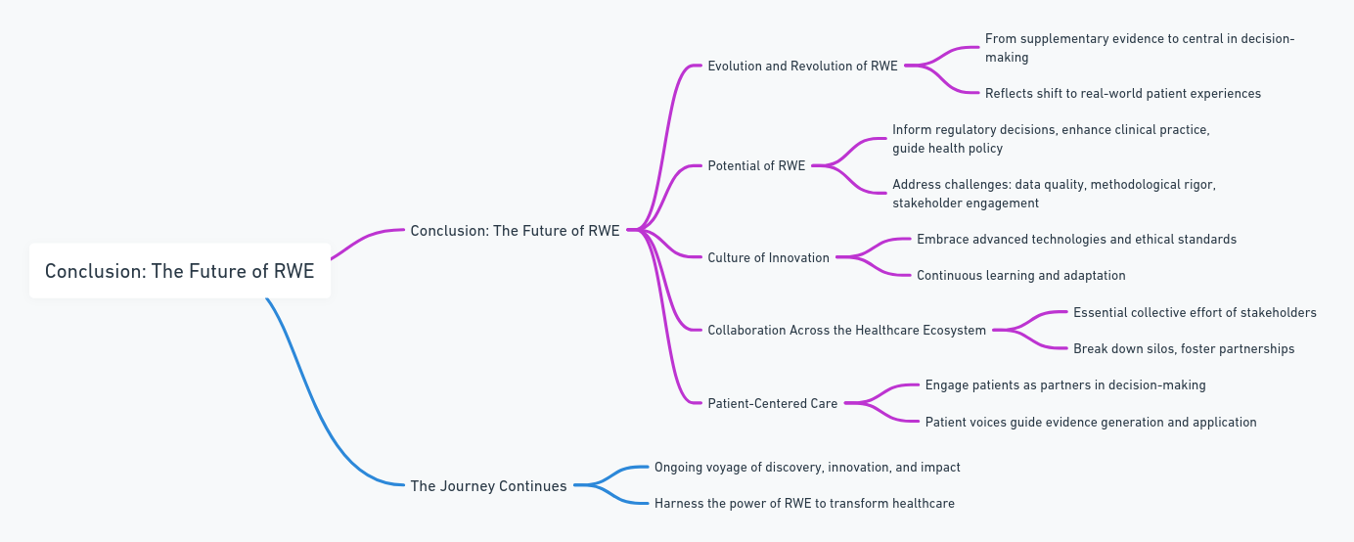

Conclusion: the strategic imperative of RWE in achieving HTA success and final thoughts

