Slide 1

The use of surrogate endpoints in HTA and Market access
Powered by GPT4 Technology

Slide 2
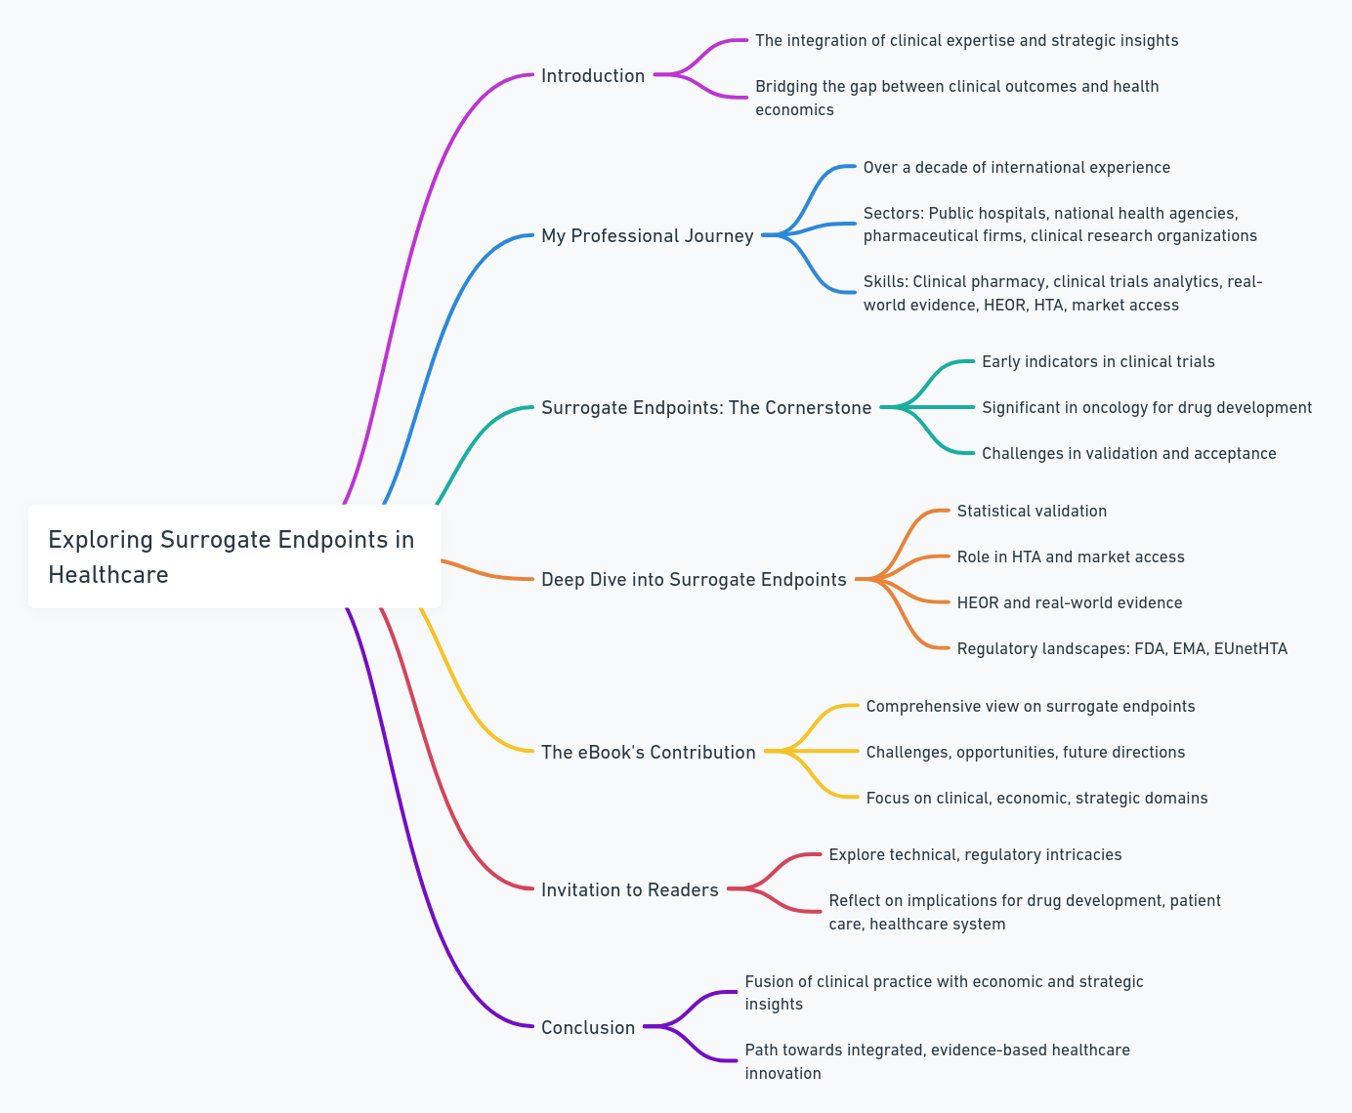

Introduction

Slide 3
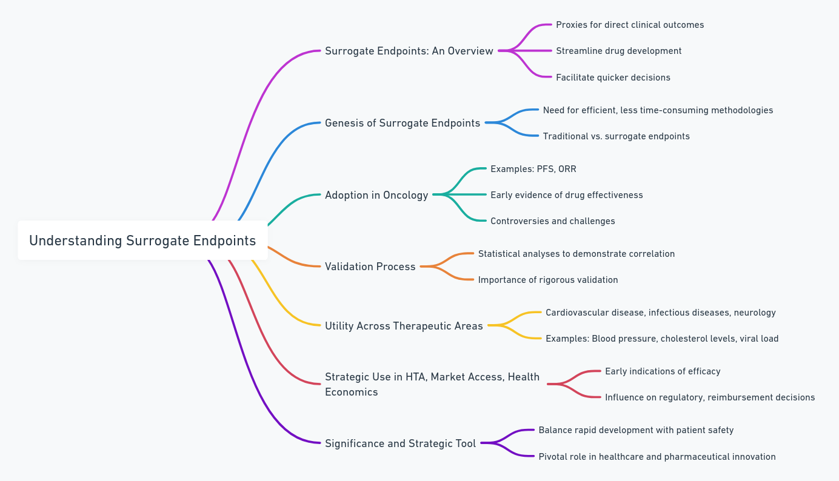

Understanding Surrogate Endpoints

Slide 4
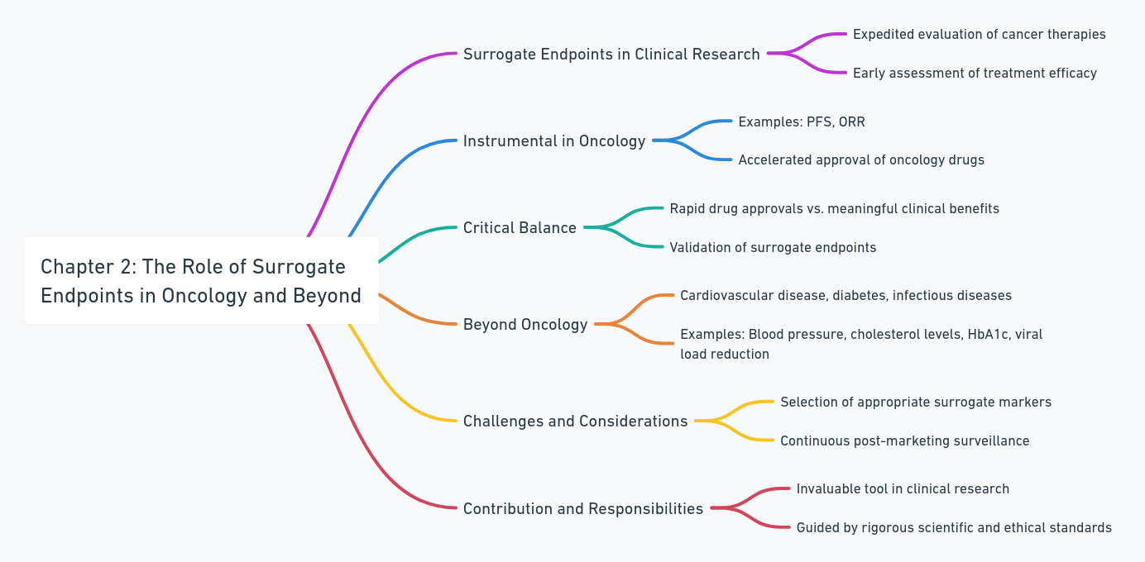

The Role of Surrogate Endpoints in Oncology and Beyond

Slide 5
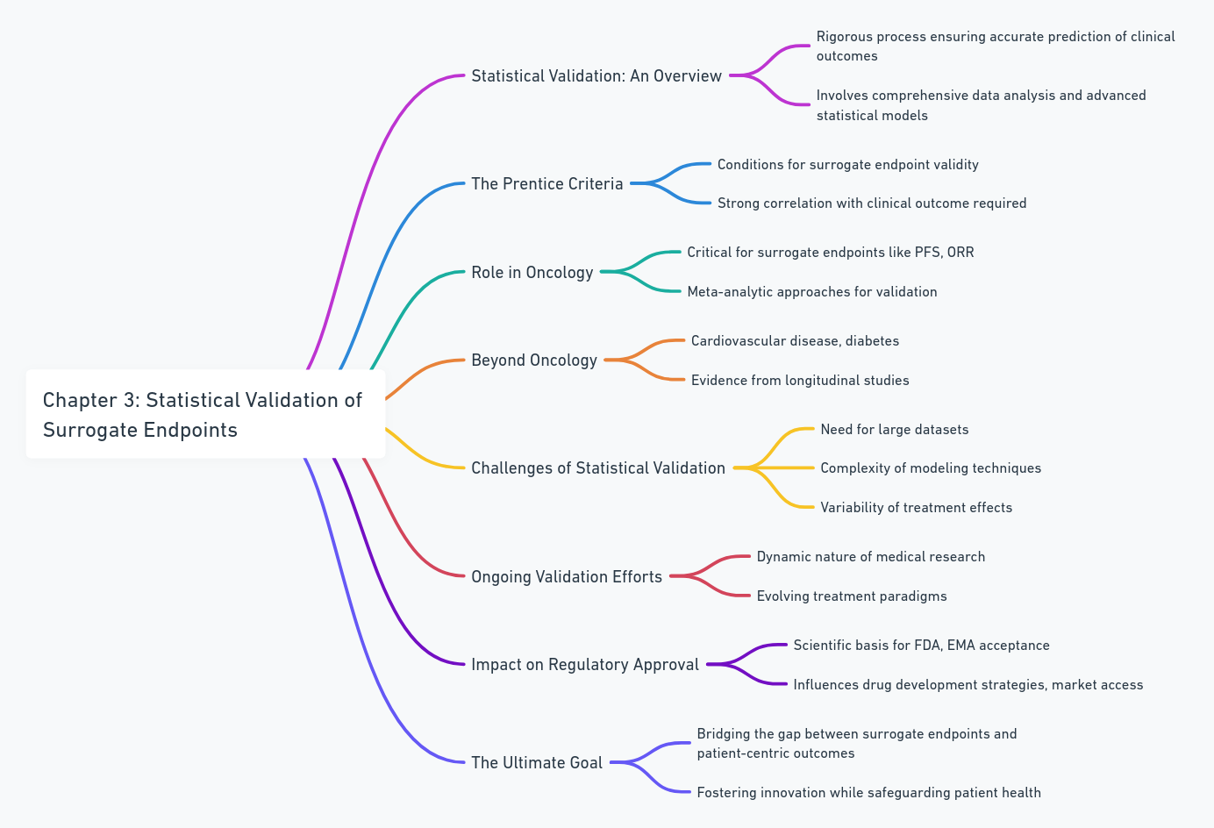

Statistical Validation of Surrogate Endpoints

Slide 6
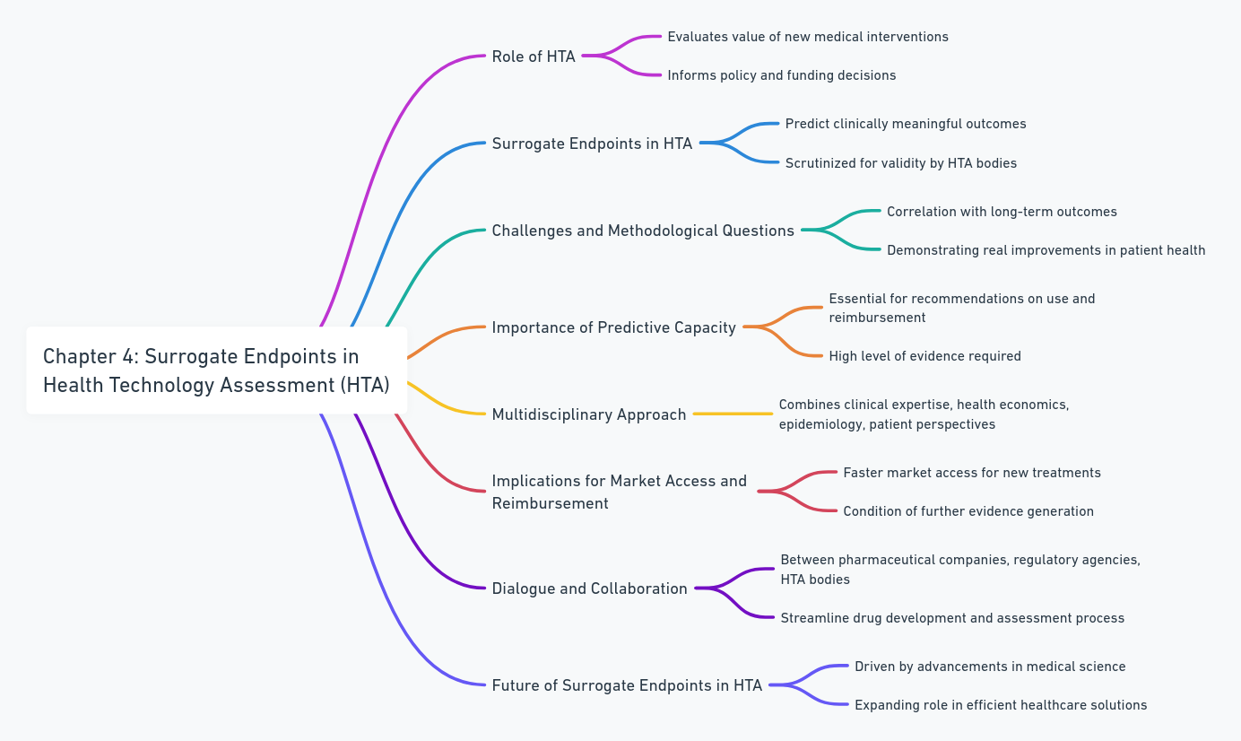

Surrogate Endpoints in Health Technology Assessment (HTA)

Slide 7
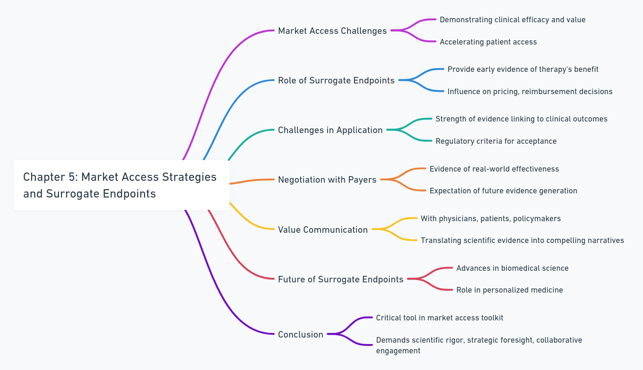
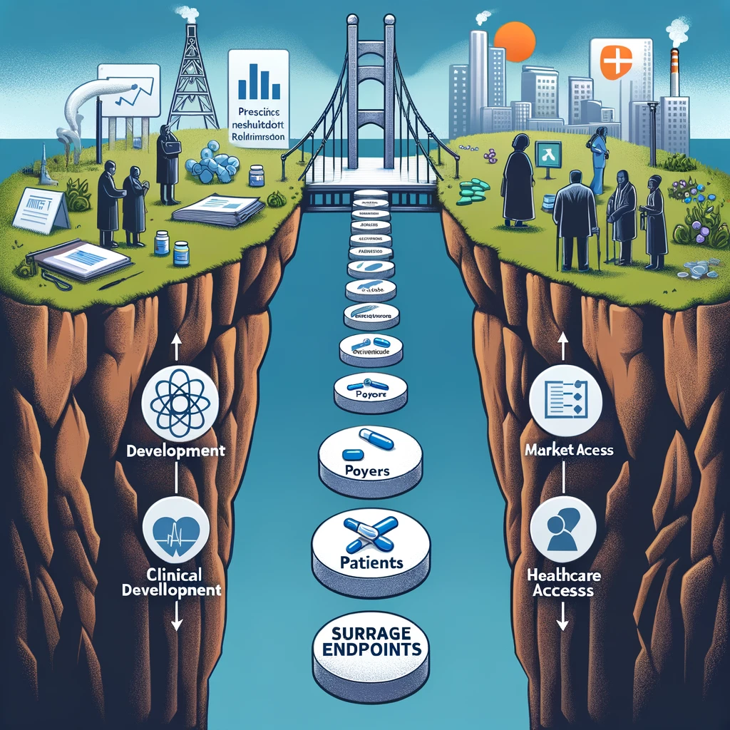
Market Access Strategies and Surrogate Endpoints

Slide 8
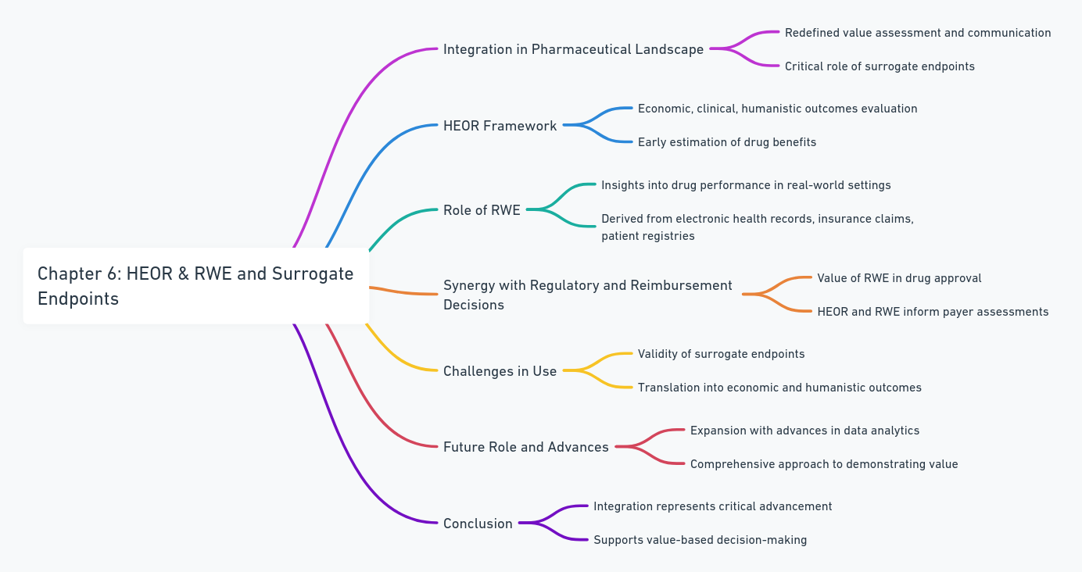

Health Economics and Outcomes Research (HEOR) & Real World Evidence (RWE)

Slide 9
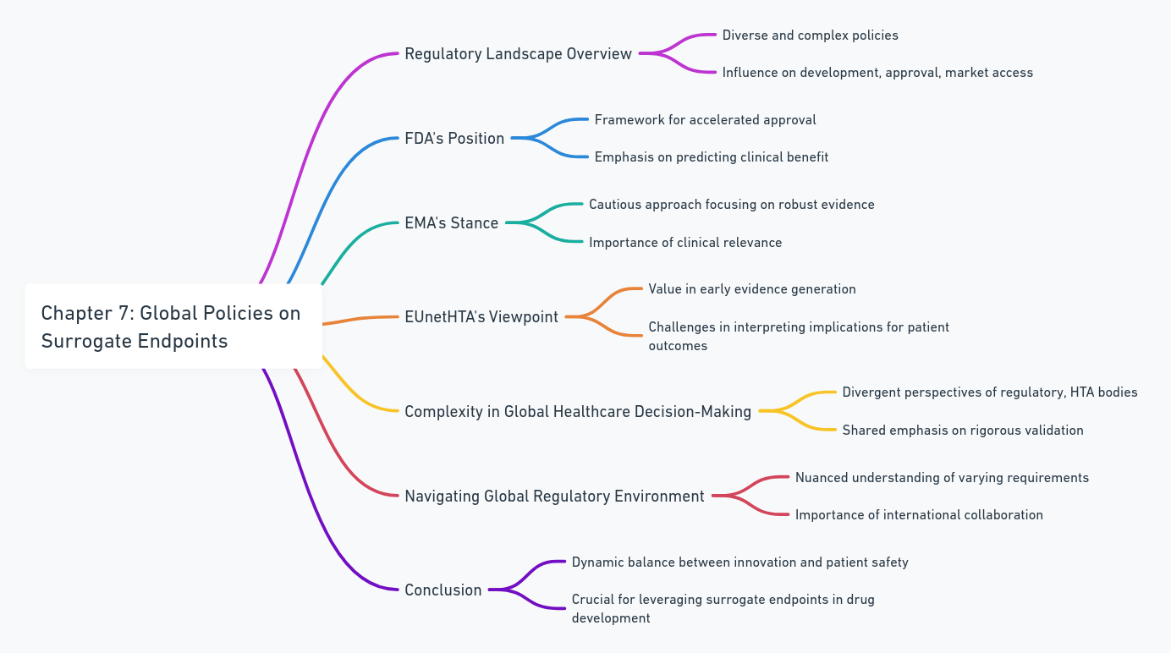

Global Policies on Surrogate Endpoints

Slide 10
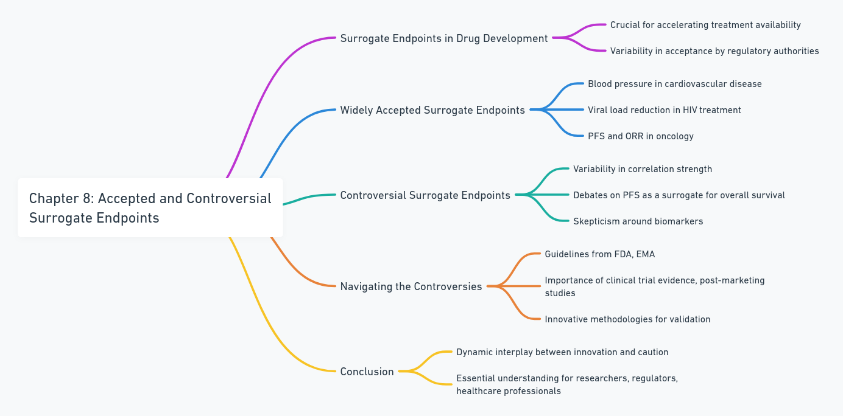

Accepted and Controversial Surrogate Endpoints

Slide 11
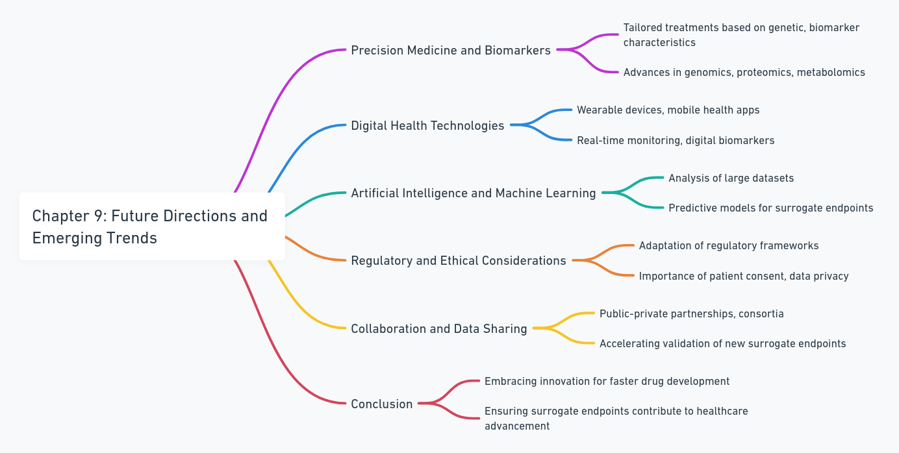

Future Directions and Emerging Trends

Slide 12
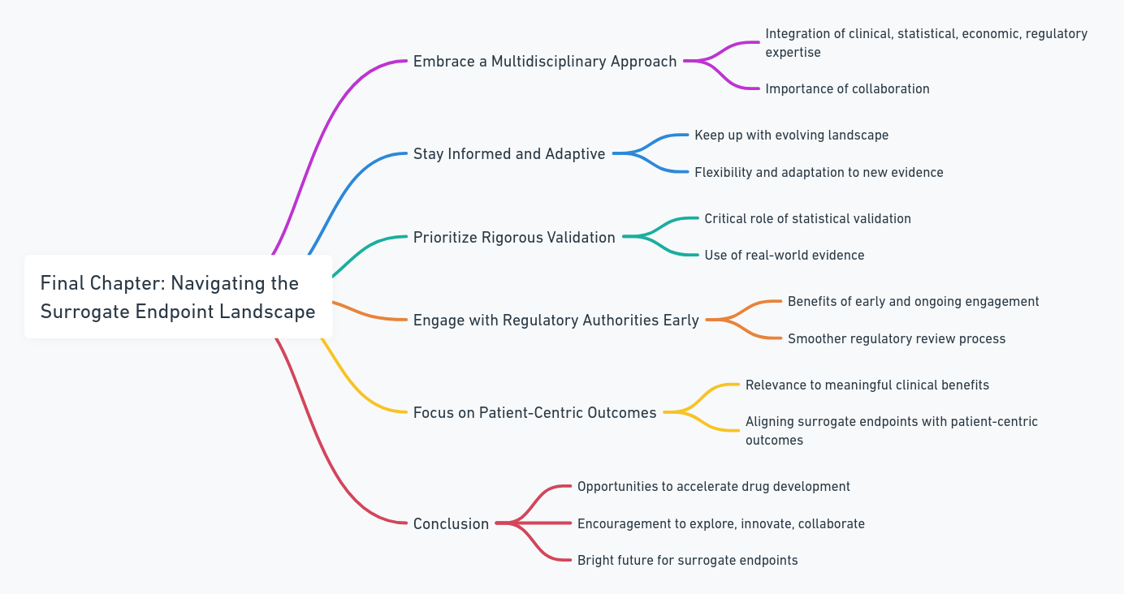

Personal Insights and Expert Advice

Slide 13
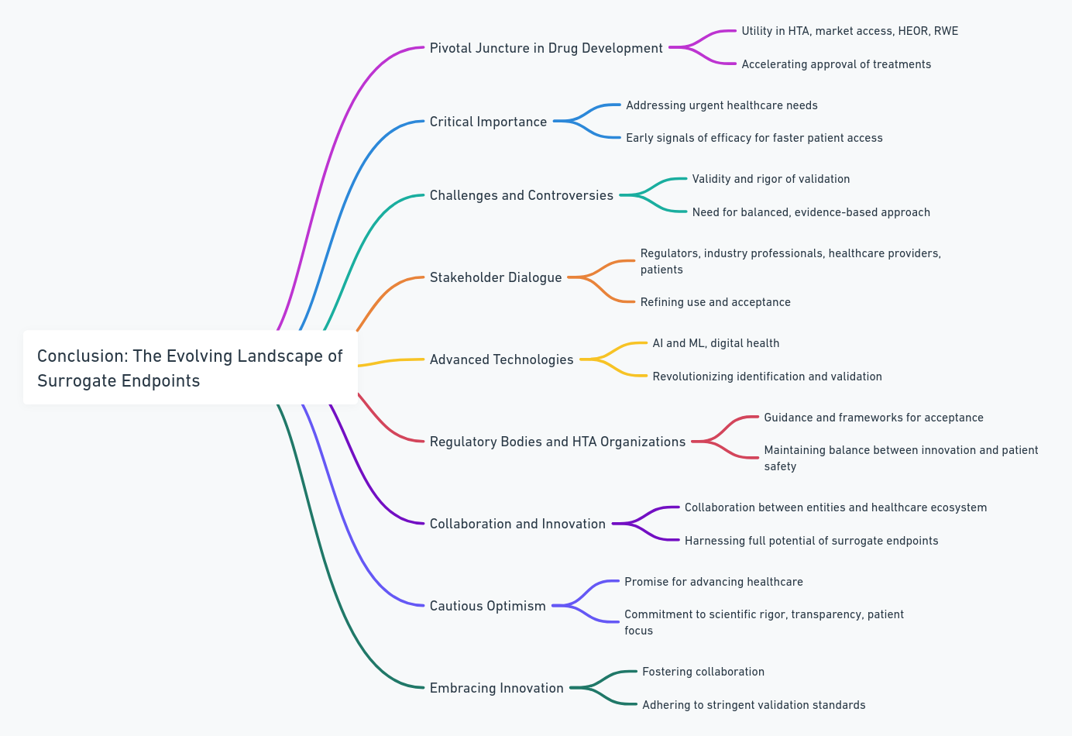

Conclusion: The Evolving Landscape of Surrogate Endpoints

