Slide 1
Bridging the Gap: Scientific Advice's Role in Health Technology Success
Powered by GPT4 Technology

Slide 2
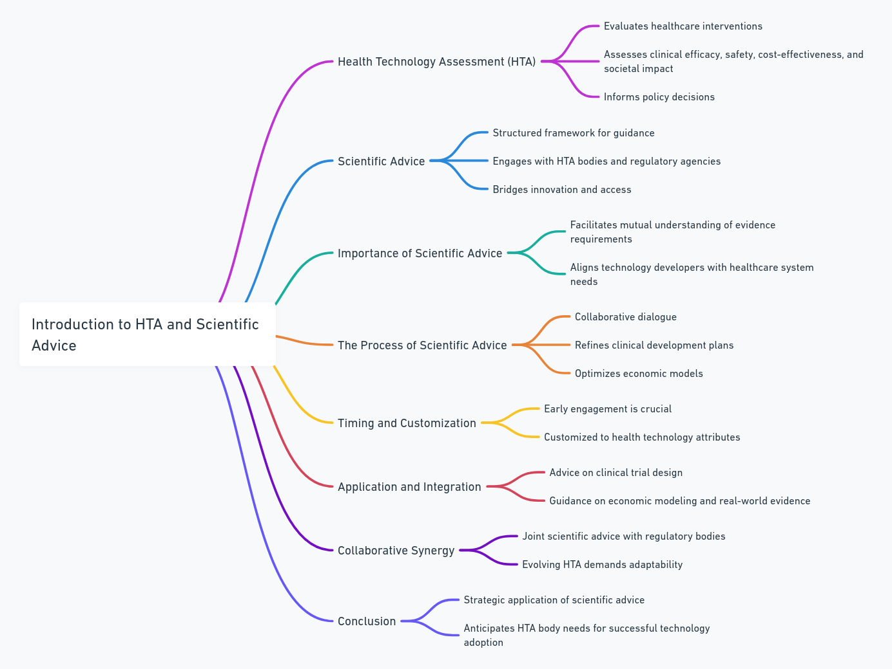
Introduction to HTA and Scientific Advice

Slide 3
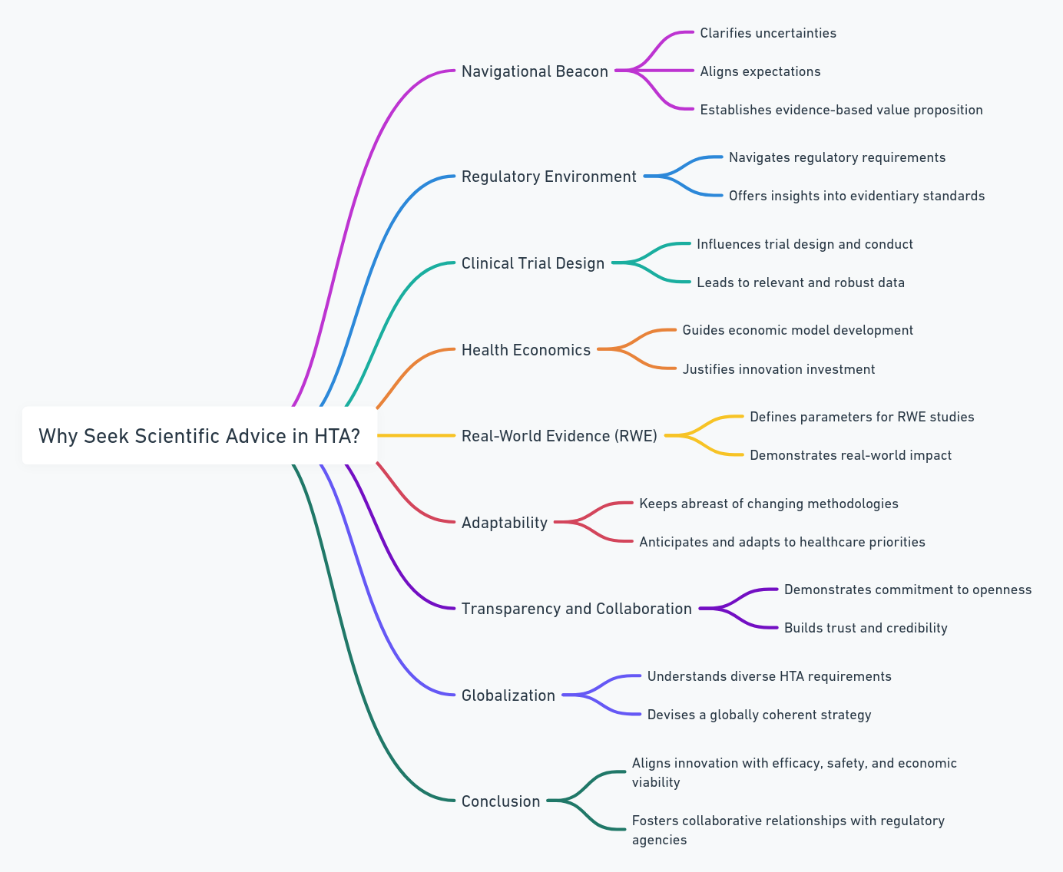
Why Seek Scientific Advice in HTA?

Slide 4
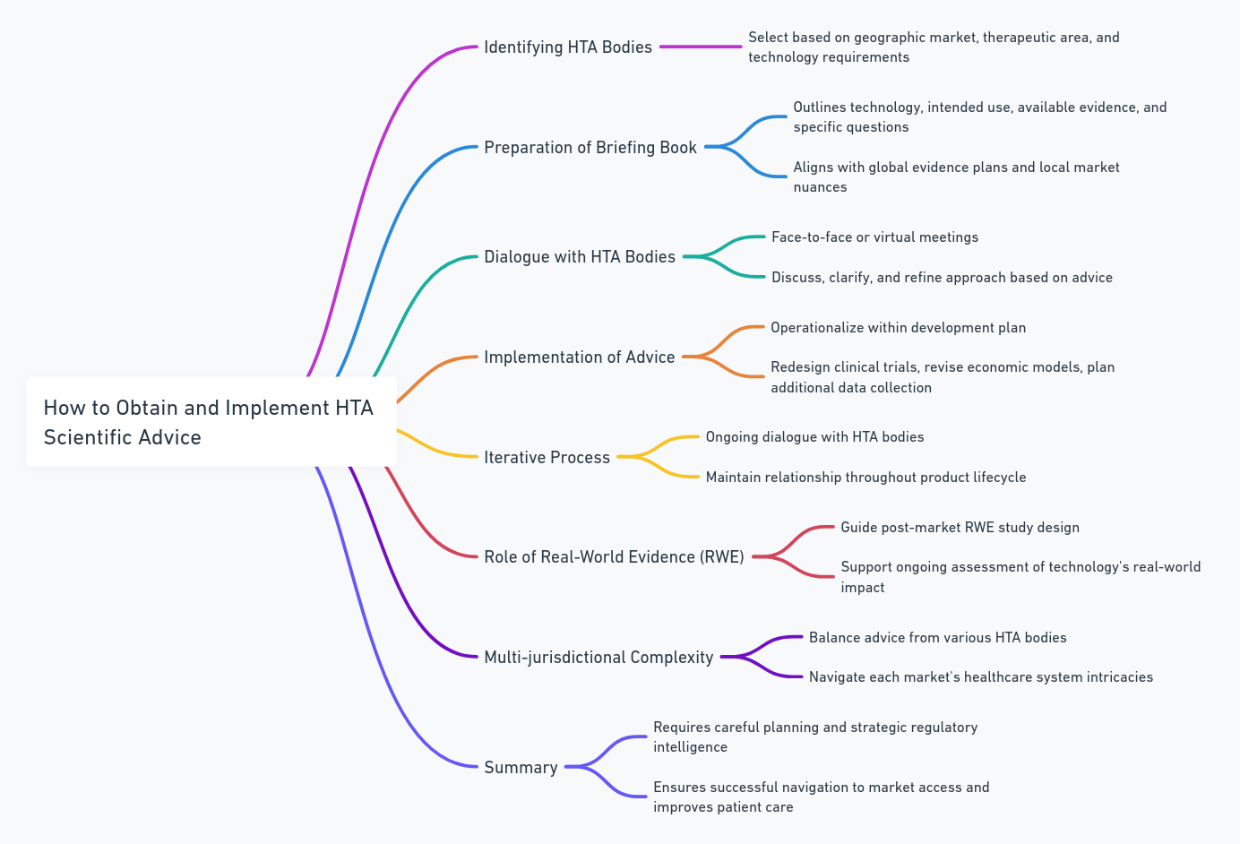
How to Obtain and Implement HTA Scientific Advice

Slide 5
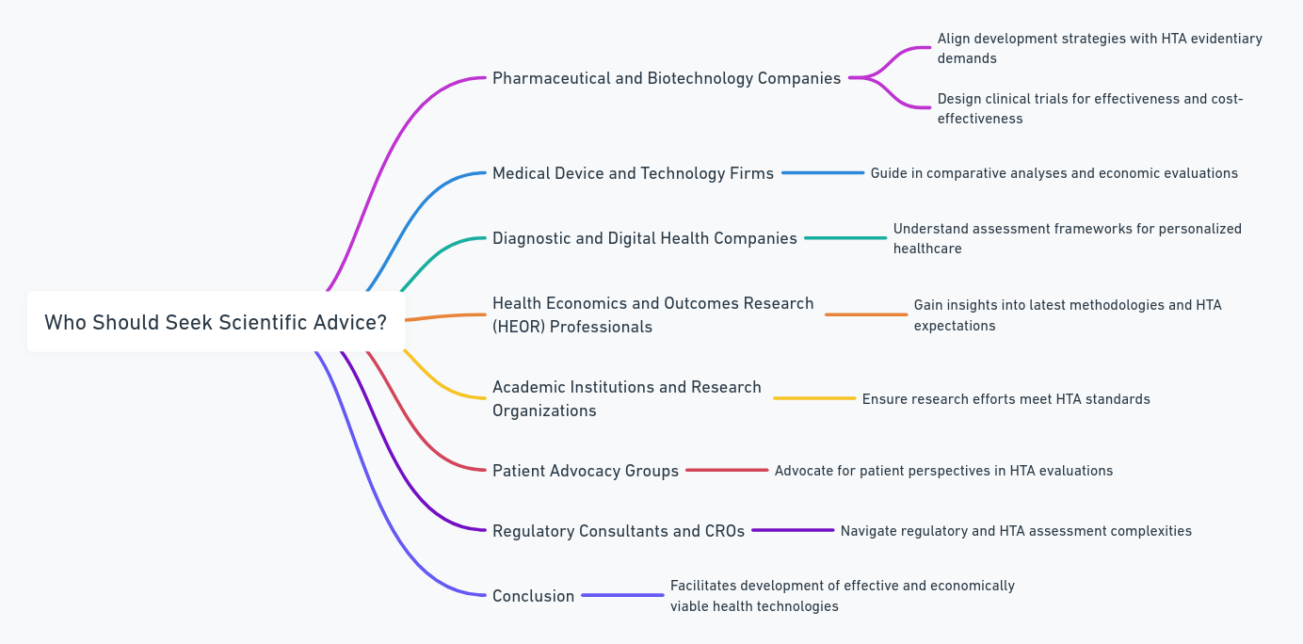
Who Should Seek Scientific Advice?

Slide 6
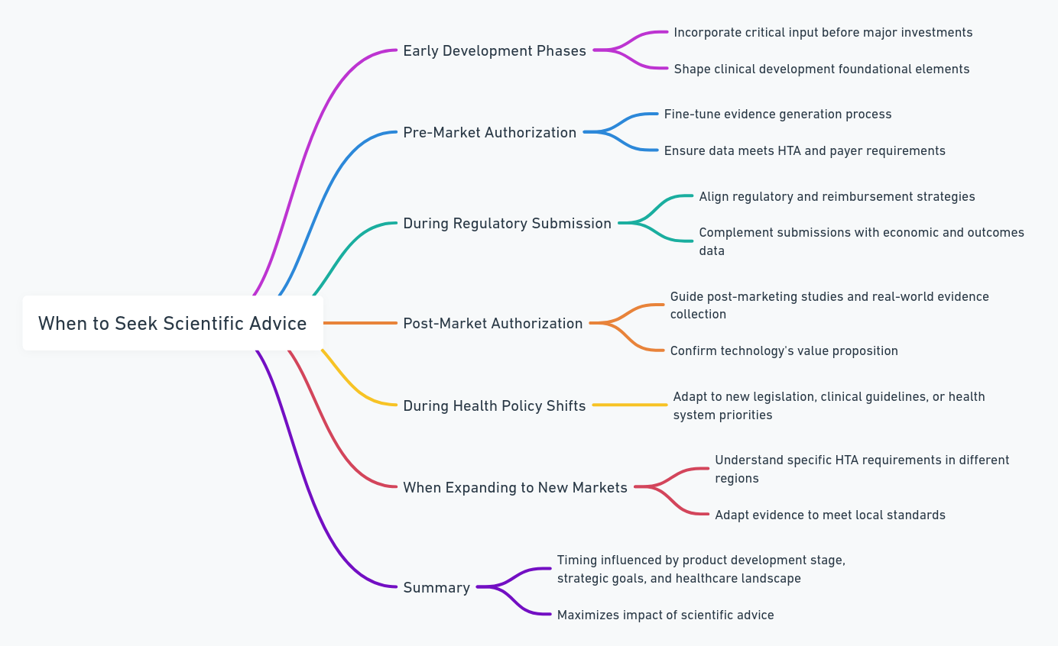
When to Seek Scientific Advice

Slide 7
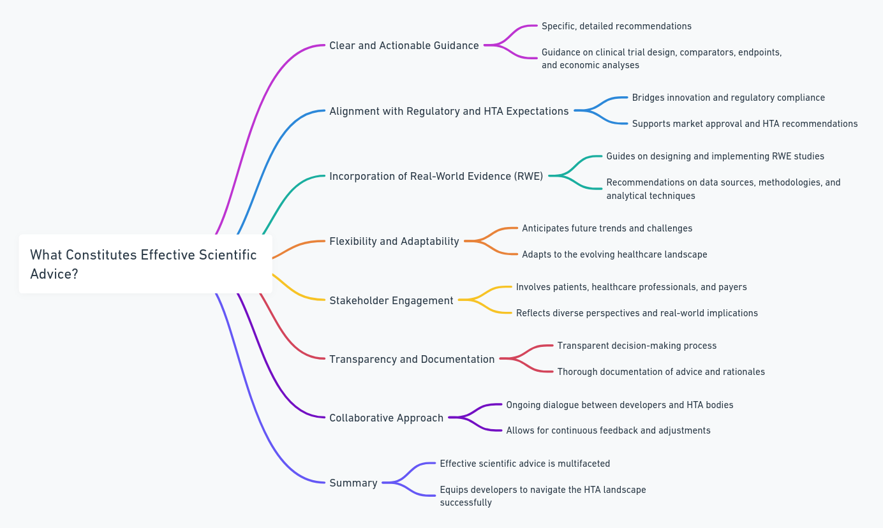
What Constitutes Effective Scientific Advice?

Slide 8
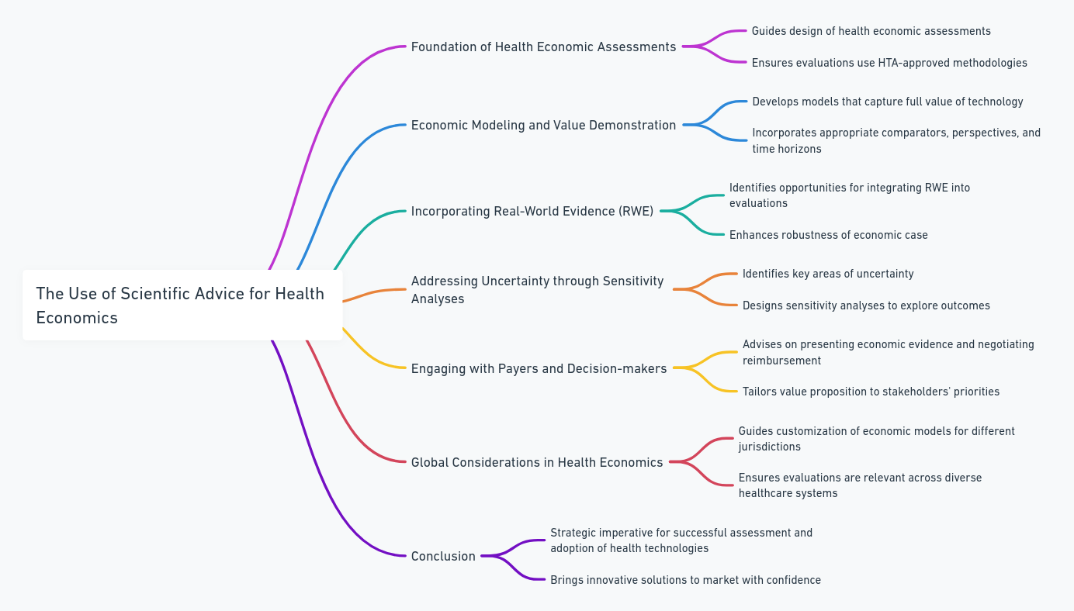
The Use of Scientific Advice for Health Economics

Slide 9
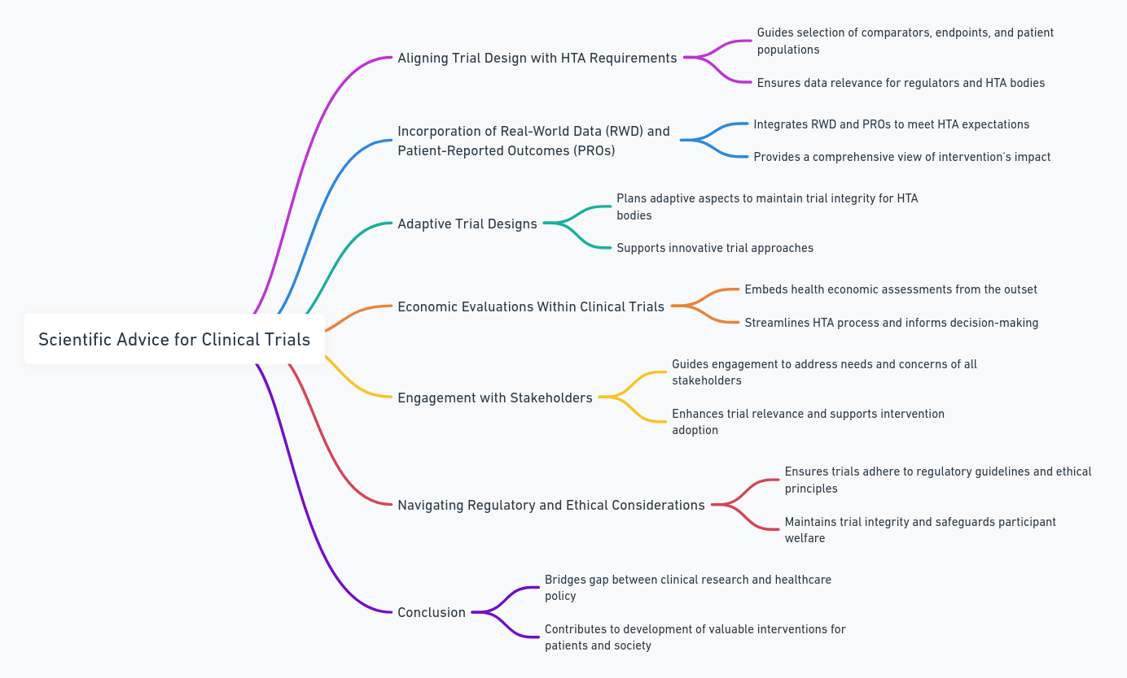
Scientific Advice for Clinical Trials

Slide 10
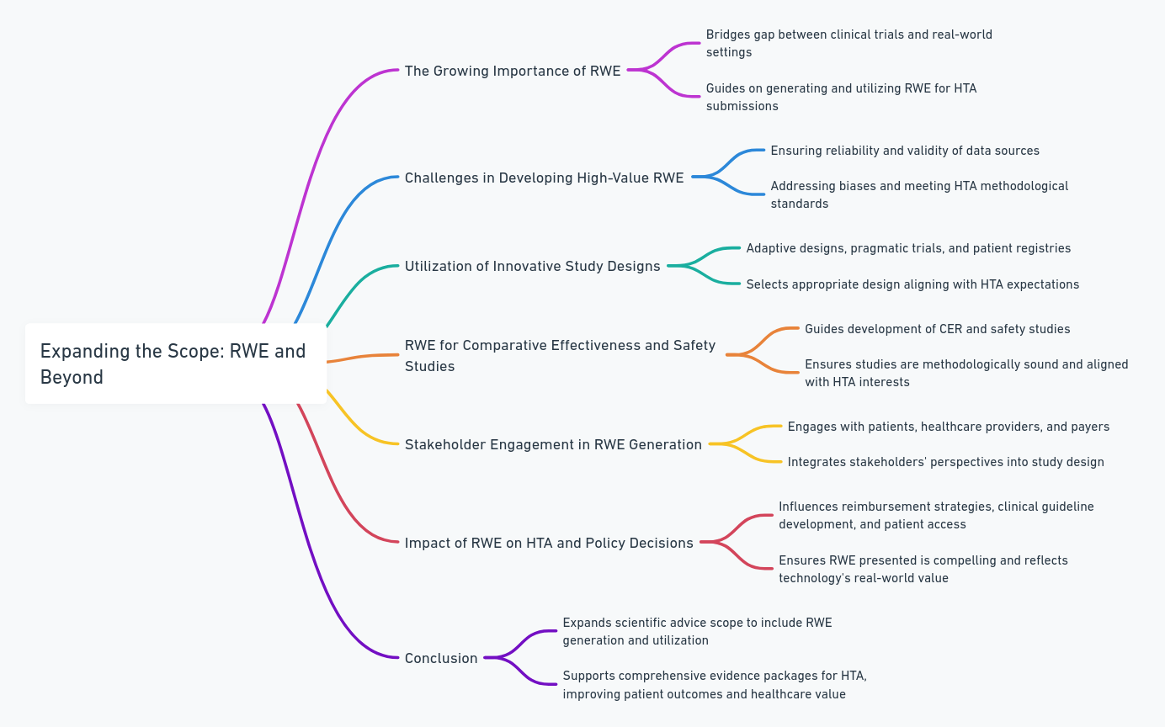
Expanding the Scope: RWE and Beyond

Slide 11
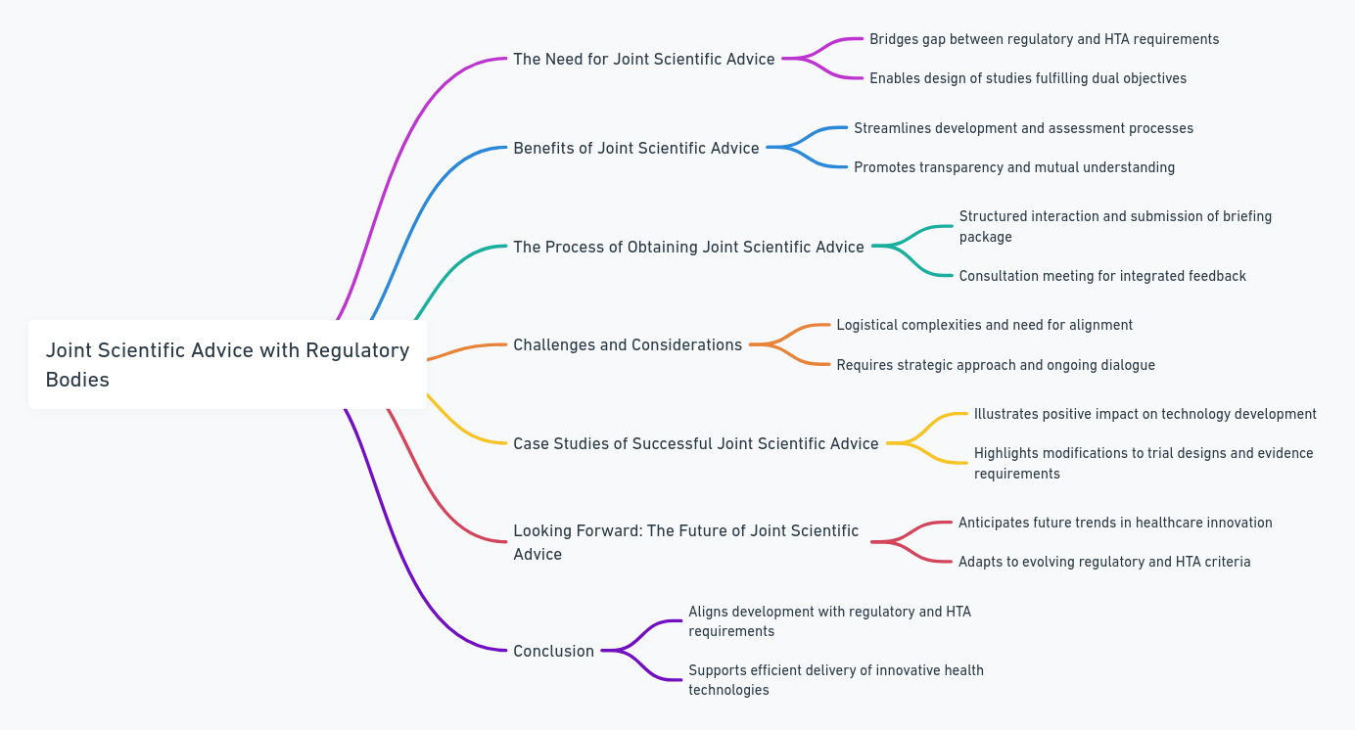
Joint Scientific Advice with Regulatory Bodies

Slide 12
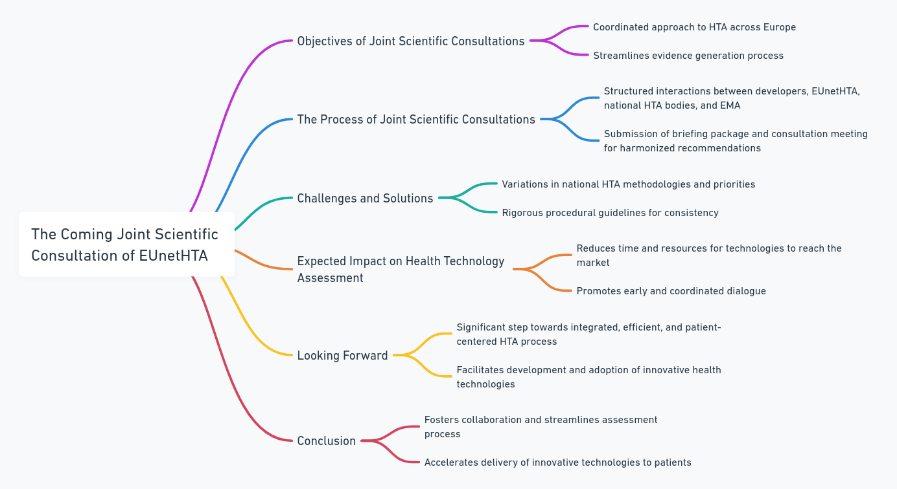
The Coming Joint Scientific Consultation of EUnetHTA

Slide 13
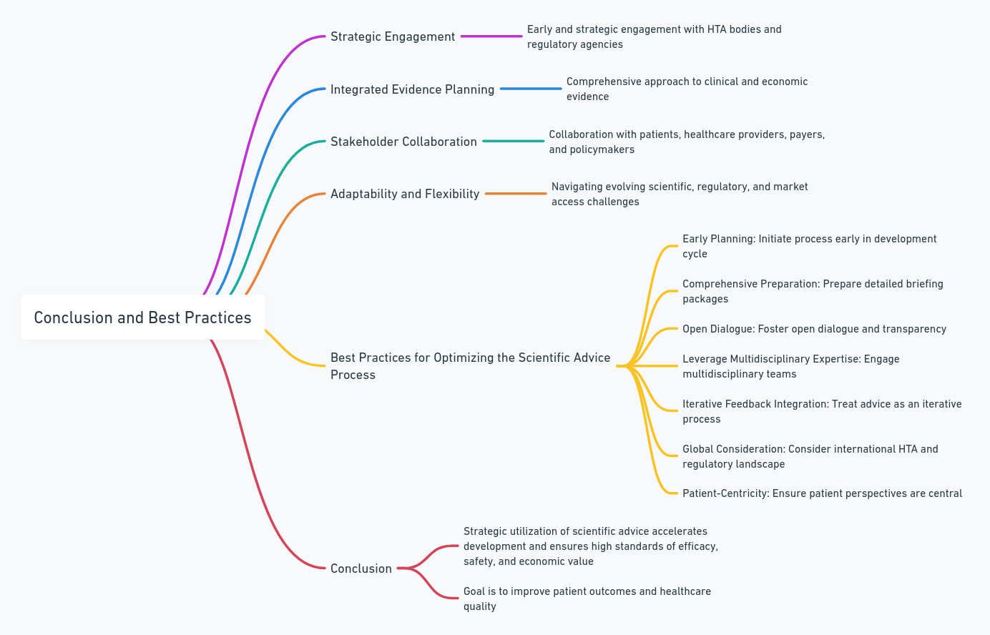
Conclusion and Best Practices

