Slide 1
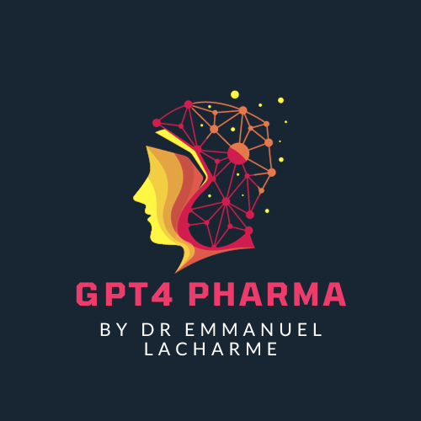
Advanced Competitive Intelligence in Pharma: Integrating AI for Strategic Decision-Making
Powered by GPT4 Technology

Slide 2
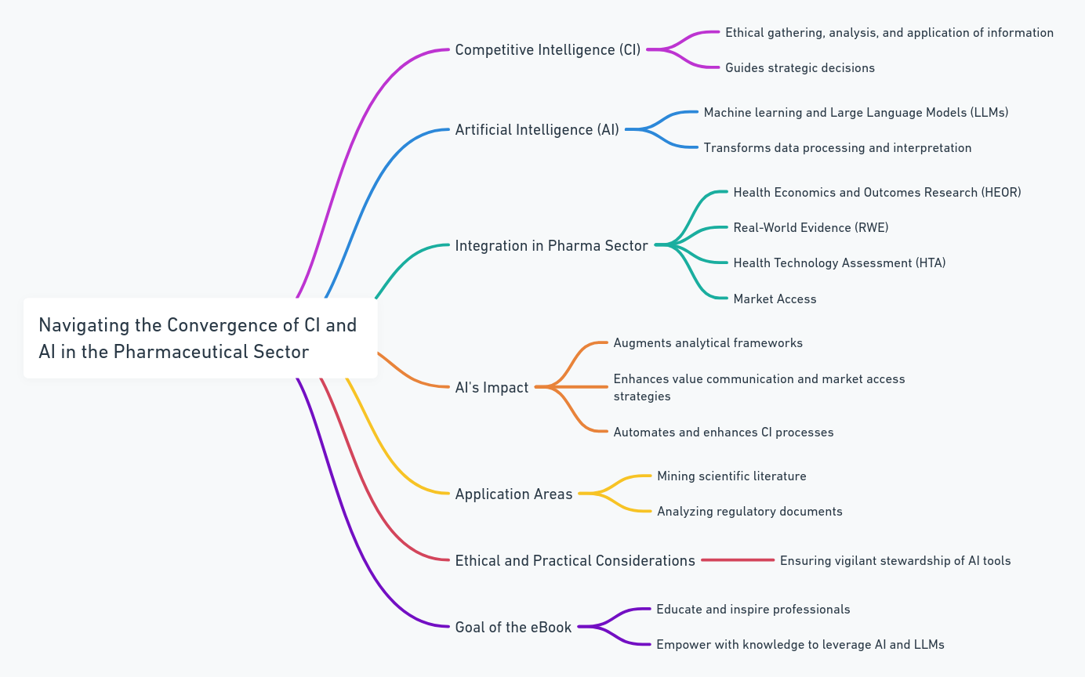
Preface: Navigating the Convergence of Competitive Intelligence and Artificial Intelligence in the Pharmaceutical Sector

Slide 3
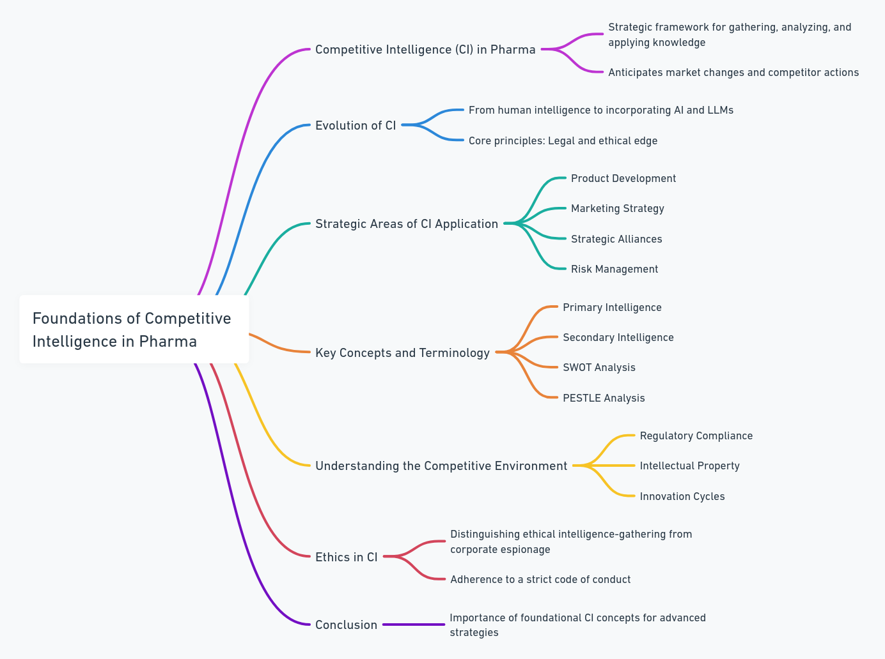
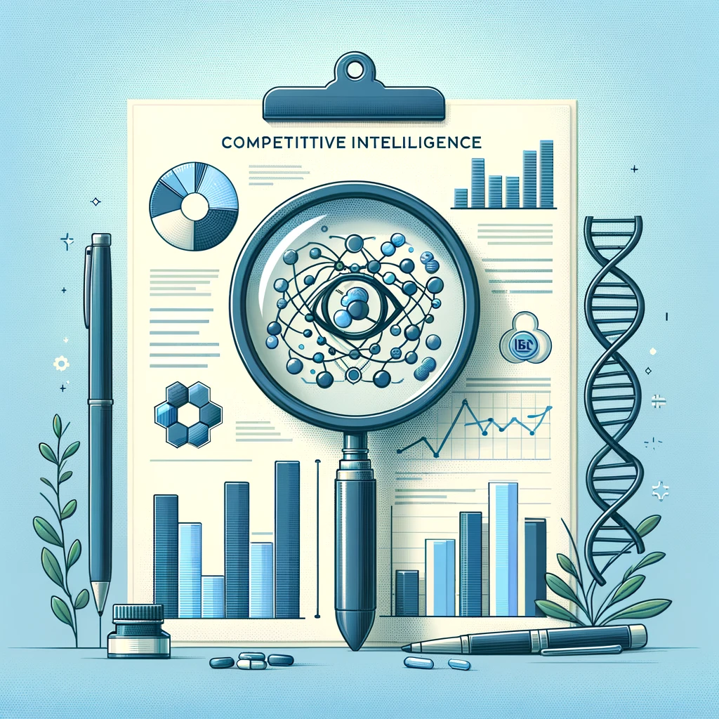
Foundations of competitive intelligence in Pharma?

Slide 4
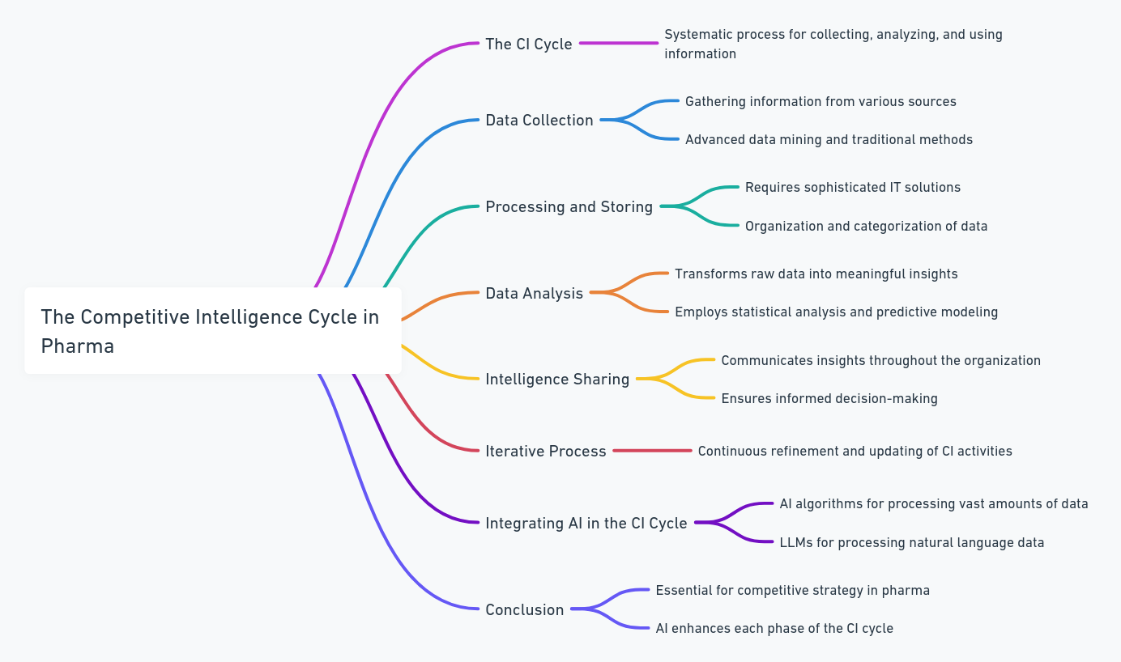
The competitive intelligence cycle

Slide 5
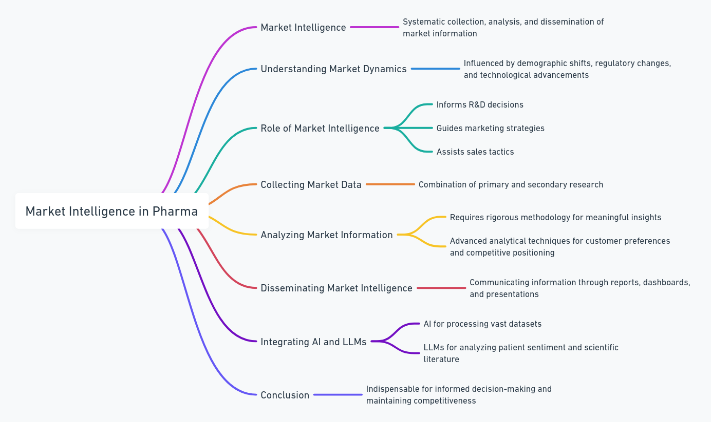
Market intelligence in Pharma

Slide 6
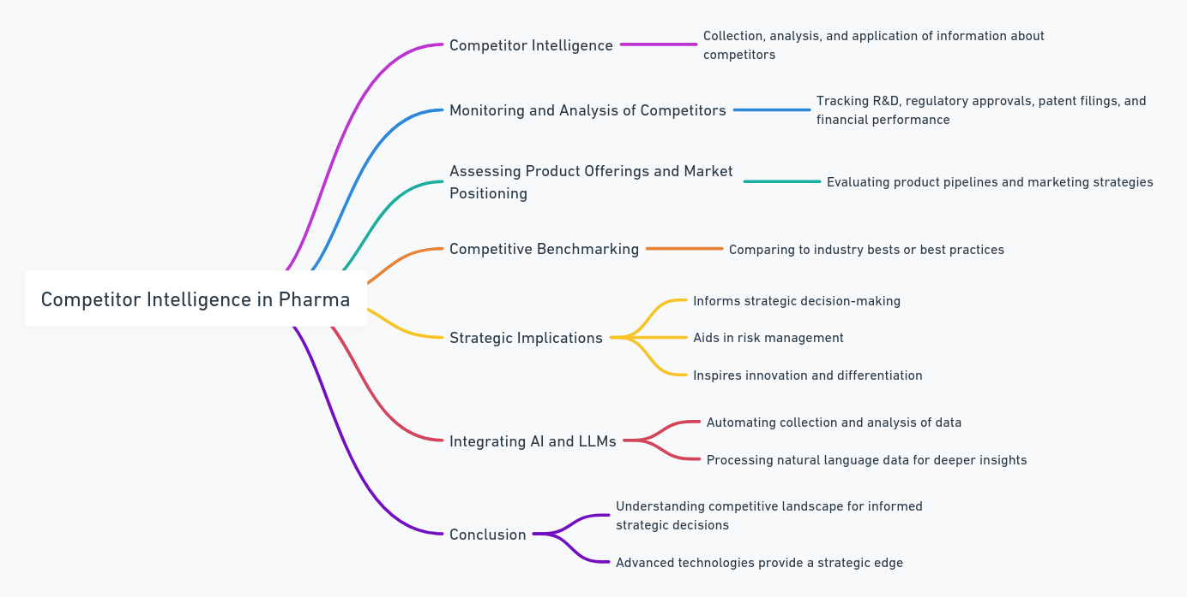
Competitor intelligence

Slide 7
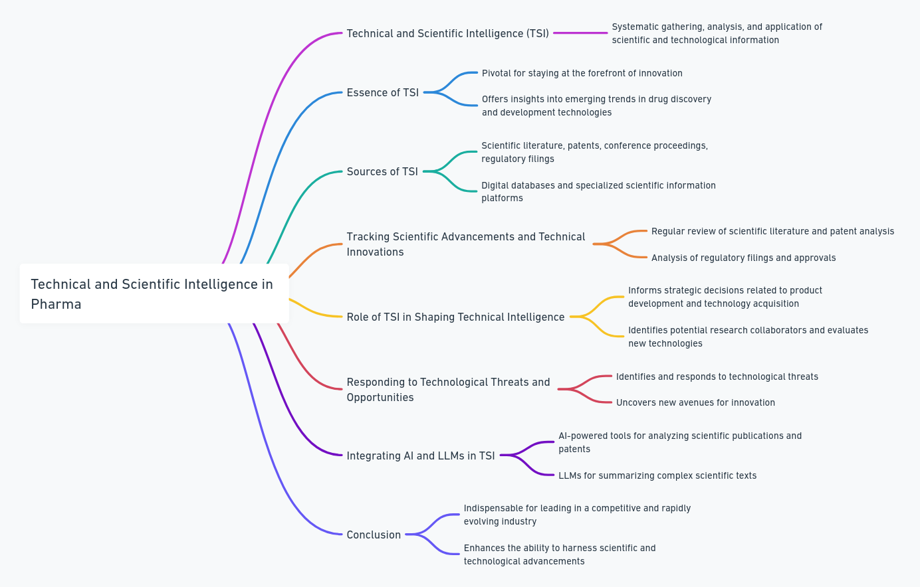
Technical and scientific intelligence

Slide 8
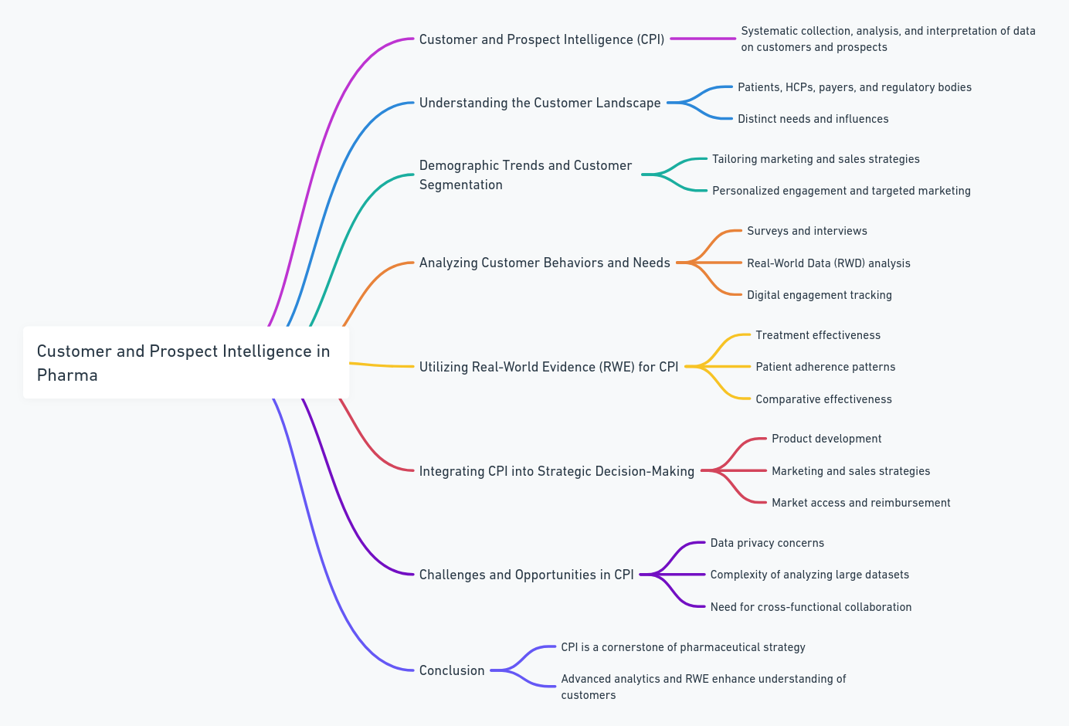
Customer and prospect intelligence

Slide 9
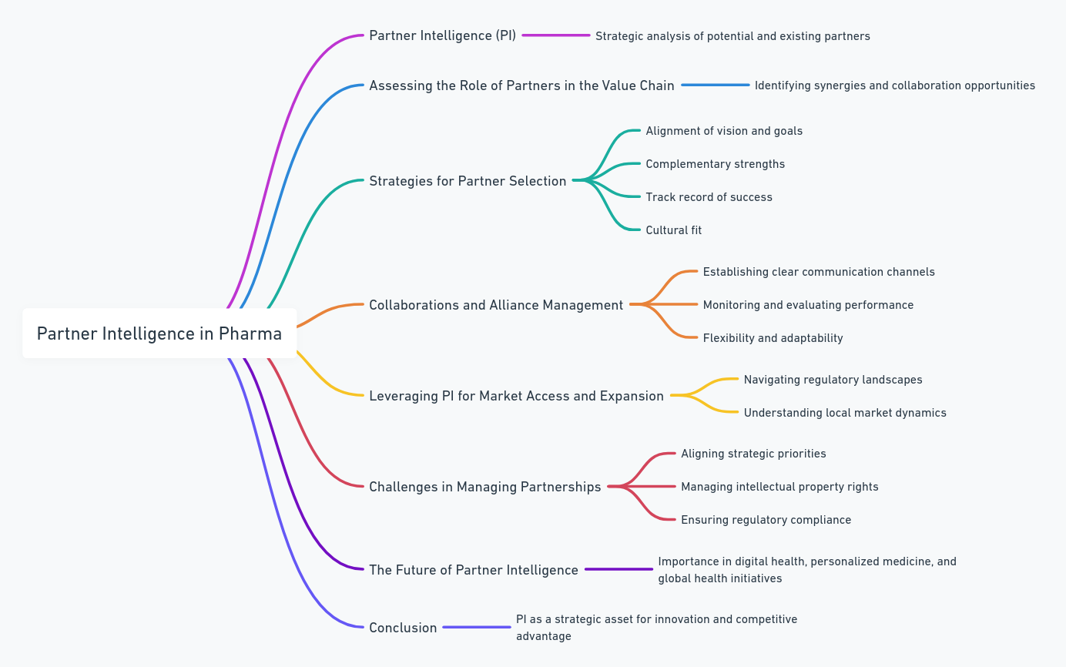
Partner intelligence

Slide 10
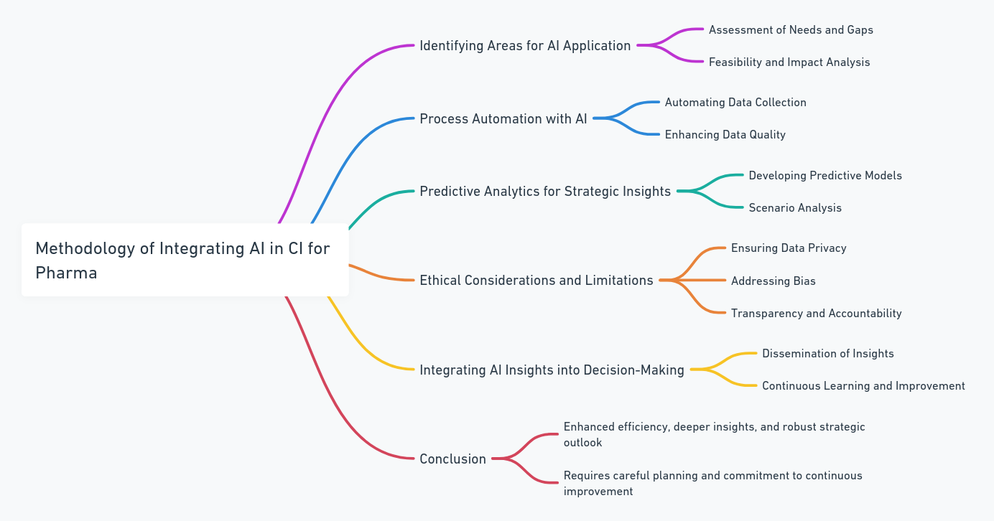
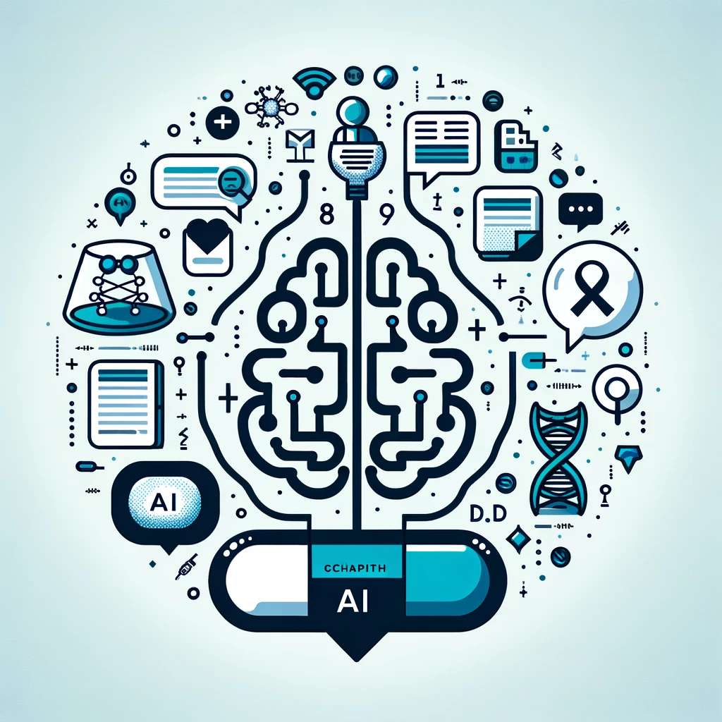
AI and LLM in CI

Slide 11
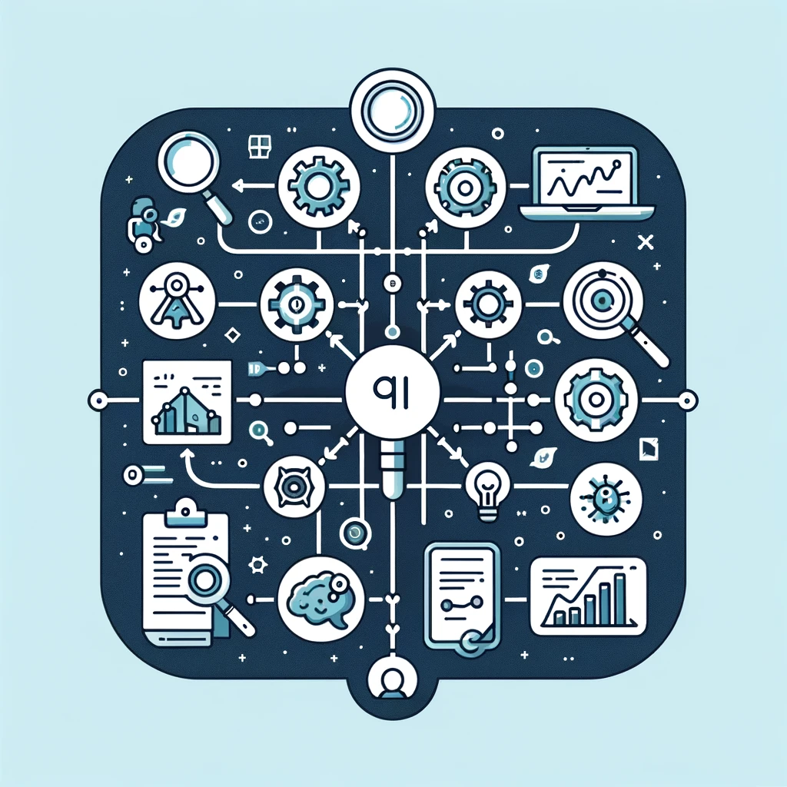
Methodology of integrating AI in CI

Slide 12
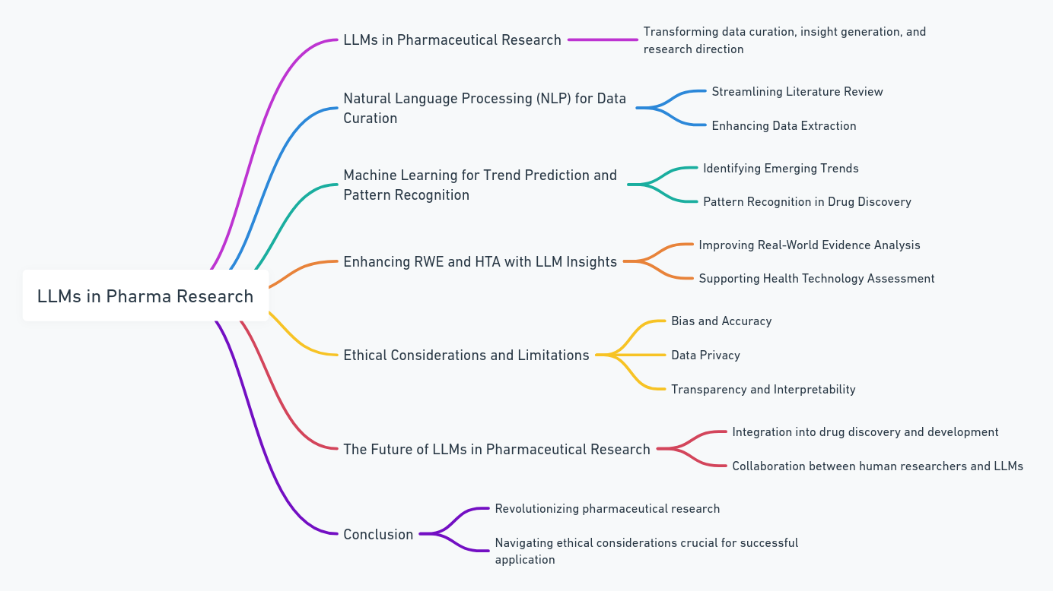
LLM in Pharma research

Slide 13
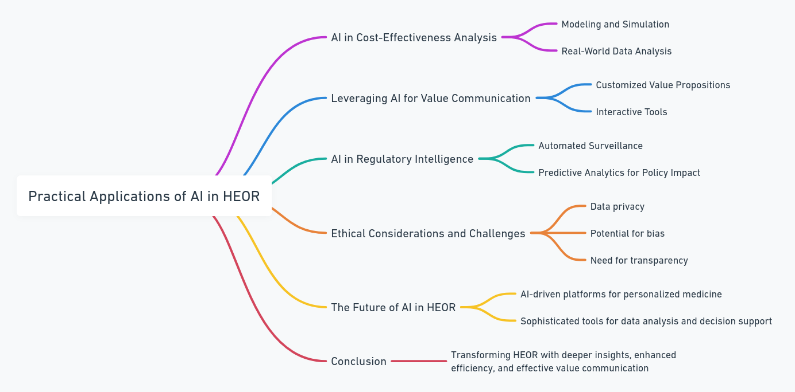
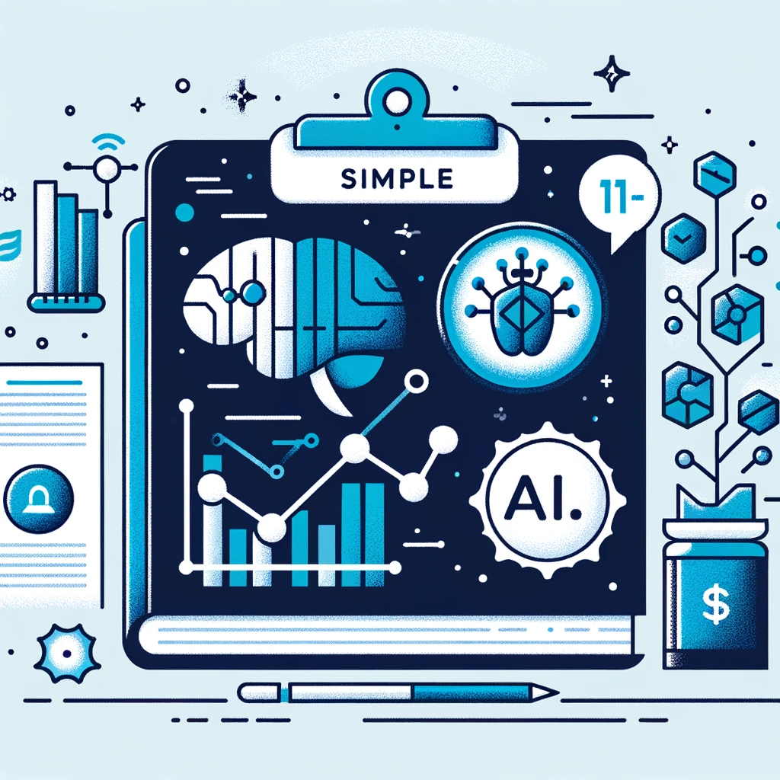
Practical applications of AI in HEOR

Slide 14
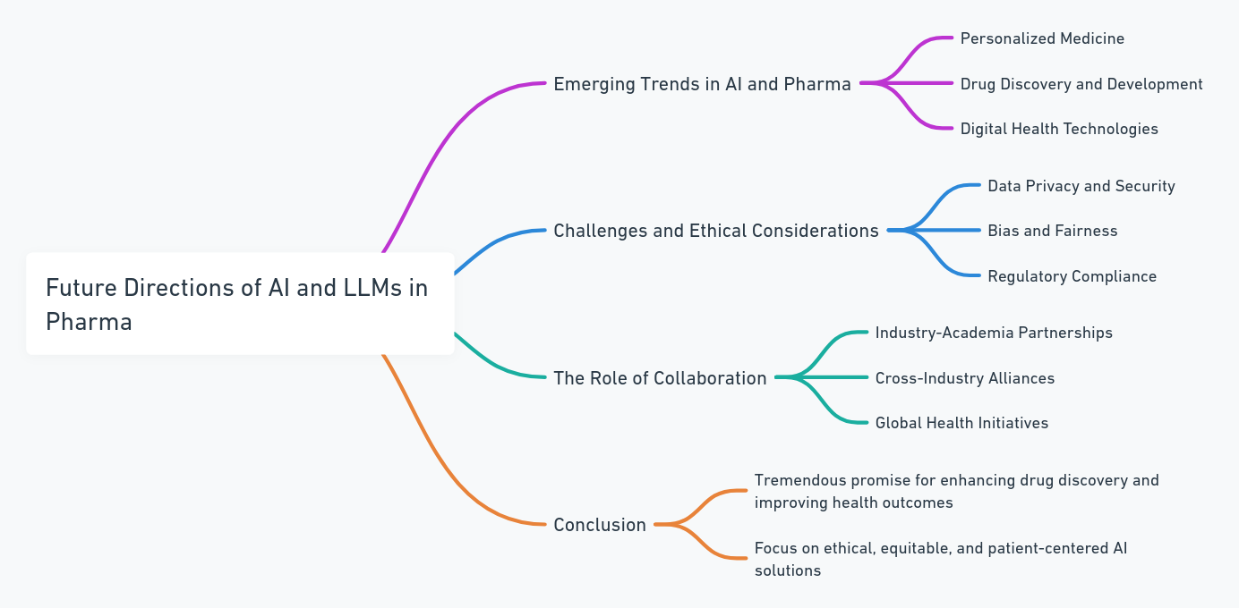
Future directions

Slide 15
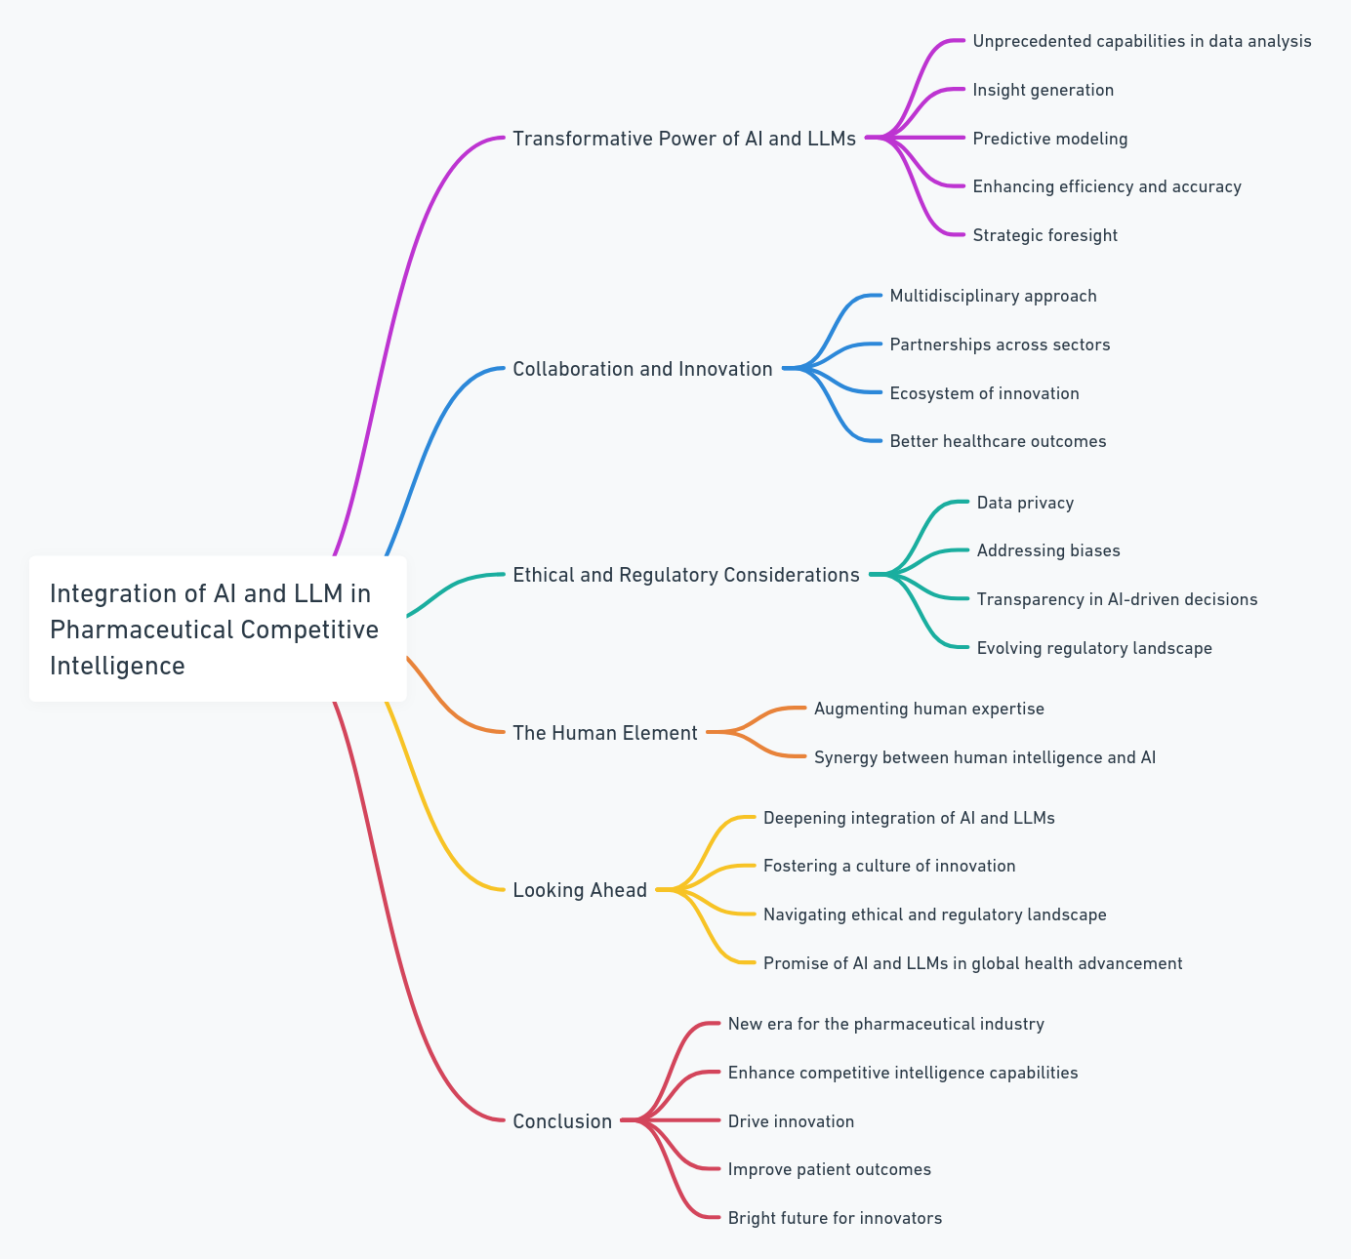
Conclusion: Navigating the Future of Competitive Intelligence with AI and LLMs in Pharma

