Slide 1
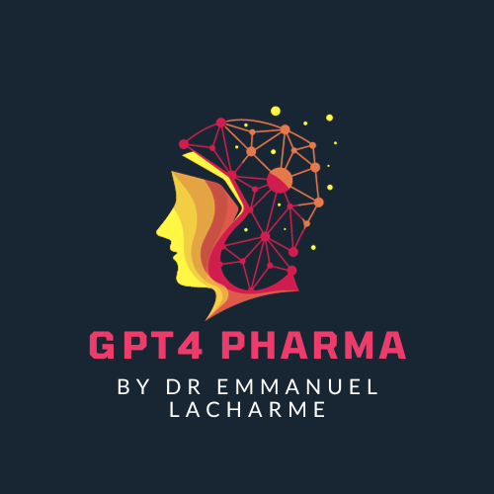
Digital Frontiers in Healthcare: Harnessing Patient Reported Data and AI
Powered by GPT4 Technology

Slide 2
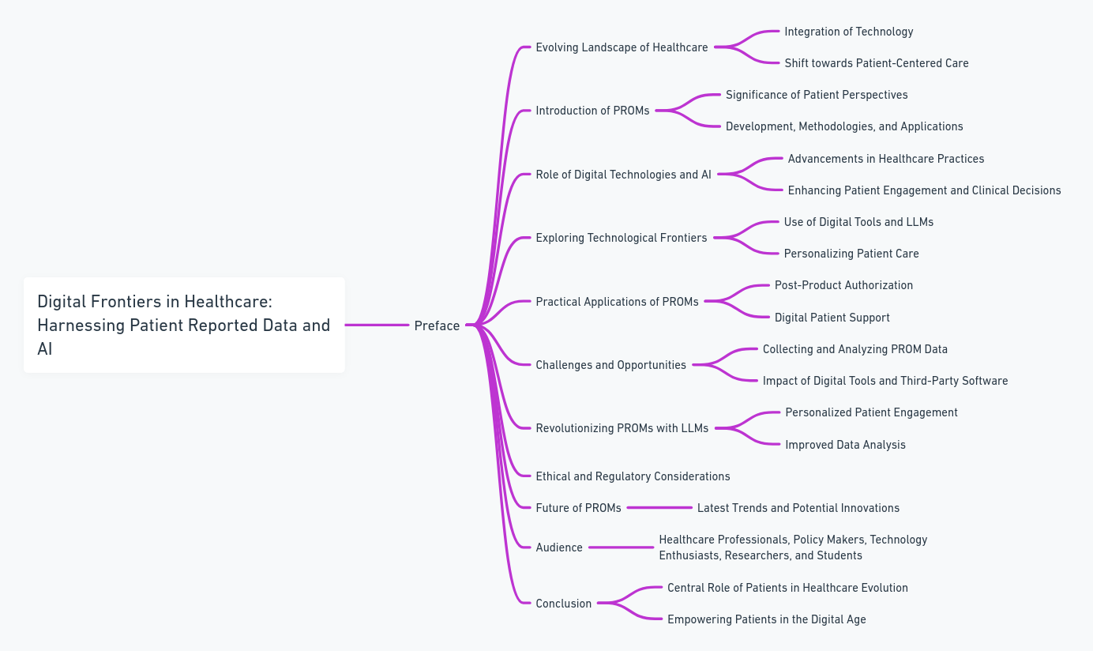
Preface

Slide 3
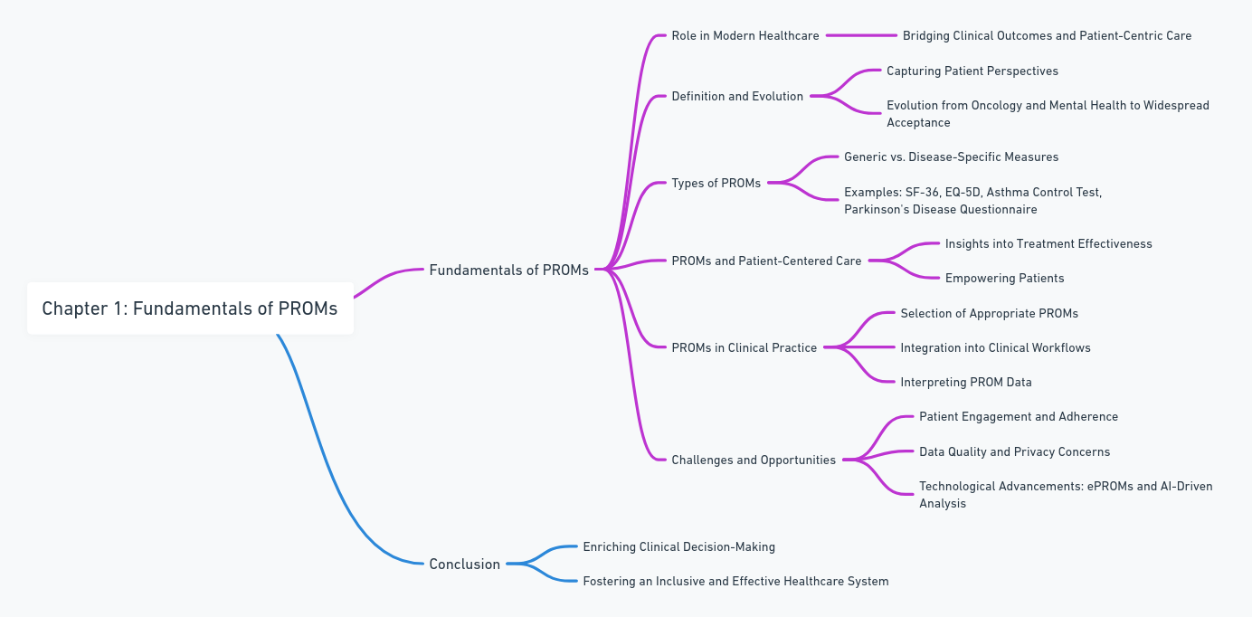
Fundamentals of PROMs

Slide 4
Gathering and Analyzing PROM Data

Slide 5
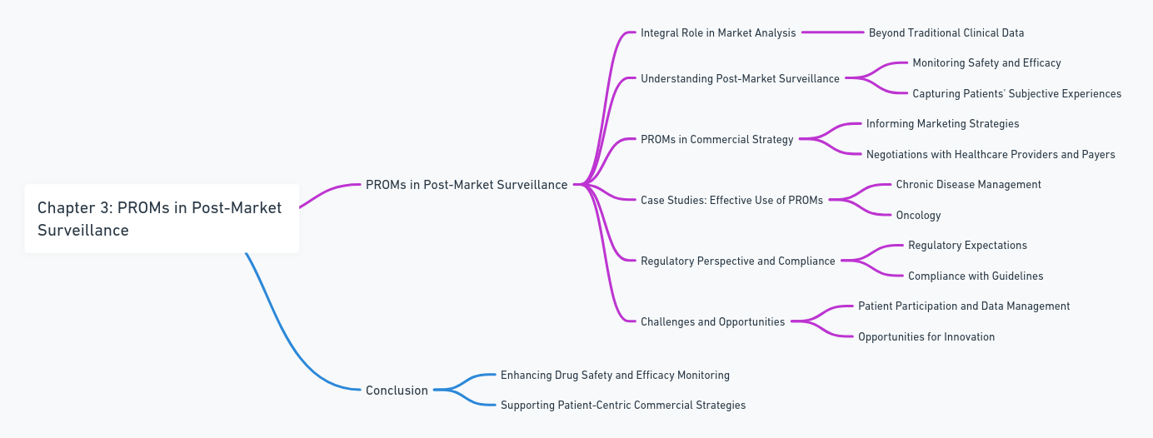
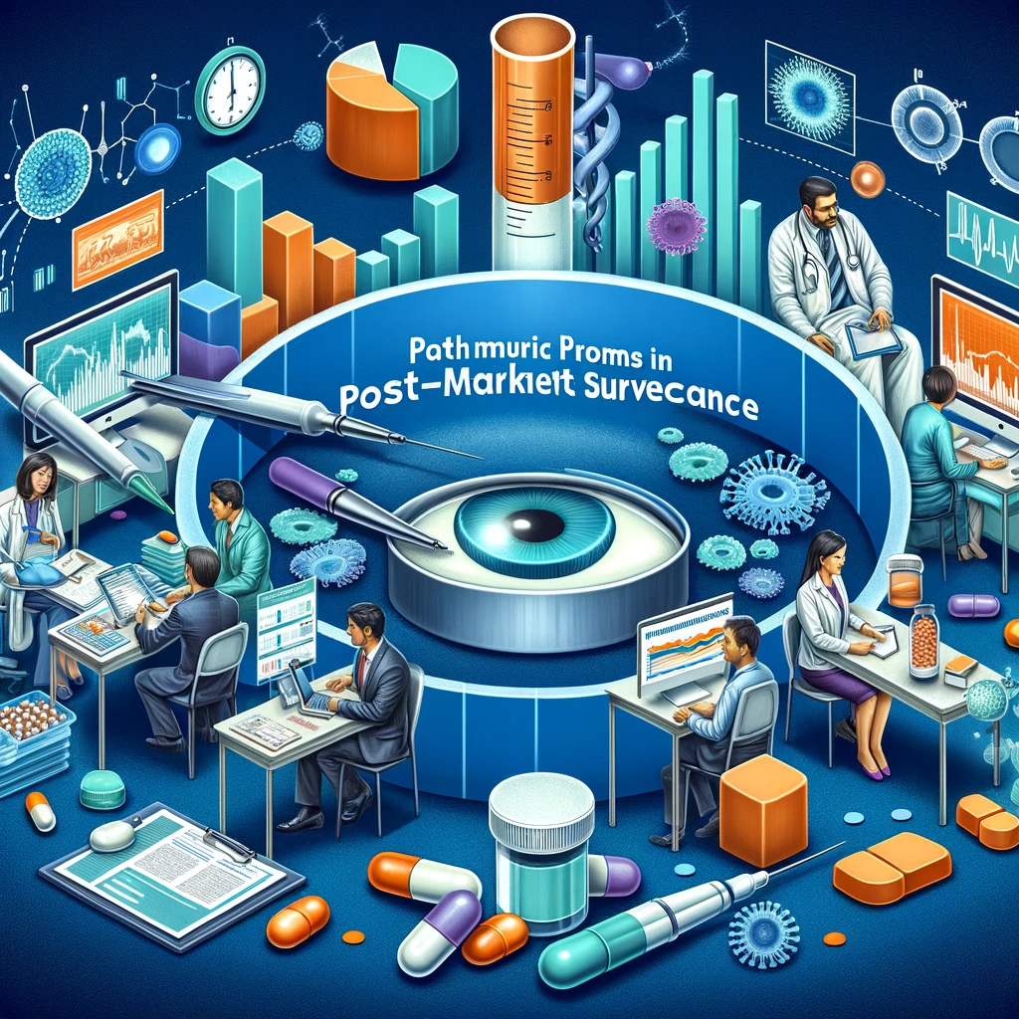
Clinical PROMs in Post-Market Surveillance

Slide 6
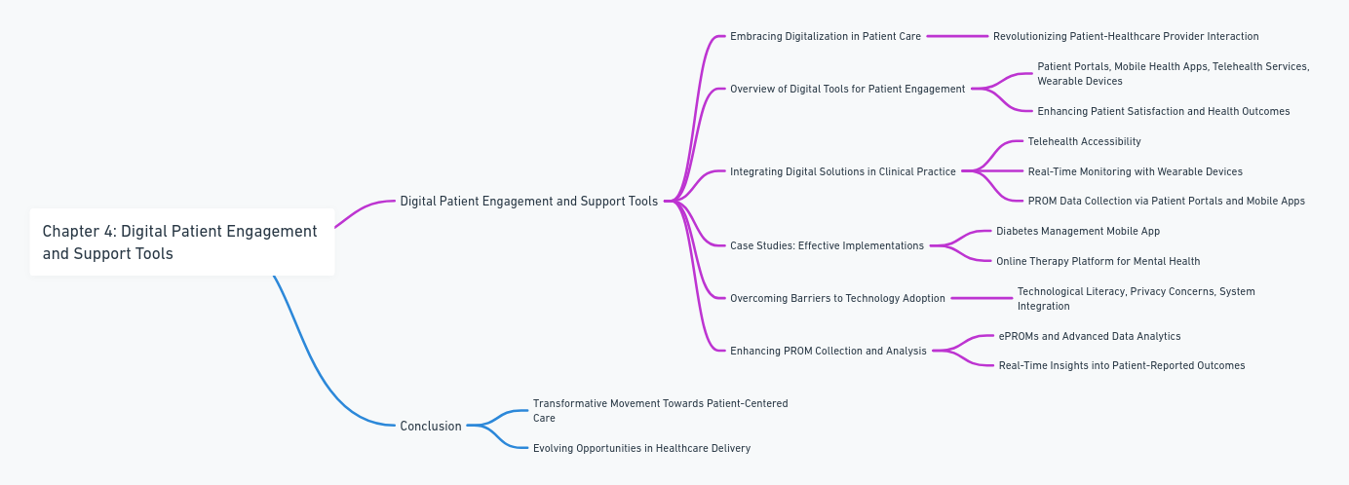
Digital Patient Engagement and Support Tools

Slide 7
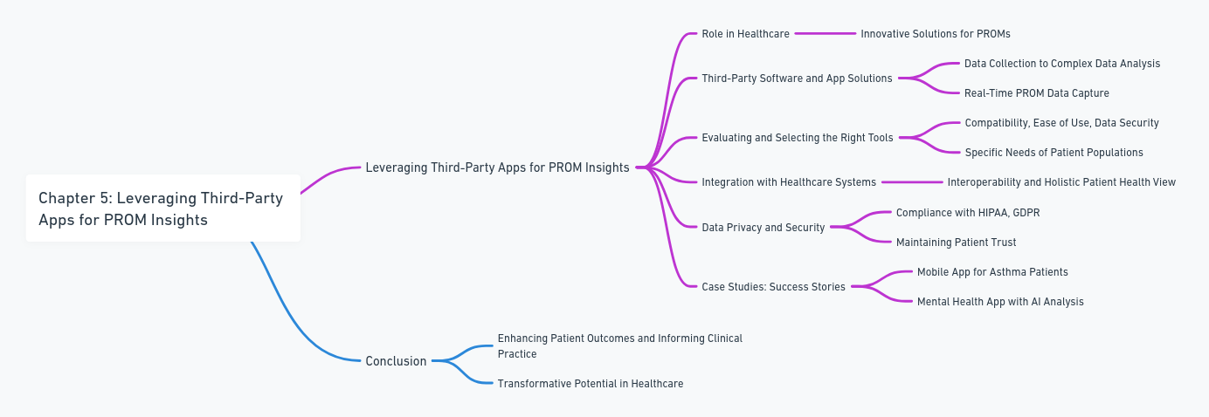
Leveraging Third-Party Apps for PROM Insights

Slide 8
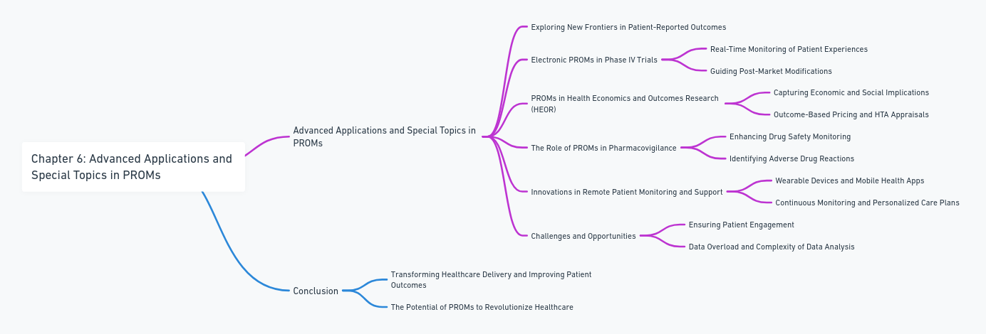
Advanced Applications and Special Topics in PROMs

Slide 9
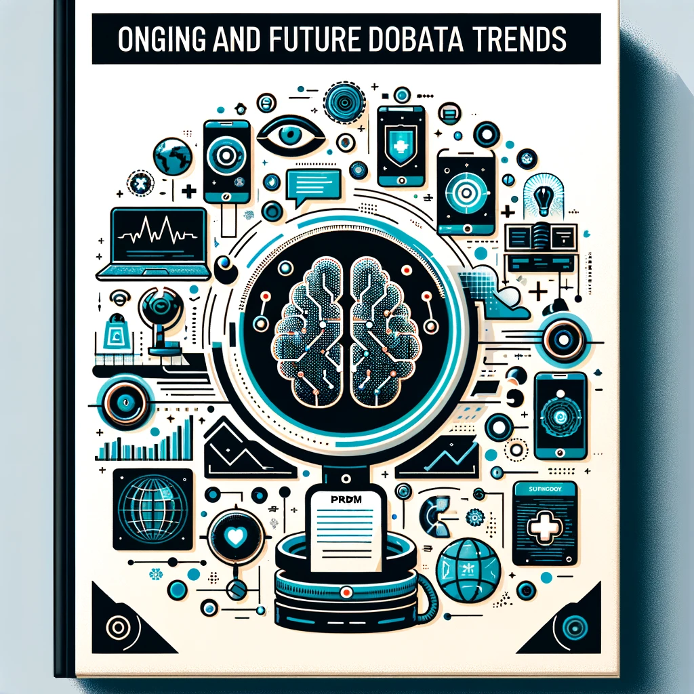
Ongoing and Future Trends in Patient Reported Data Services

Slide 10
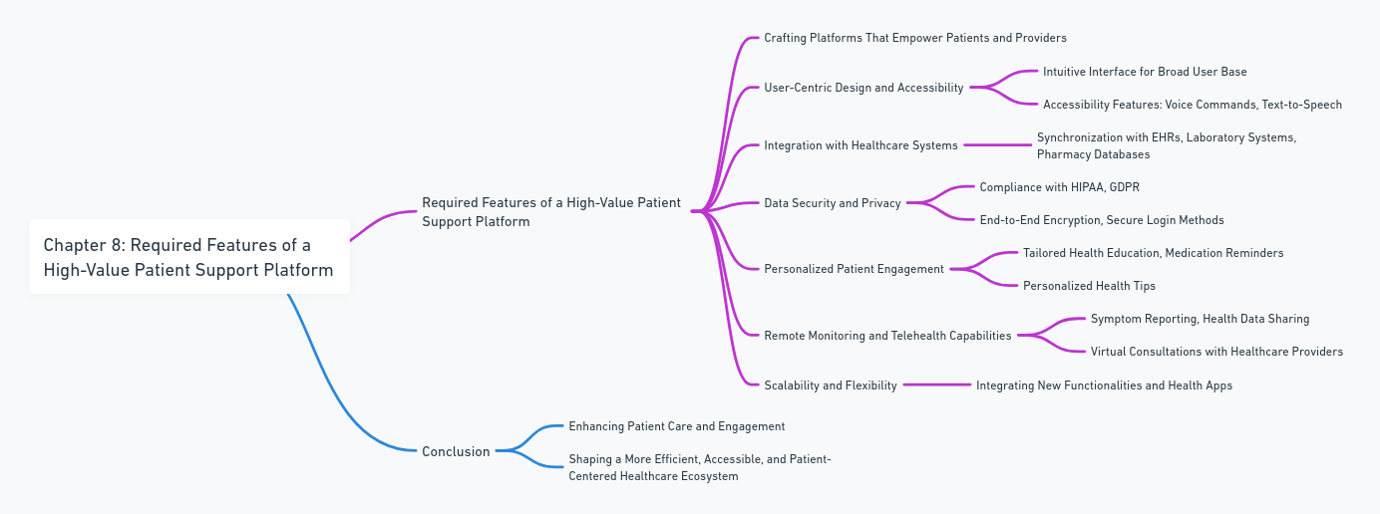
Required Features of a High-Value Patient Support Platform

Slide 11
Strategies for Implementing High-Value Patient Support Platforms

Slide 12
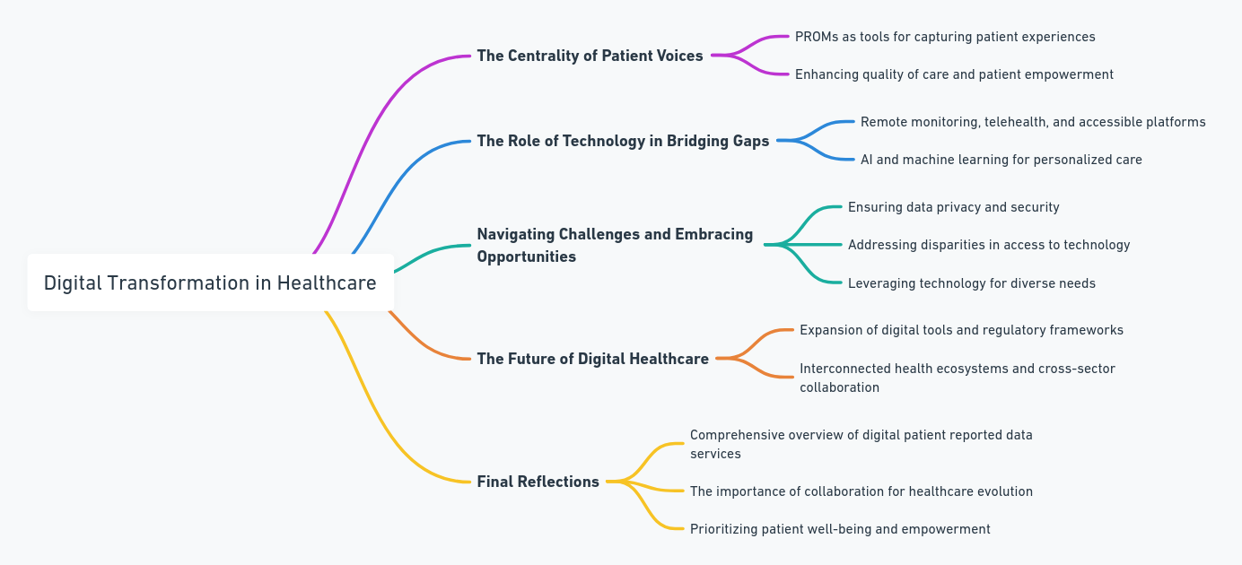
Conclusion: Empowering Healthcare through Digital Innovation

