Slide 1
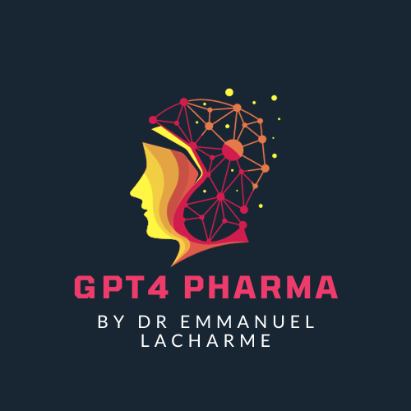
Revolutionizing Life Sciences: The Pivotal Role of ChatGPT in Healthcare Innovation
Powered by GPT4 Technology

Slide 2
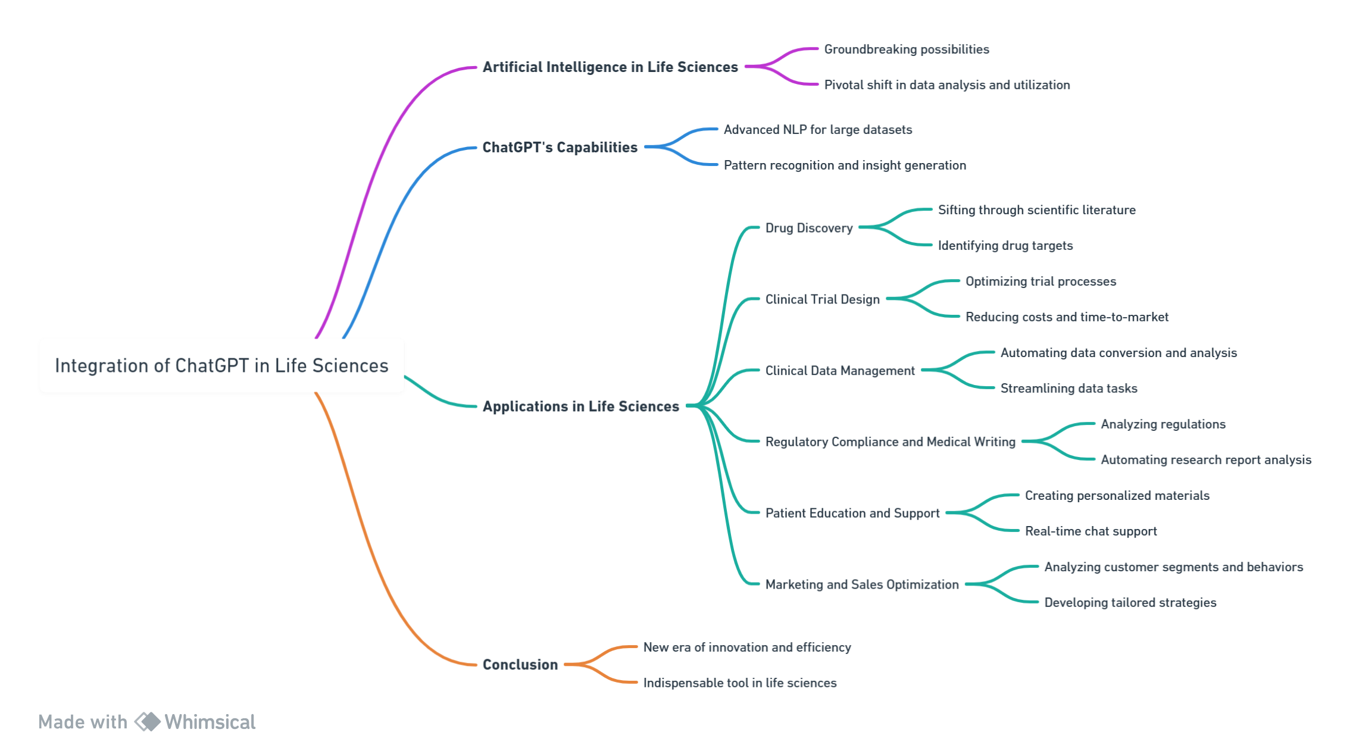

Introduction to ChatGPT in Life Sciences

Slide 3
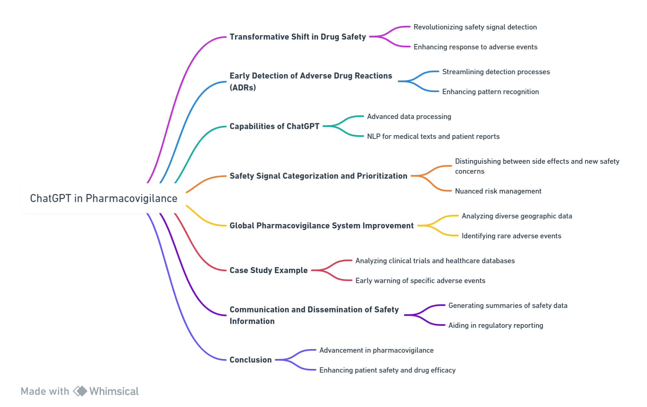

Safety Signals and Drug Safety Monitoring with ChatGPT

Slide 4
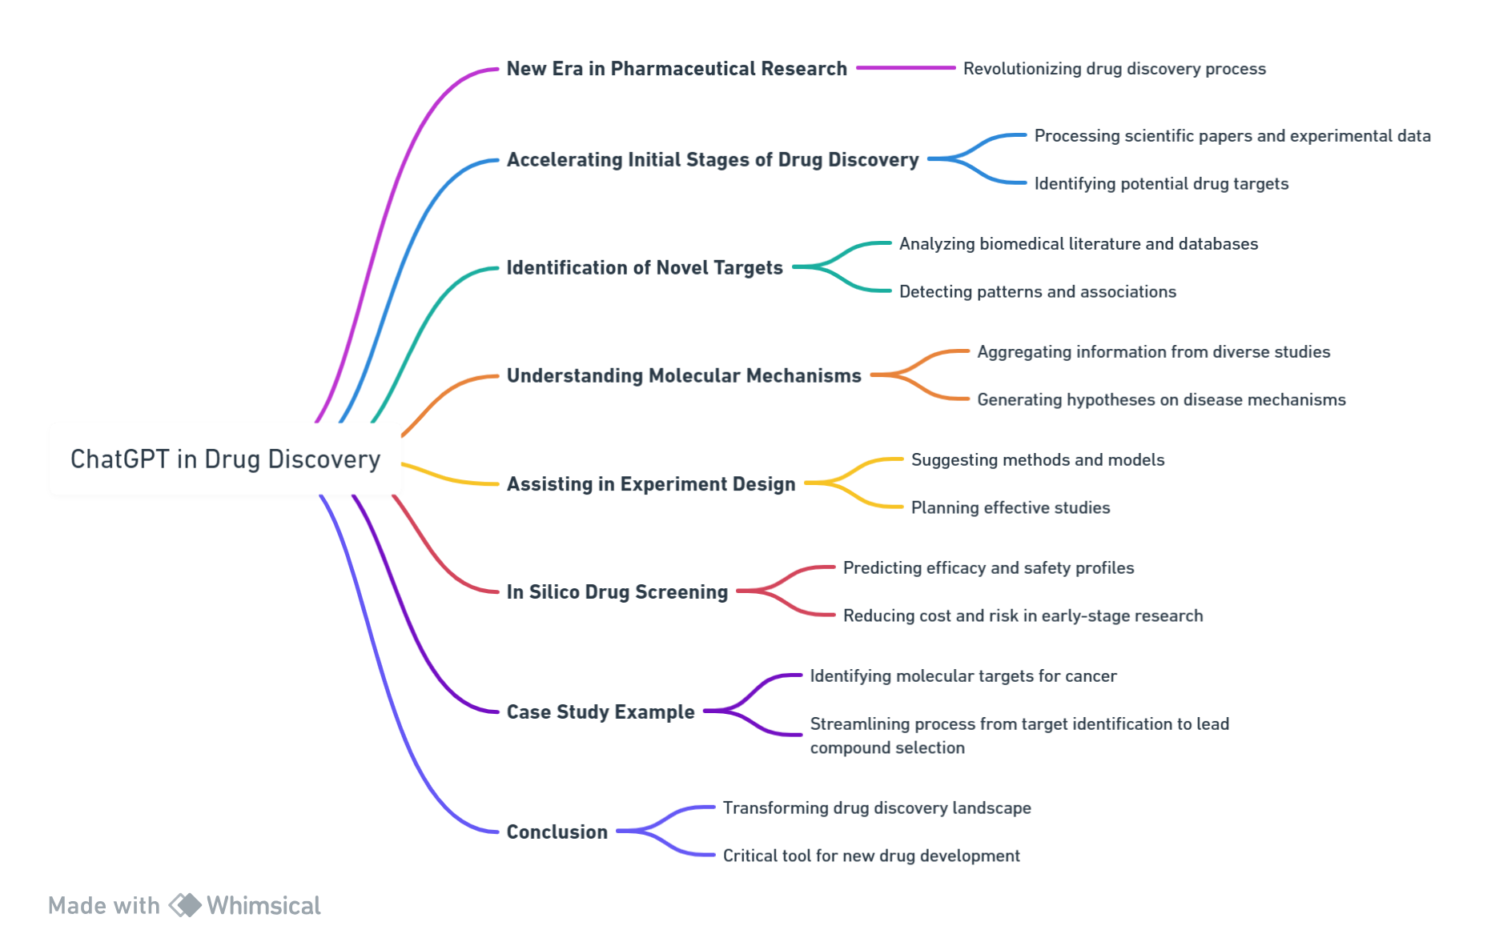
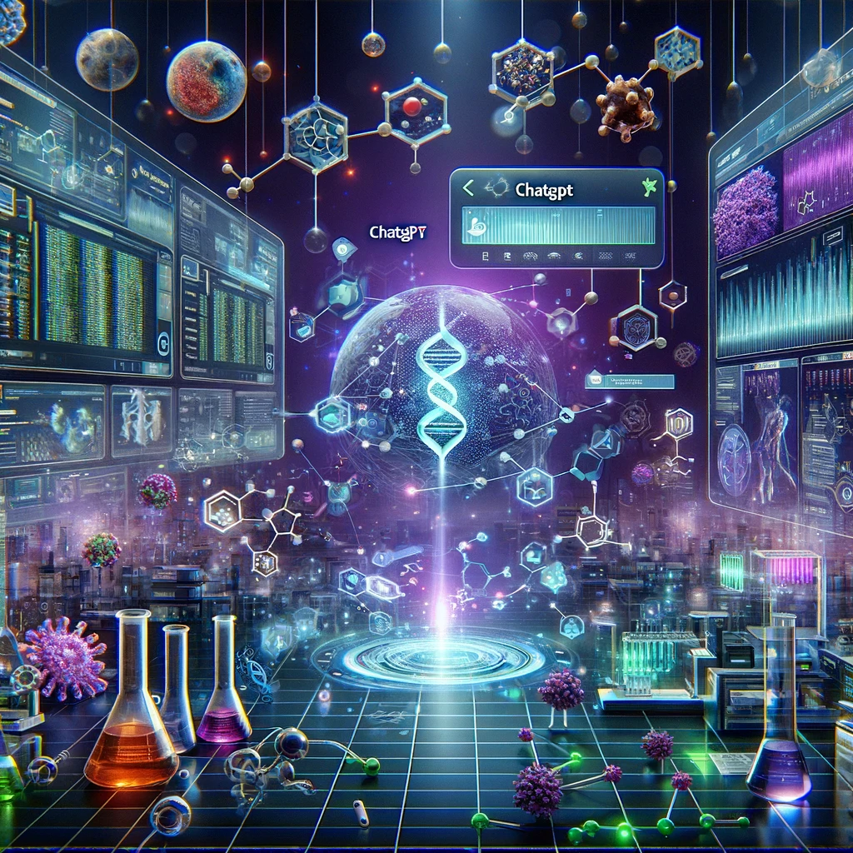
Advancing Drug Discovery with ChatGPT

Slide 5
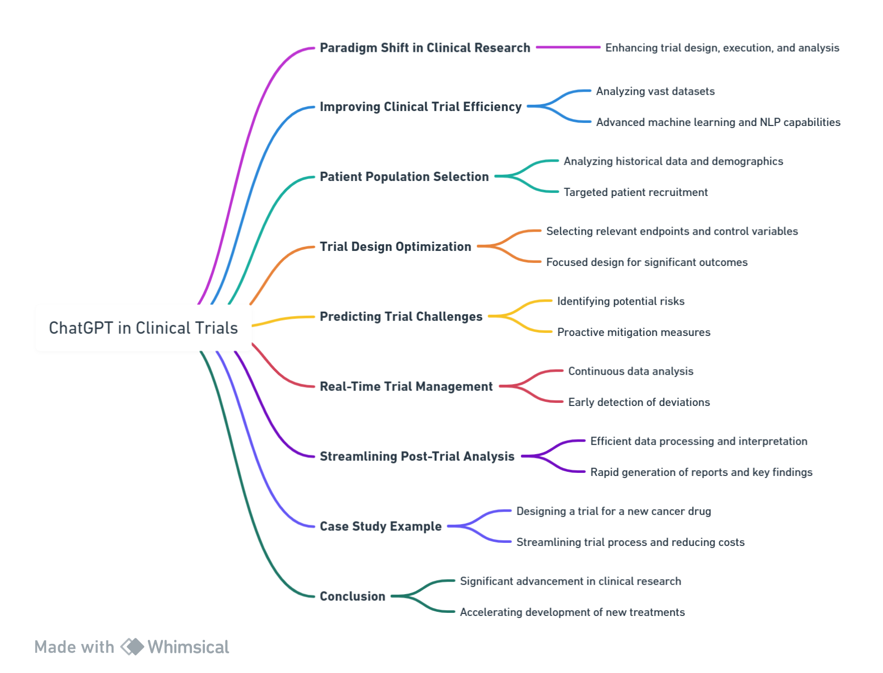
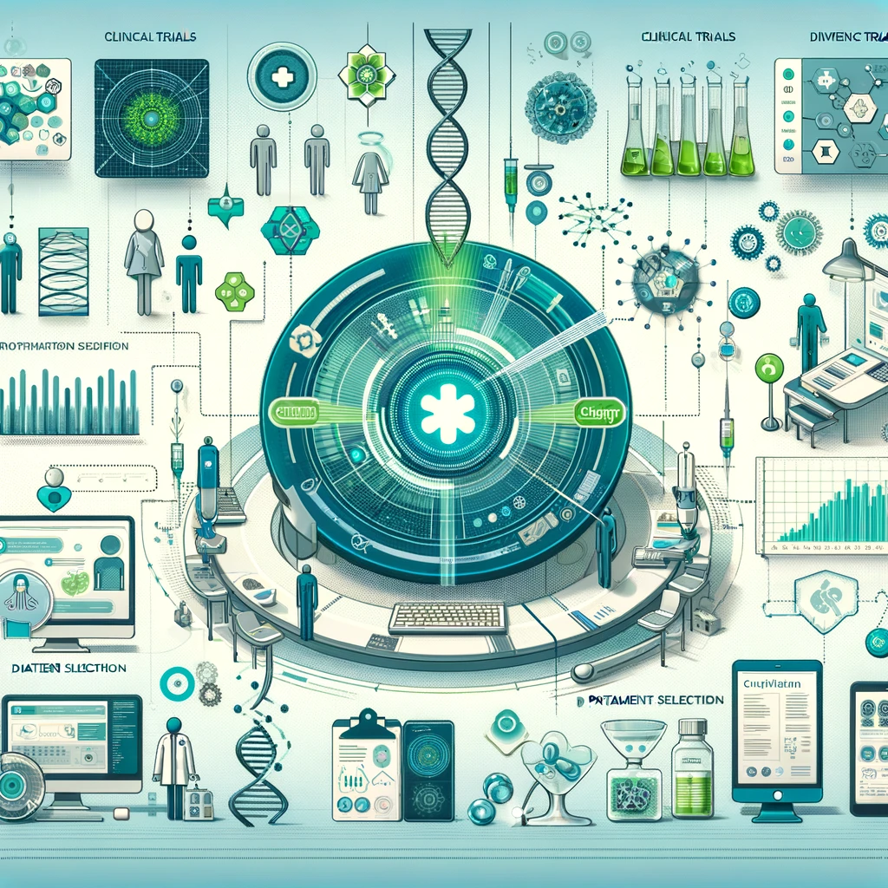
Optimizing Clinical Trials with ChatGPT

Slide 6
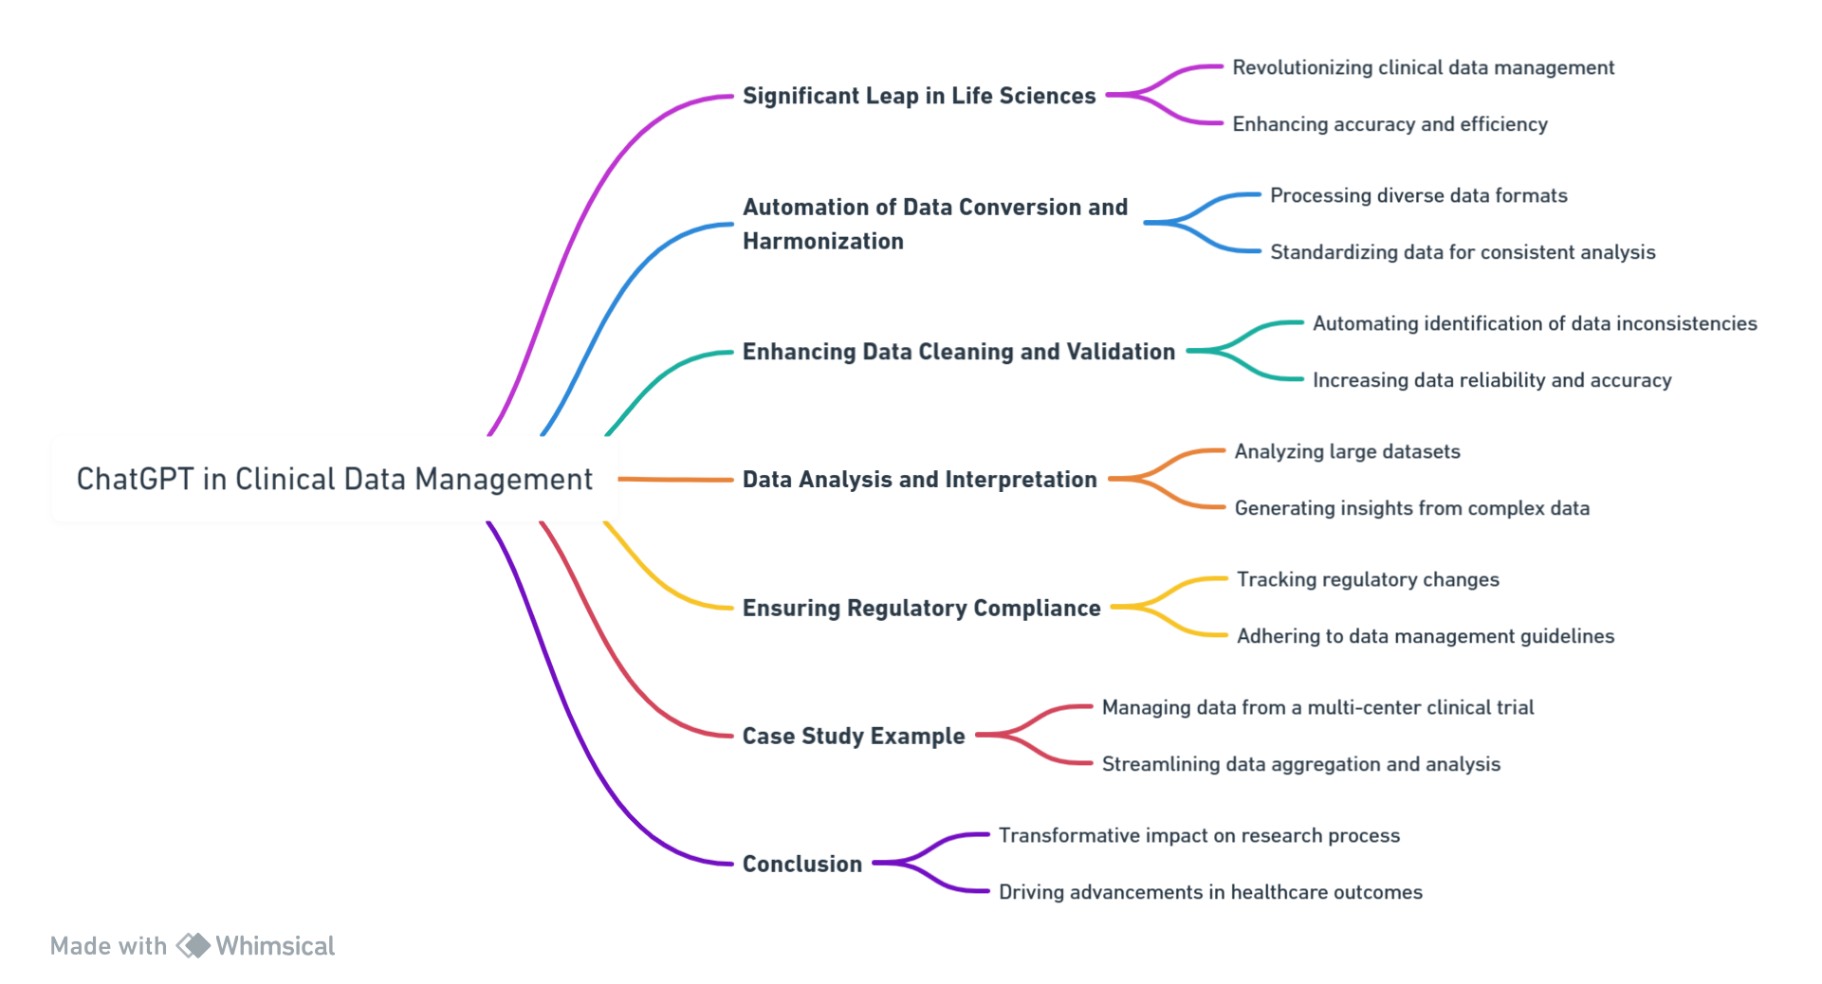

Transforming Clinical Data Management with ChatGPT

Slide 7
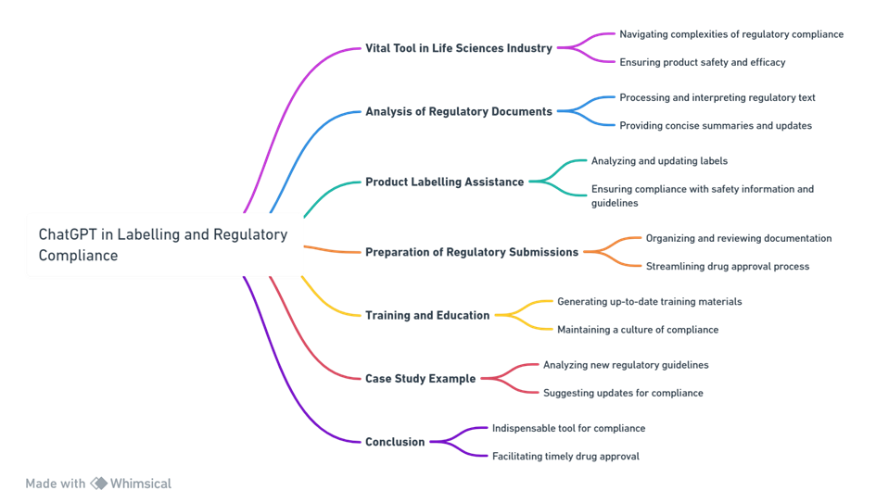

Navigating Labelling & Regulatory Compliance with ChatGPT

Slide 8
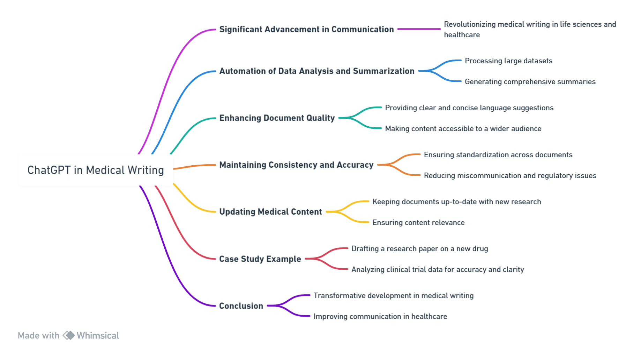

Enhancing Medical Writing with ChatGPT

Slide 9
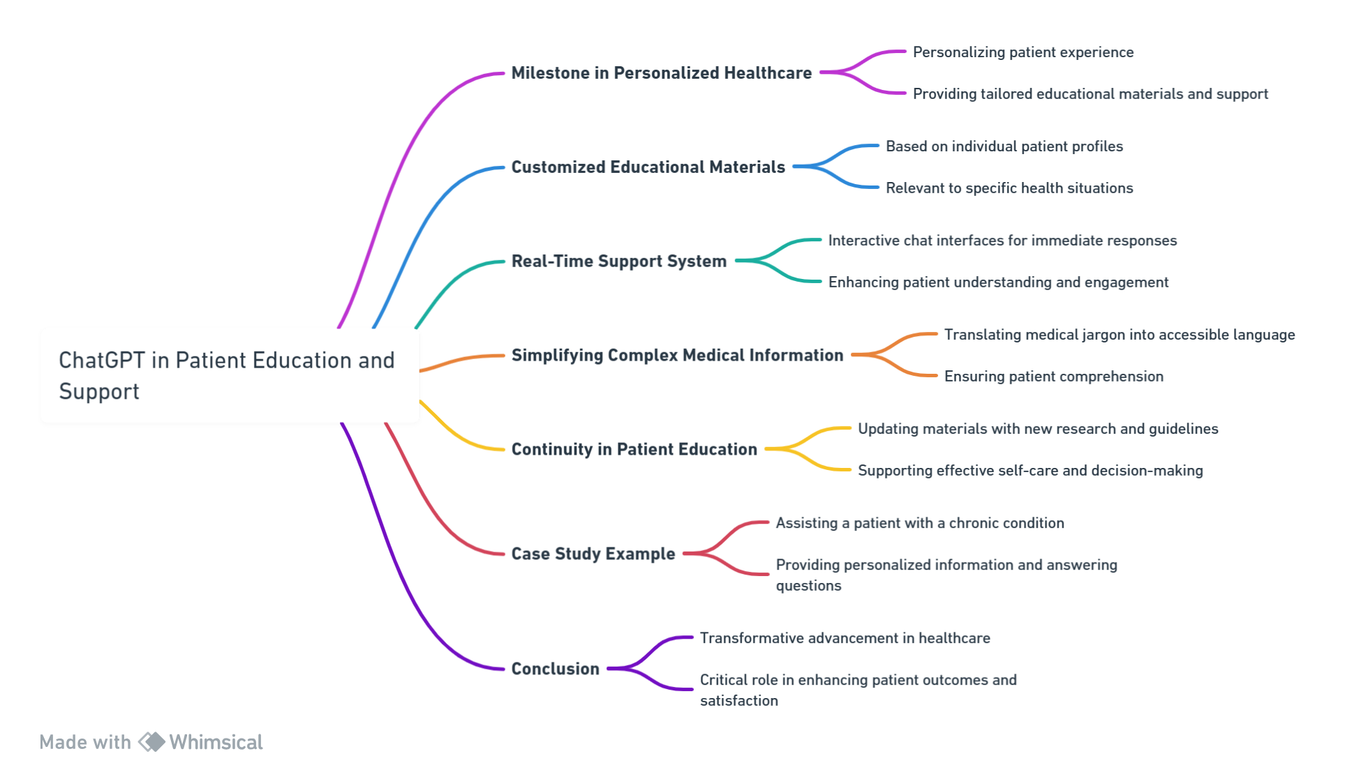

Personalizing Patient Education and Support with ChatGPT

Slide 10
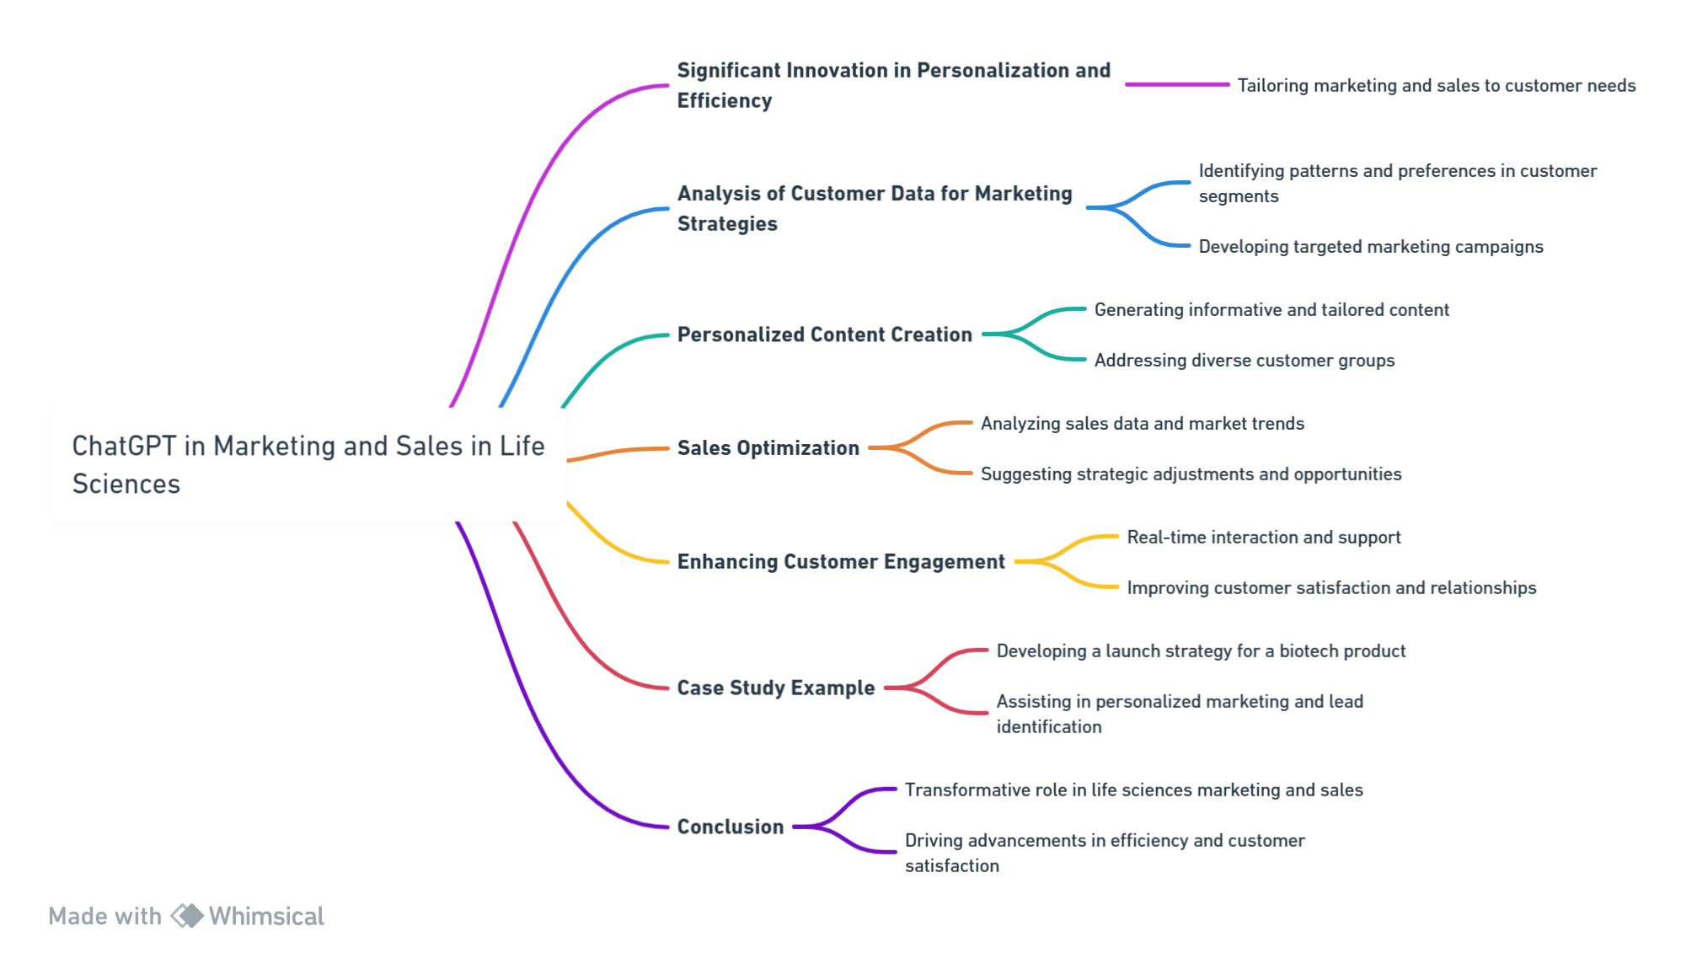

Streamlining Marketing and Sales in Life Sciences with ChatGPT

Slide 11
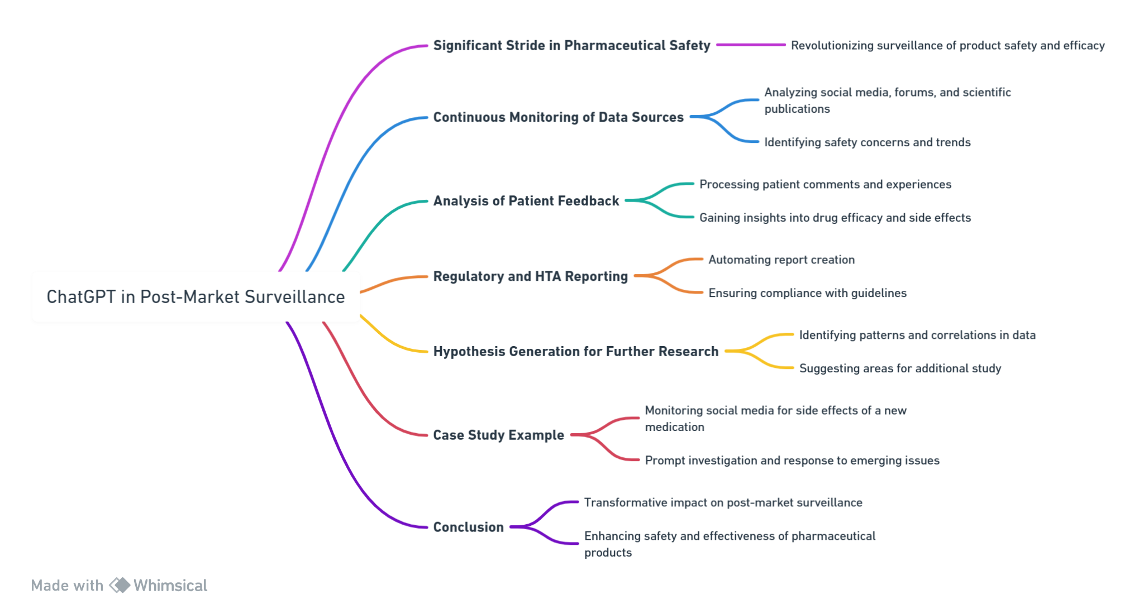

Leveraging ChatGPT for Post-Market Surveillance in Life Sciences

Slide 12
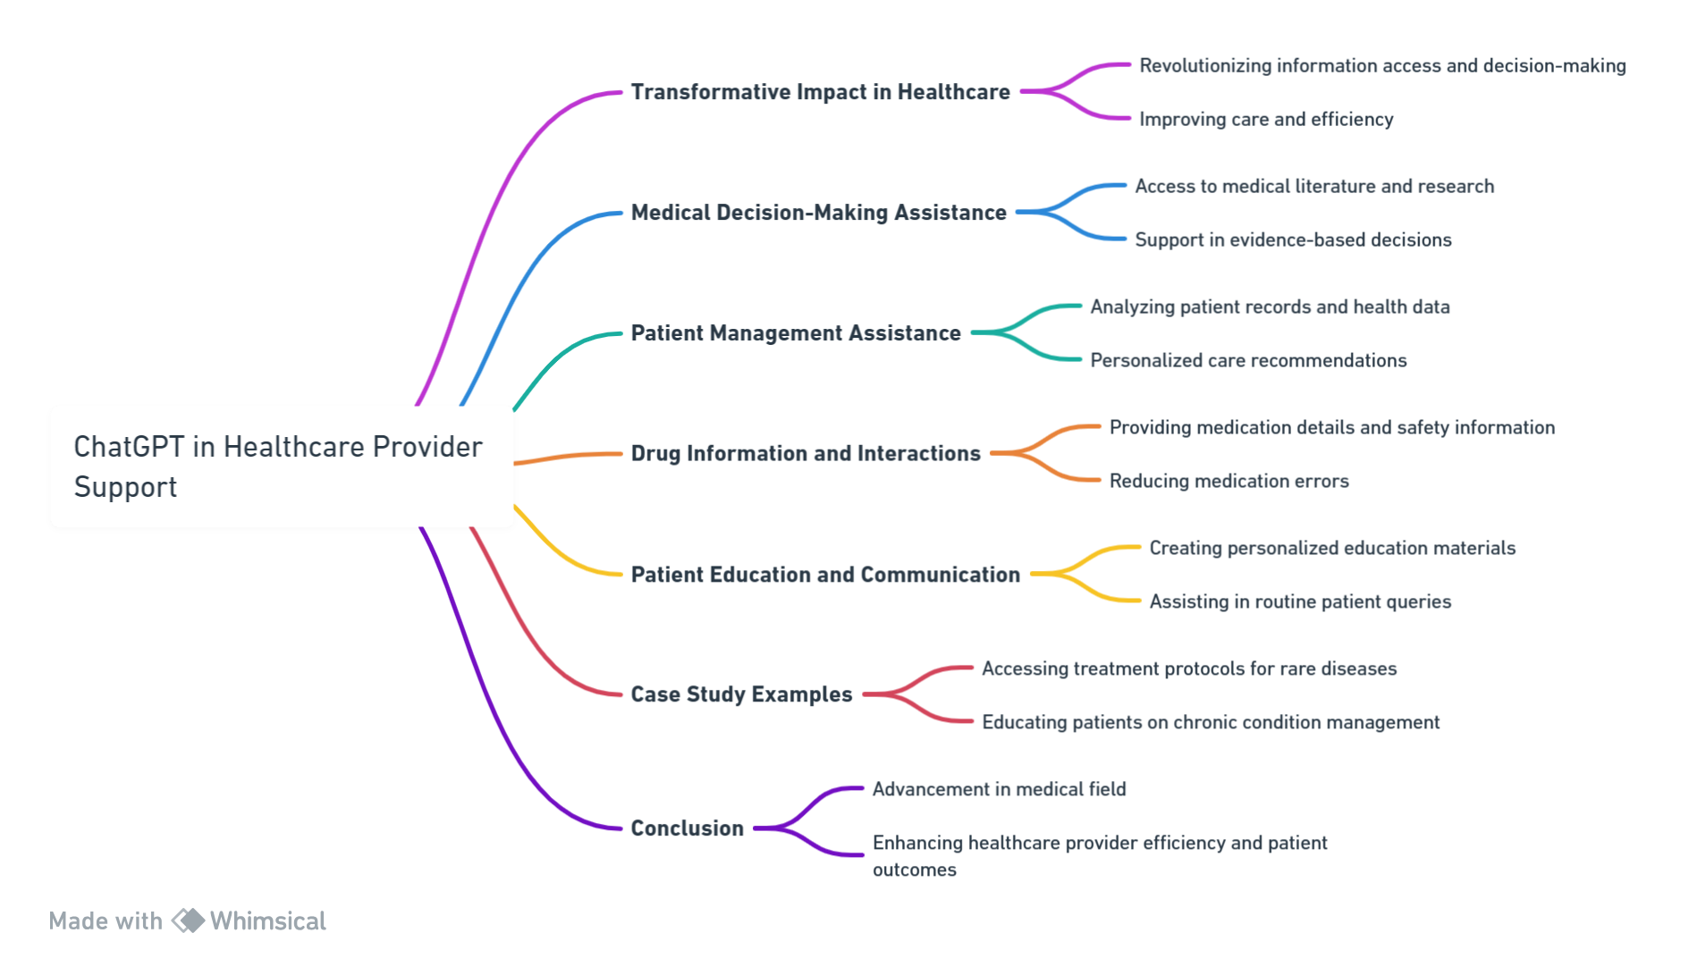

Enhancing Healthcare Provider Support with ChatGPT

Slide 13
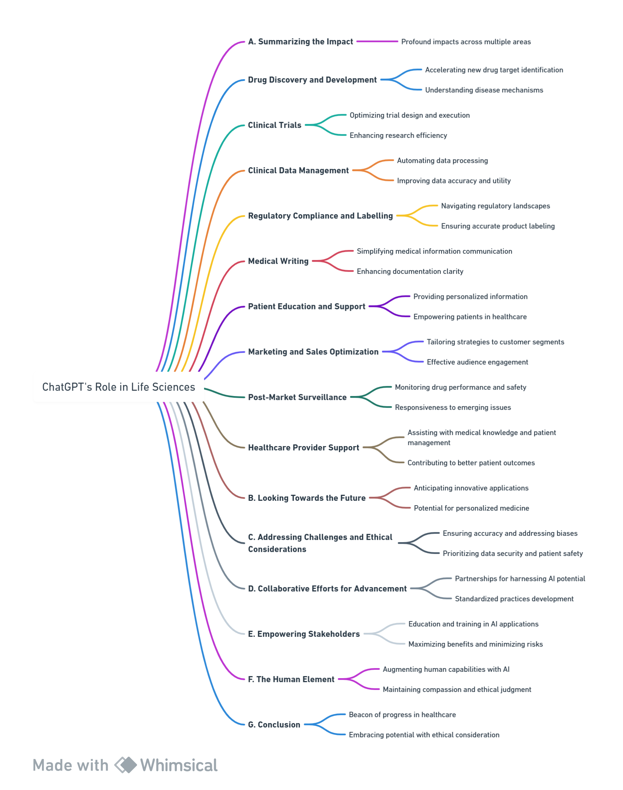
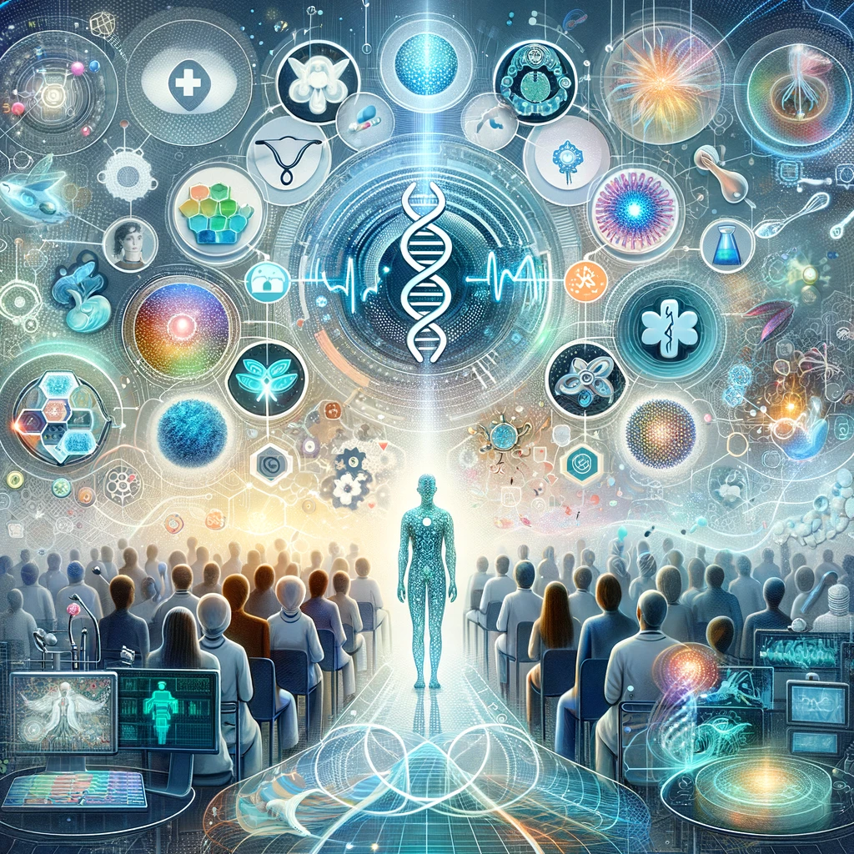
Conclusion: Enhancing Healthcare Provider Support with ChatGPT

